Slide 1
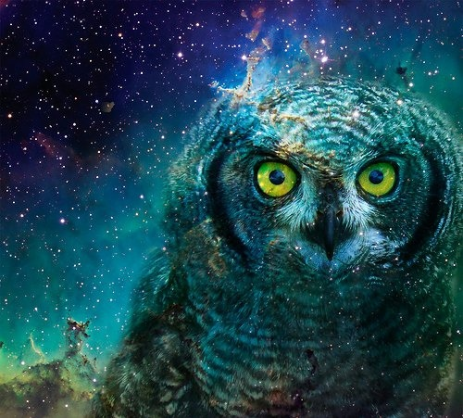
OWLS in SPACE!
Colin Cunningham & David Henry
UK Astronomy Technology Centre
Notes:
Or ‘Can we build an Overwhelmingly Large Telescope’ on Space?
The recent TECHBREAK technology foresight activity that was organised by the European
Science Foundation for ESA came up with some ideas for building 30m plus diameter single
primary mirror telescopes. While these are a long way from being technically feasible, they
could be applicable for the science goals of FISICA, and would certainly be a little easier at far
infrared wavelengths. I will describe a concept for a 100m Gregorian telescope, manufactured
in space and with a free-flying secondary mirror/corrector module, potentially offering very
high angular resolution and sensitivity over a narrow field of view

Slide 2
TECHBREAK: a technology foresight activity for the European Space Agency points the way to future space telescopes
Colin CUNNINGHAM & David Henry (UK ATC,STFC, UK)
Martin CULLUM (ESO, DE)
Paul KAMOUN (Thalès Alenia Space, FR)
Jean-Jacques TORTORA (EUROSPACE, FR)
Jean-Pierre SWINGS (CSL & ESSC Chairman, BE)
ESF Office: Jean-Claude Worms
Emmanouil Detsis
Notes:
HOW LONG? 20 mins including questions, so 30 slides?

Slide 3
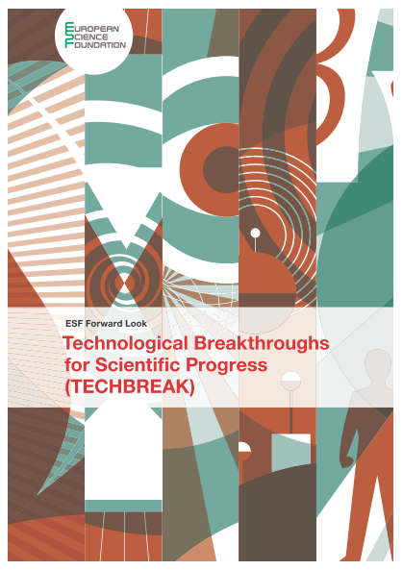
Study Carried out by the European Science Foundation for ESA
http://www.esf.org/fileadmin/Public_documents/Publications/techbreak.pdf
Notes:
Take stock of breakthrough scientific objectives;
Identify partnership schemes through synergies with non-space specialists;
Forecast the development of technologies for the achievement of scientific breakthroughs. These technologies should enable novel space missions in the 2030-2050 timeframe;
Prepare a Final Forward Look Report to be submitted to ESA to advise its High-level Science Advisory Committee

Slide 4
Key Enabling Technologies in TECHBREAK
Nanotechnology:
Advanced materials (including design and production techniques
Photonics & Metamaterials:
Micro and nano electronics: Very large market worldwide for product, Moore law reaching each limits. The race is on for the replacement technology.
Biotechnology and medicine: Easy, fast and accessible sensing is the key issue but also holistic approaches to human physiology are being introduced.
An effort was made to avoid areas that ESA is active. ‘What ESA knows’ is nevertheless not trivial…..

Slide 5





Space Overwhelming Drivers (ODs)
TECHBREAK defined five ‘Overwhelming Drivers’ for space.
Main areas where technological improvements are needed in order to be able to generate breakthroughs in space capabilities.
a brief introduction to the space environment and space operations for non-space experts
A communication tool that the TECHBREAK team utilised for bridging the knowledge gap between space and non-space experts.
‘food for thought’ stimulus that might result in a spin-in idea
1
3
5
2
4
 | Overwhelming Drivers
1 | Reduce mass, maintain stiffness
2 | Build a spacecraft and space missions that can last 50 years
3 | Deploy a 30m+ telescope into space (assembling, deploying, self-supporting, positioning, maintaining)
4 | Autonomous geophysical survey of planets
5 | Enable humans to stay in space for more than two years (Mars mission)

Slide 6
OD3: Deploy a 30+ meter telescope into space
Problem | Potential Solution
Assembly of large mirrors in space | Flexible or foldable mirror and support structure, to circumvent volume restrictions on launch
 | Formation flying of parts (no support structure), to relieve constraints on the primary mirror F/ratio . Technologies such as micro-thrusters and laser metrology for fine position control and precise formation flying. Formation flying might be achieved by utilising other forces to maintain position, such as ferromagnetic forces
 | Robotic systems for the assembly of structures in space
 | Novel packaging and deployment techniques based on biological organisms
Maintenance of large mirrors in space | Robotic systems for the maintenance of structures in space
 | Technologies for maintaining the optical surface quality of large mirrors in space
 | Advanced coating materials to prevent degradation.

Slide 7
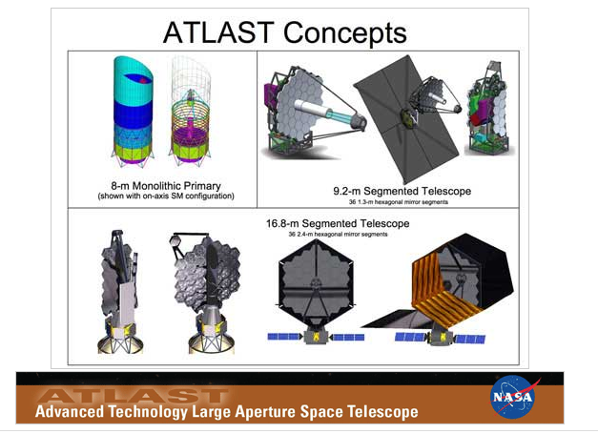
‘Conventional’ route to bigger space telescopes

Slide 8
Innovative ideas for Giant Space Telescopes

Slide 9
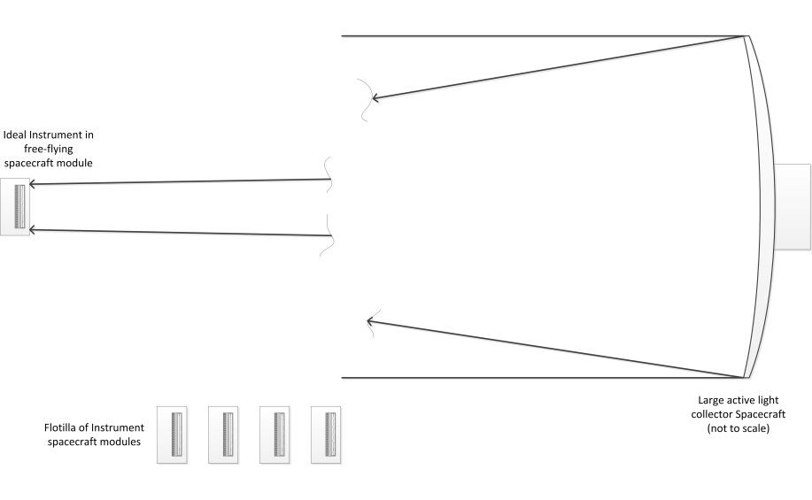
Free flying modules

Slide 10
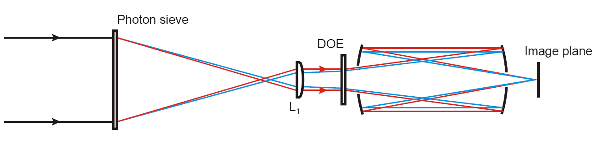
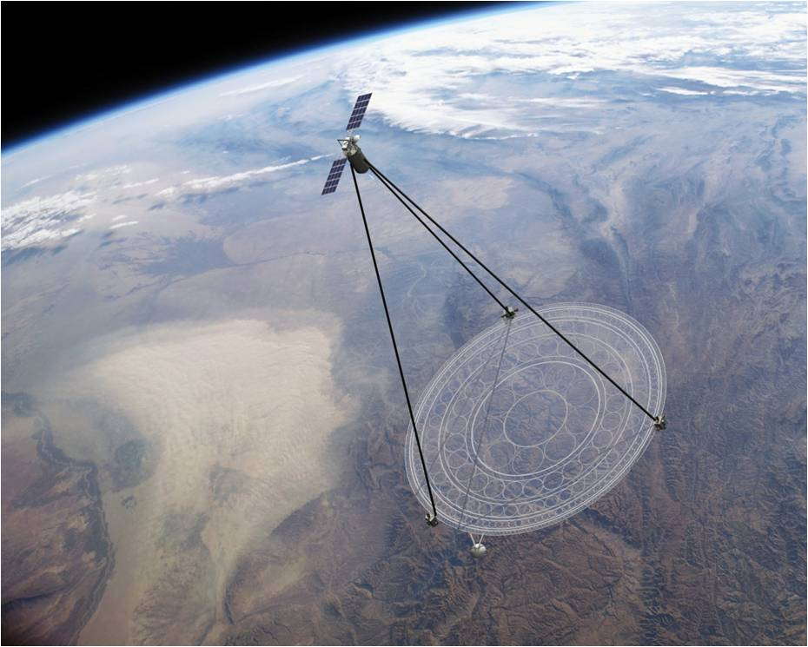
Photon Sieve Membrane Telescope
Geoff Anderson, USAF
MOIRE: from Ball Aerospace and Lawrence LIvermore

Slide 11
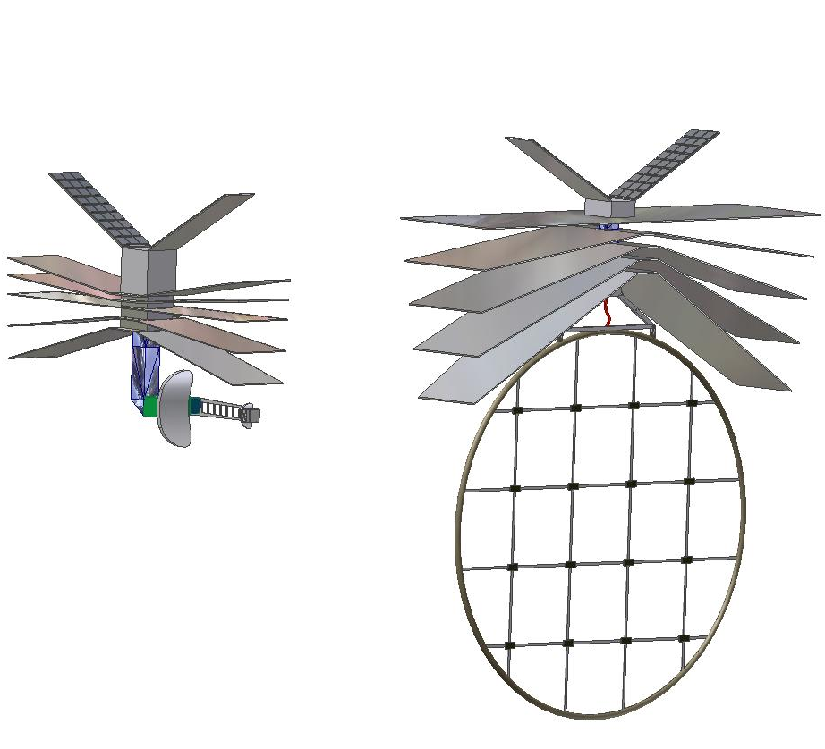
ServiceModule
Solar
arrays
Sunward
“GISMO”
is two Spacecraft
Proposed by Tim Hawarden for Far IR & submm
Instrument
Spacecraft :
Field Optics FO
(re-imager of L1),
Fresnel Corrector FC
Instruments
3000m
Lens S/C
30-m Primary Lens

Slide 12
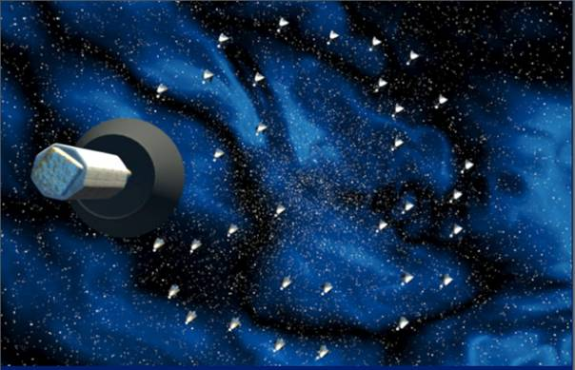
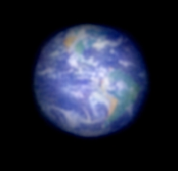
Antoine Labeyrie’s Hyper Telescope

Slide 13
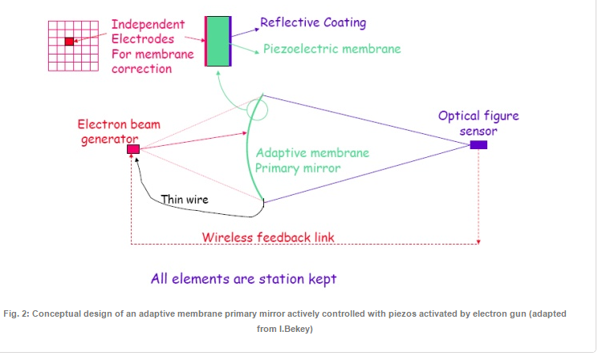
Membrane Telescopes
Université libre de Bruxelles
Department of Mechanical Engineering and Robotics
Active Structures Laboratory
avenue F.D.Roosevelt, 50
B-1050 Brussels
Belgium
Notes:
McInnes idea for SRP modulated membrane on spinning inflatanble rim – but 7 Km FL, and needs solar radiation!

Slide 14
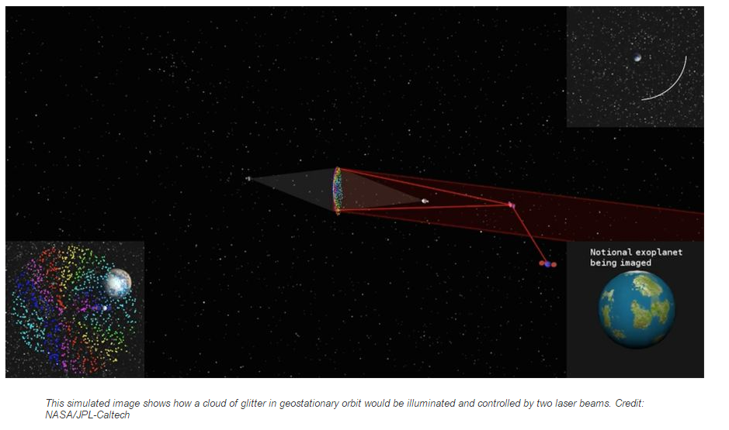
Orbiting Rainbows aims to bring exoplanets into focus
NASA project could form optical structures from orbiting swarms to image distant objects.

Slide 15
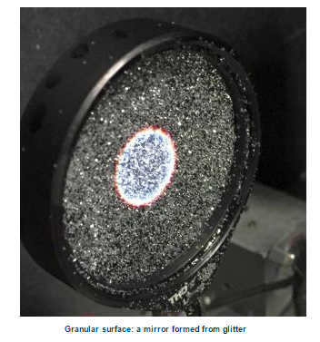
Glitter Mirror – very seasonal!

Slide 16
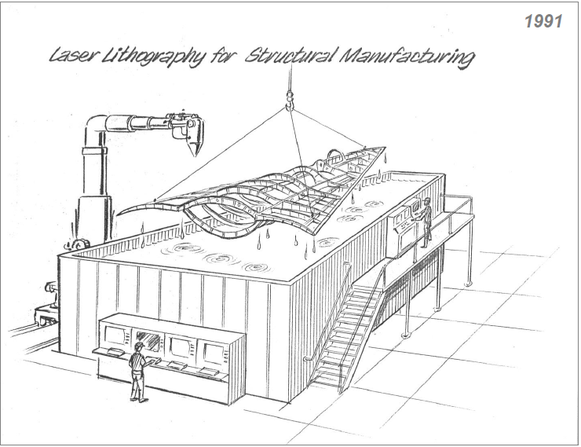
Additive Manufacturing:
Lockheed Martin Cartoon - 1991

Slide 17
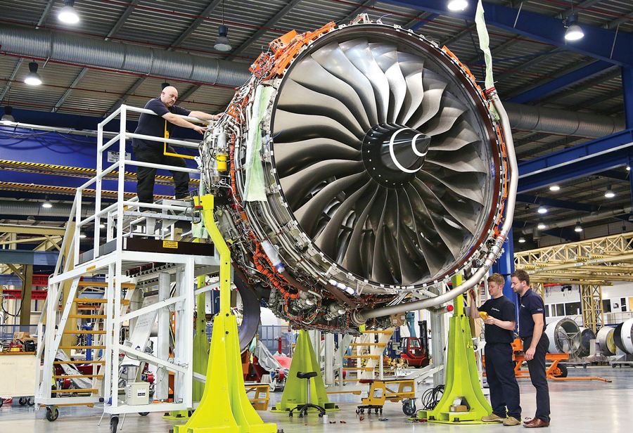
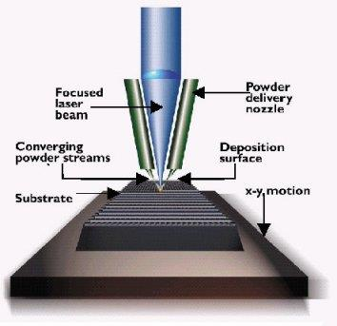
Advanced Materials: Additive Manufacturing
Sintered Metal laser and electron beam layered construction: Rolls Royce and Sheffield University
Notes:
Add images, eg Dutch bridge

Slide 18
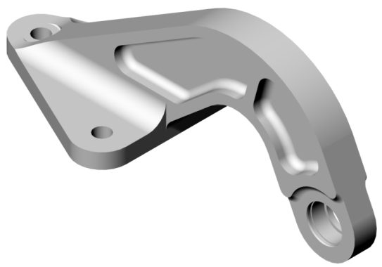
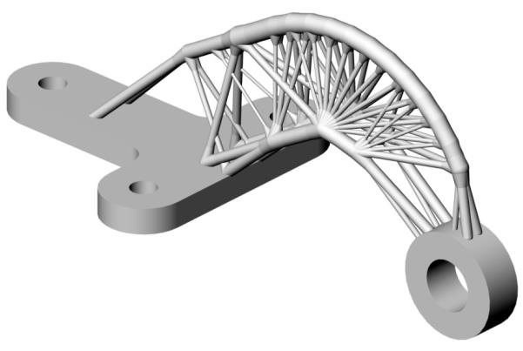
Prof Iain Todd, University of Sheffield
Minimal mass structures
Designed using Structural Topology Optimisation
Original Design
Topology Optimised Design
69% weight saving achieved using through Structural Topology Optimisation

Slide 19
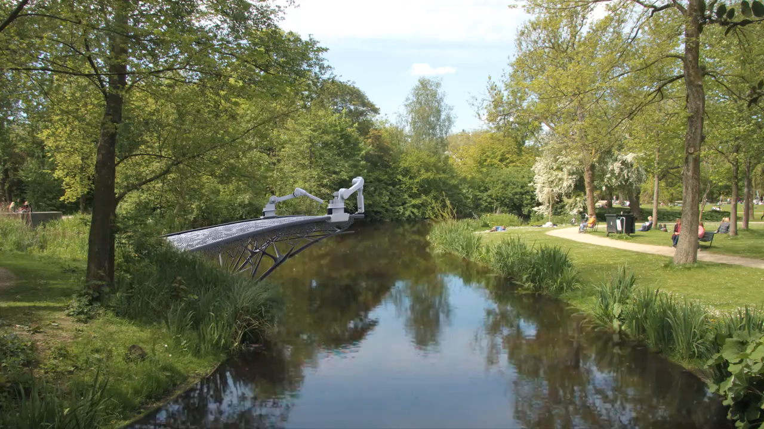
Continuous wire generation: building a bridge in Amsterdam
http://mx3d.com/projects/bridge/

Slide 20
MX3D Video removed – too big!

Slide 21
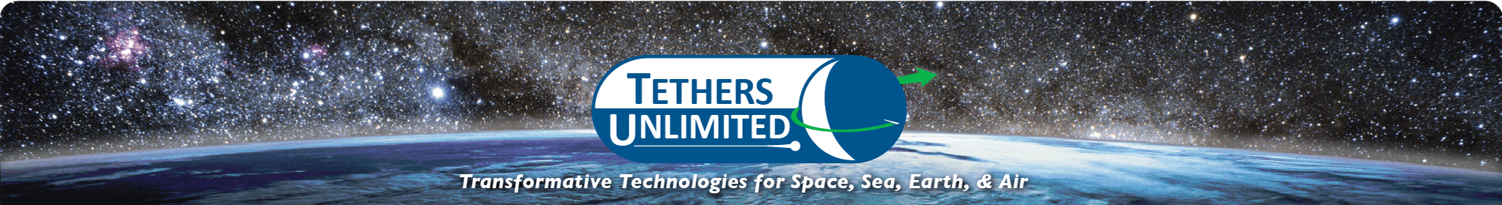
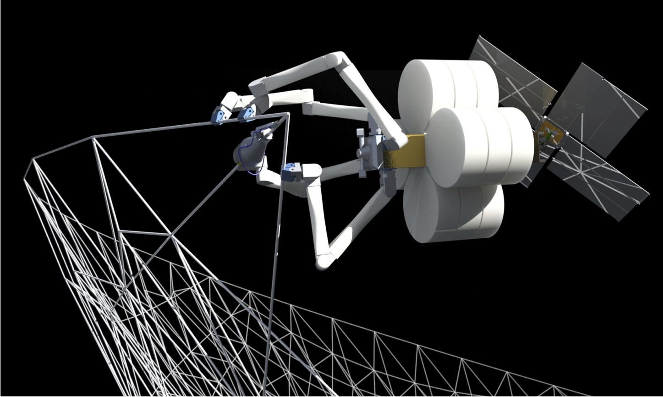

Slide 22
How could we exploit some of these technologies for future space telescopes?

Slide 23
The challenges (NIR)
Sensitivity
  If you want to get spectroscopy of the HDF galaxies you need at least a 30m telescope
  If you want to get spectroscopy of the faintest galaxies discovered by JWST you need at least a 100m
  If you want to get spectroscopy of candidate earth-like planets within 10pc you need at least an 80m
  ➔ Maximize diameter
Roberto Gilmozzi, 2004 SPIE, Glasgow

Slide 24
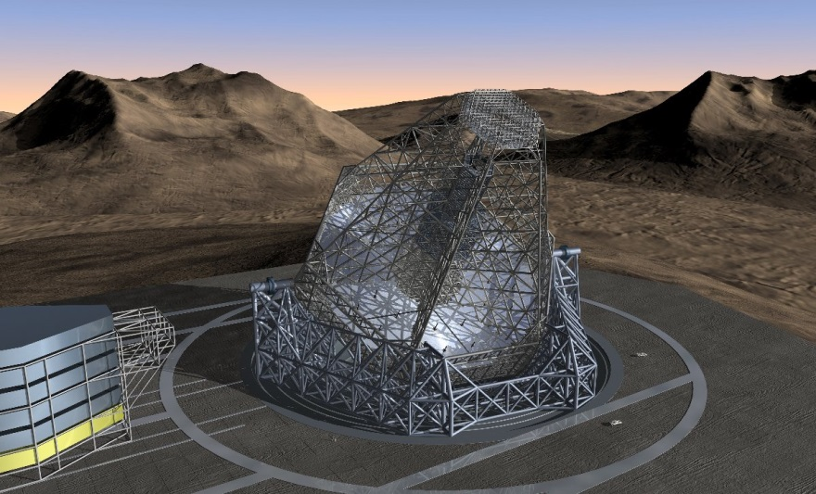
Manufacturing an Overwhelmingly Large Telescope in Space
Notes:
Don’t need support structure or Adaptive Optics

Slide 25
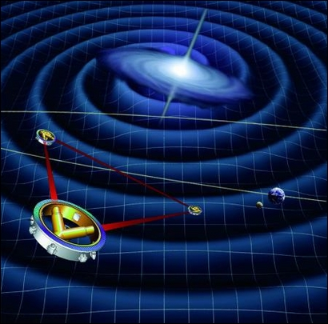
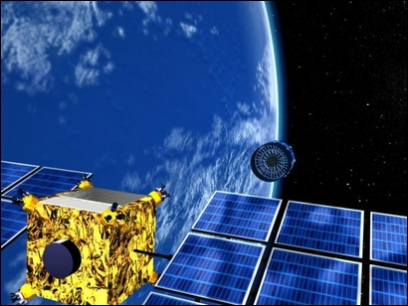
Formation Flying Concepts
XEUS
LISA
Notes:
LISA: Precision is ??

Slide 26
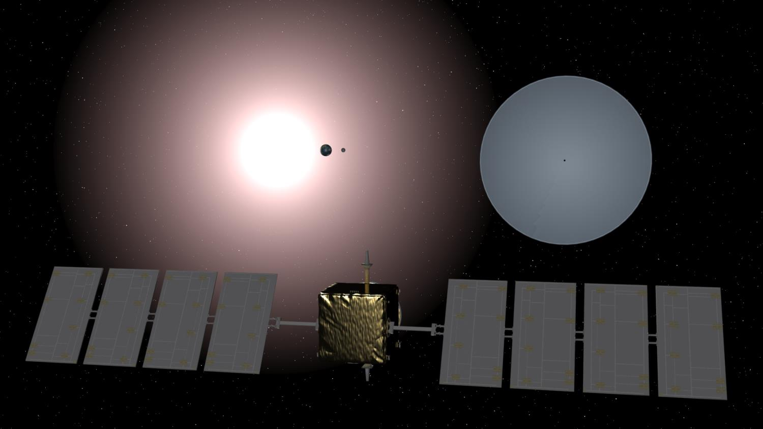
‘SPOWL’

Slide 27
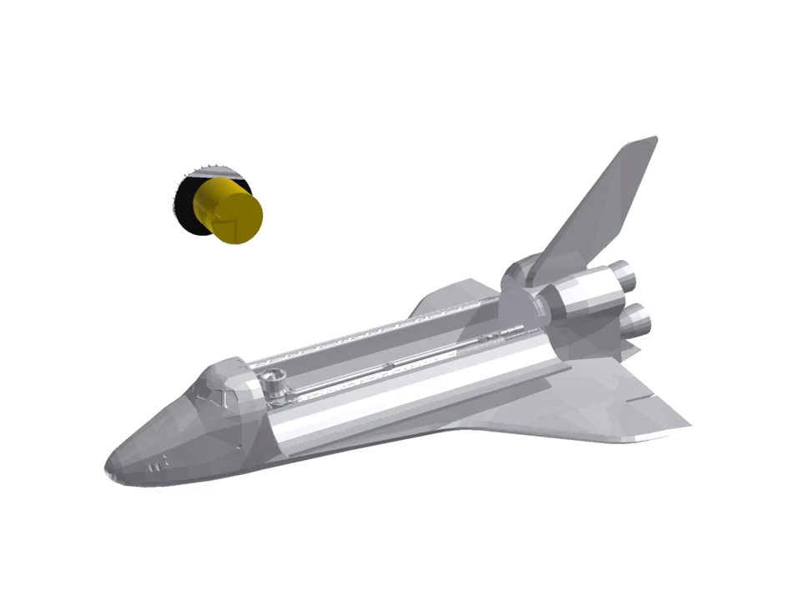

Slide 28
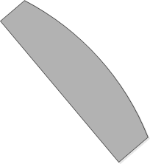
Additive Manufacturing in Space

Slide 29
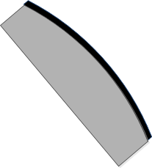
Additive Manufacturing in Space
Andersson J. and Anders A., “Gasless sputtering: Opportunities for ultraclean metallization, coatings in space, and propulsion”, Applied Physics Letters 92, 221503 (2008)

Slide 30
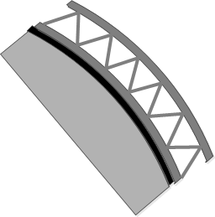
Additive Manufacturing in Space

Slide 31
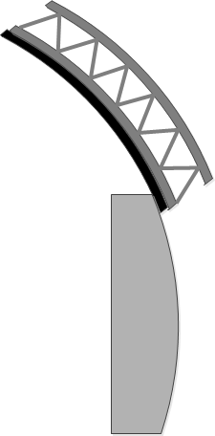
Additive Manufacturing in Space

Slide 32
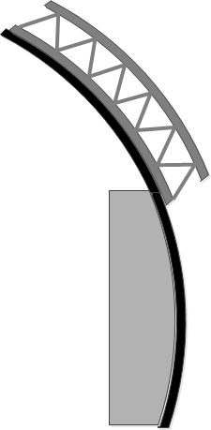
Additive Manufacturing in Space

Slide 33
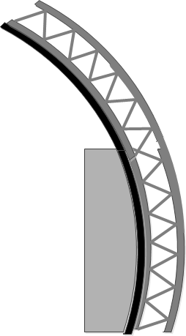
Additive Manufacturing in Space

Slide 34
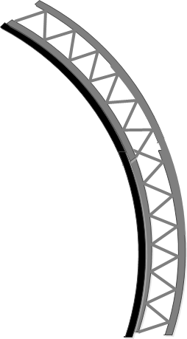
Additive Manufacturing in Space

Slide 35
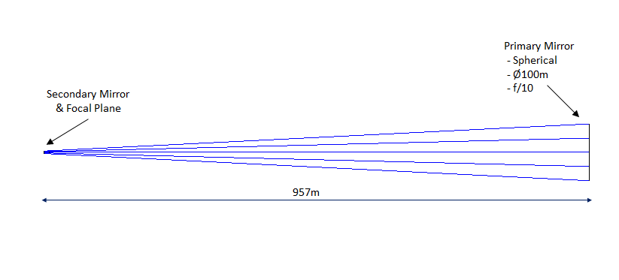
Gregorian Telescope

Slide 36
Primary Mirror
- Spherical
- Ø100m
- f/10
Secondary & Tertiary
Mirrors
& Focal Plane
958m

Slide 37
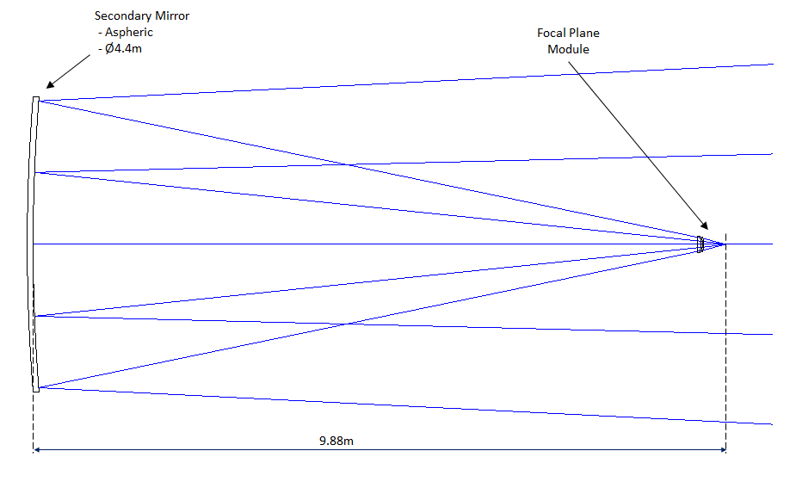
Secondary Mirror and Corrector Module

Slide 38
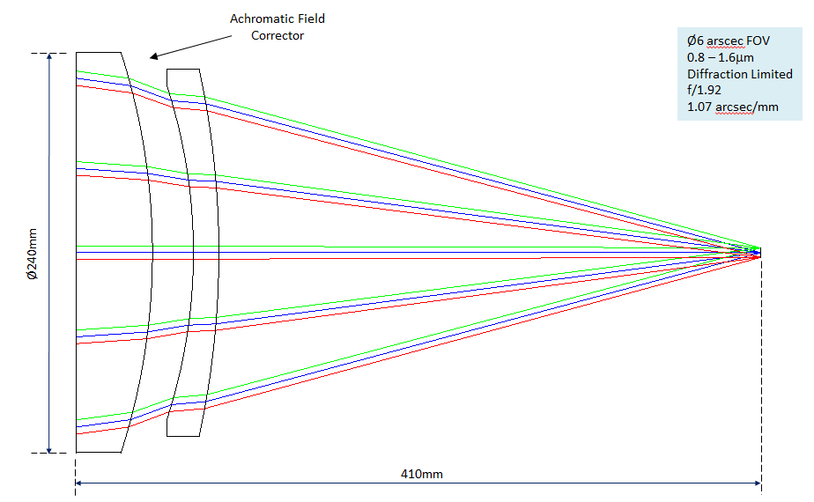
Corrector Optics: Diffraction Limited over 6 arcsec field
Notes:
But pixels are 1 µm

Slide 39
Secondary Mirror
- Aspheric
- Ø4.4m
Ø8 arcsec FOV
Diffraction Limited
f/20
0.103 arcsec/mm
Tertiary Mirror
- Hyperbolic
- Ø0.5m
Focal Plane
10.0m
Notes:
10 µm – and all reflective

Slide 40

Positioning the Secondary Spacecraft
Positional (Z) <0.25mm
Angular <10 microradians (2 arcsec)
Positional (X/Y) <10mm

Slide 41
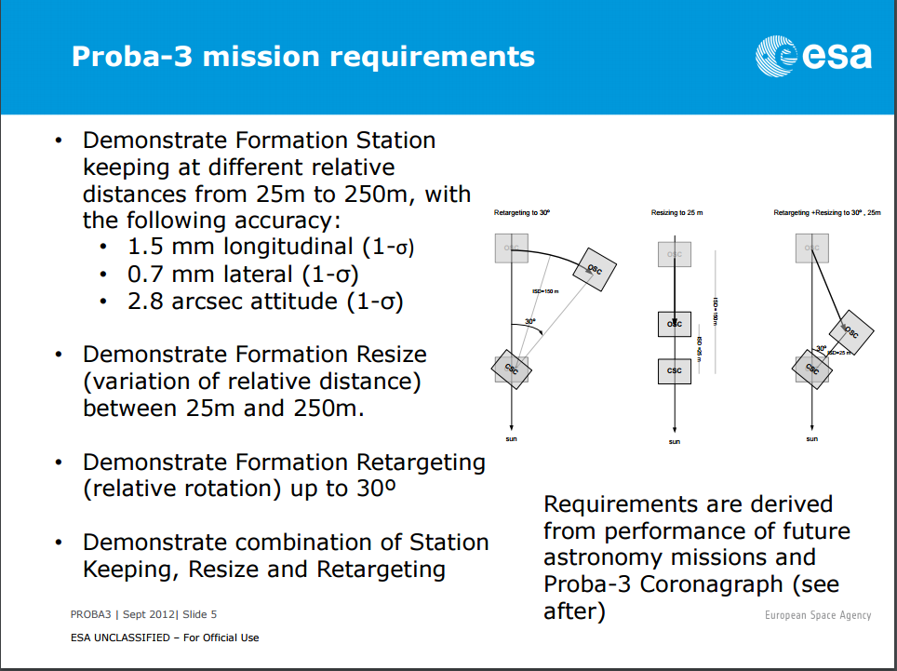

Slide 42
Positioning the Secondary Spacecraft
Positional (Z) <0.25mm about factor 3 better than Proba -3
Angular <10 microradians (2 arcsec)
Positional (X/Y) <10mm

Slide 43
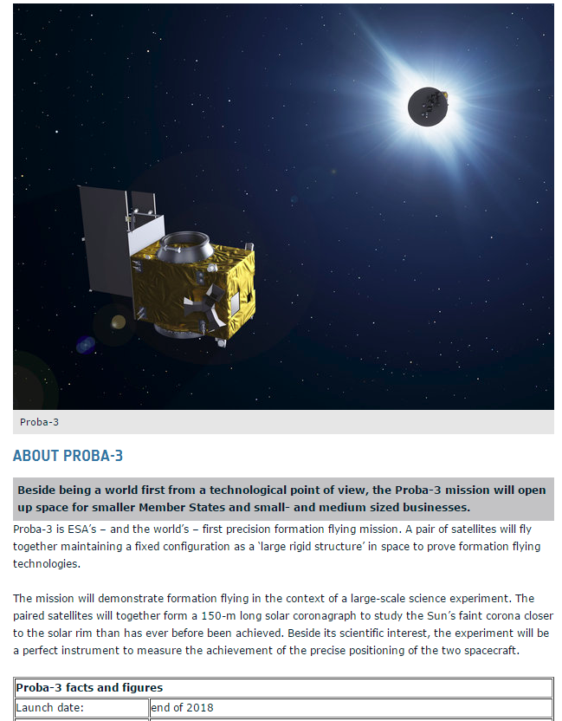

Slide 44
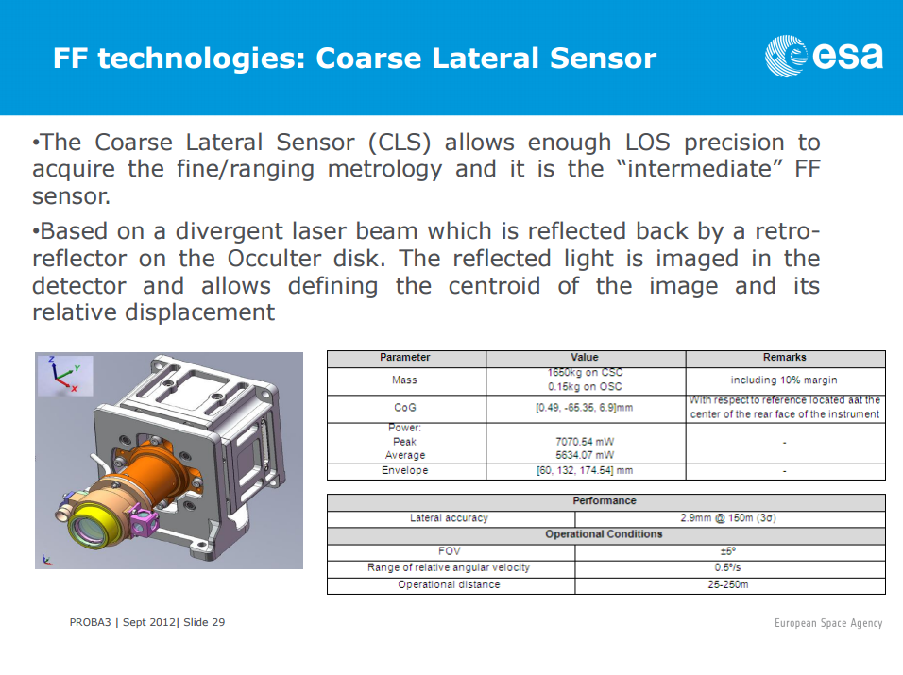

Slide 45
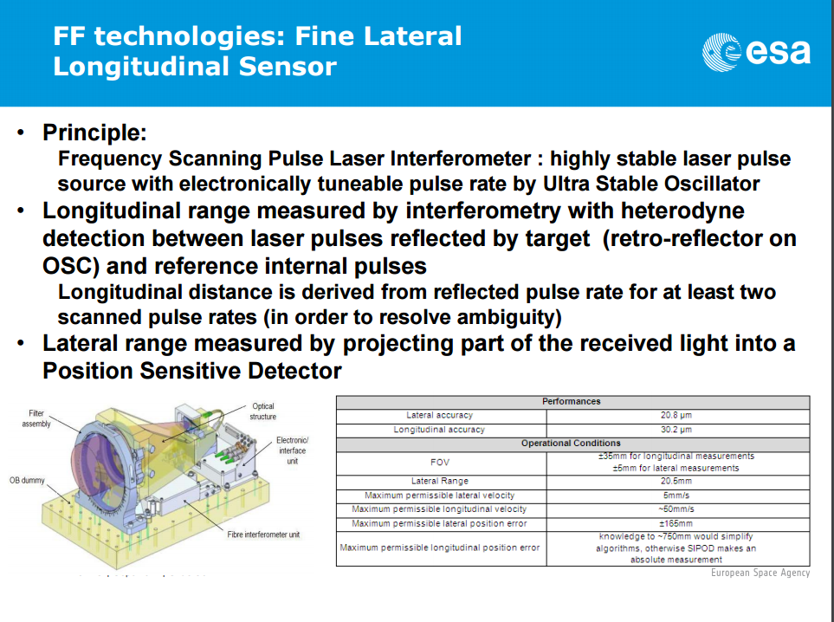

Slide 46
OK, so many other problems!
Contamination from powder sintering
How to get the mirror free from the mandrel
Alignment and tolerances of ‘segments’ during manufacturing
Pointing and slewing
Thermal shield – manufacture in space too!
Active cooling of the Primary for Far IR?
Power to Secondary module
Resonant frequencies of primary mirror

Slide 47
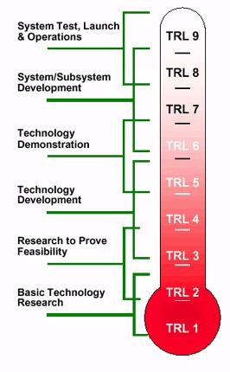
Technology Readiness Level
Whacky Idea
TRL -1

Slide 48
100m filled-aperture Telescope
Spherical Gregorian telescope:
  Narrow Field: Diffraction limited over 6 arcsecs at 1µm, but ideal for exoplanets and similar to the Integral Field Spectrometer (HARMONI) on the E-ELT
  FoV at 30µm would be about 100 arcsecs, so doesn’t meet FIRI requirements
Angular Resolution: scales as D
  12x JWST: 2 milliarcsecs at 1µm, 60 mAs at 30 µm
Sensitivity: scales as D⁴ if diffraction limited
  20,000 x JWST!
  Makes cosmology science in FIR feasible?

Slide 49
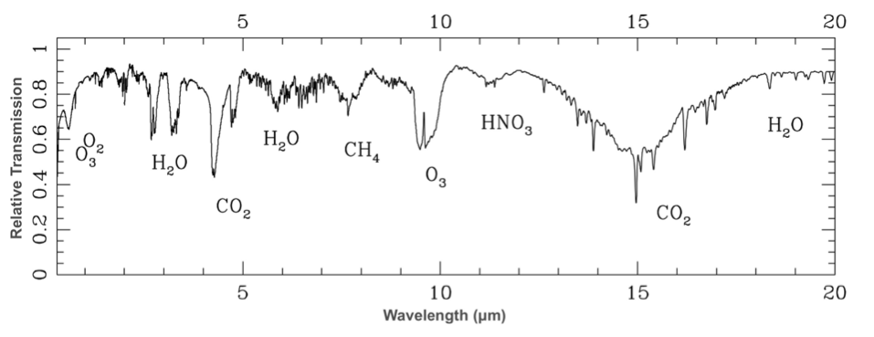
Characterise Earth-like planets
A 100m telescope can in principle detect an earth-like planet around a solar-type star out to a distance of 100 light years
  there are about 500 stars of this type to be surveyed
It could detect Methane and Oxygen – both together signifying life
Image credit: Kaltenegger, L. and Traub, W. (2009) Transits of Earth-Like Planets. Astrophysical Journal.

Slide 50
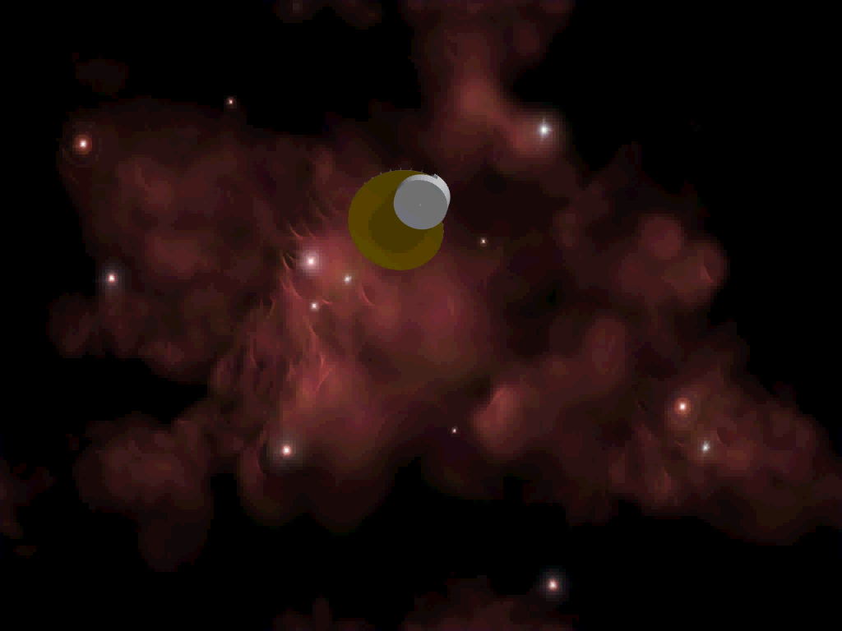
SPOWL for Far IR?
Got to be easier than NIR!
Alternative to 100m baseline interferometer, but with much higher sensitivity

