Slide 1
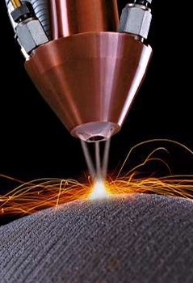



Towards cost effective instrumentation
Dr Emmanuel HUGOT
Aix Marseille University, CNRS
Laboratoire d'Astrophysique de Marseille

Slide 2
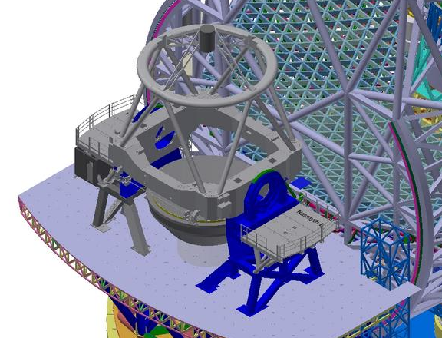
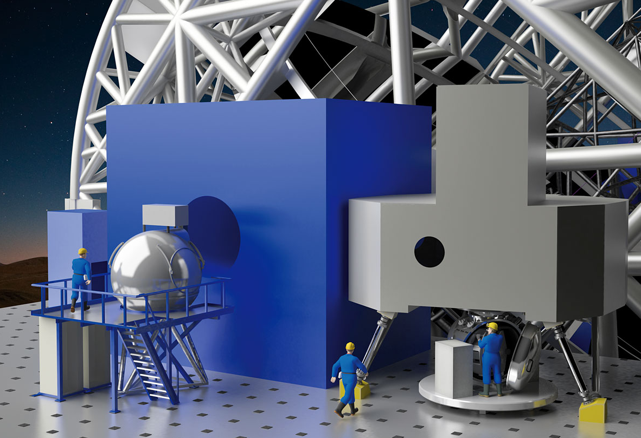
The Era of Giants: challenges
E-ELT instrumentation
Science drivers: farthest galaxies, faintest exoworlds, ...
Focal plane station = Size of a VLT unit (!)
VLT SPHERE: 50m³ → E-ELT HARMONI 300m³

Slide 3
The Era of Giants: challenges
E-ELT instrumentation
Science drivers: farthest galaxies, faintest exoworlds, ...
Focal plane station = Size of a VLT unit (!)
VLT SPHERE: 50m³ → E-ELT HARMONI 300m³
Wish list
Cryogenic environment (IR)
High throughput & stability
High angular resolution
PSF uniformity in the field
And more:
Multiplex
Broad wavelenght range
Low noise/large formats detectors
...
Beyond current limitations
New paradigms

Slide 4
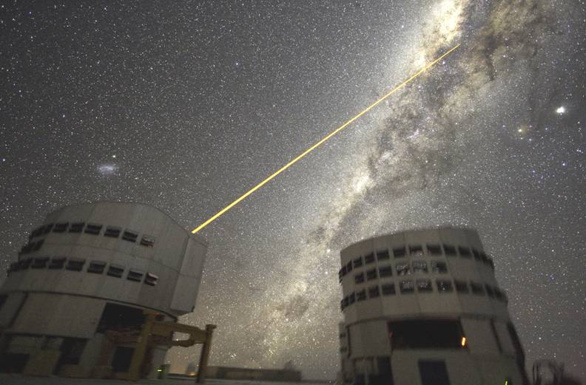
Need for Large Visible AO WFS Detector to sample spot elongation
Sodium layer
T ~ 10km
H ~ 80km
Predicted spot elongation pattern
Sodium Laser Guide Stars
Frame rate ~1 kframe/sec
require bright “guide stars”
With natural guide stars only 1% of the sky is accessible
Sodium layer at 80-90 km altitude can be stimulated by Laser to produce artificial guide stars anywhere on the sky
LLT
Pupil plane
Detector plane
Distance from launch site

Slide 5
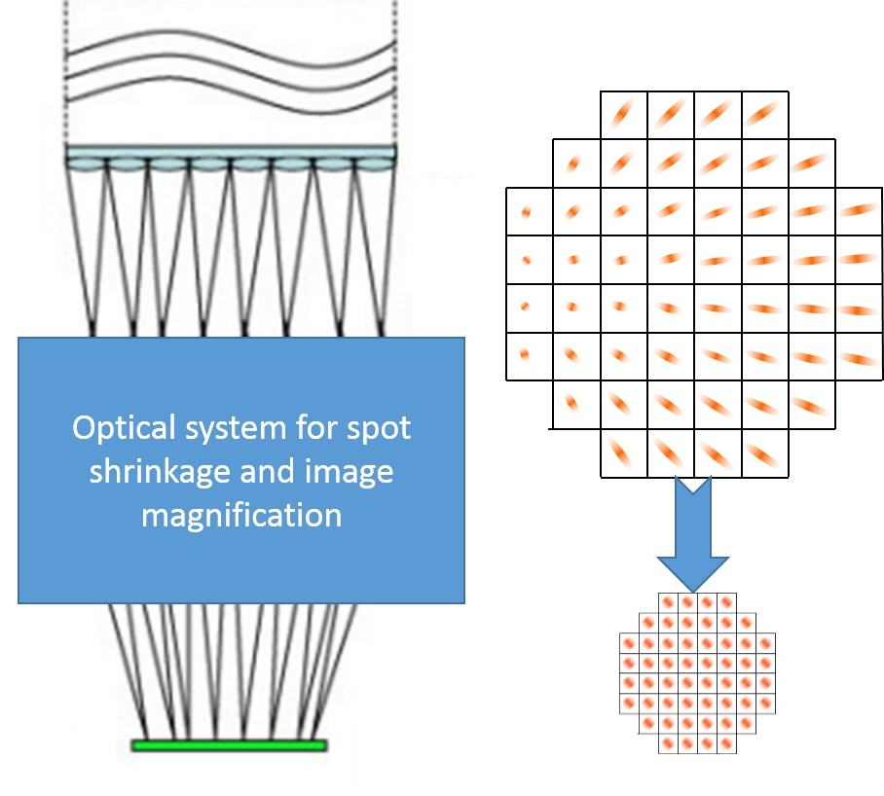
Add an optical transfer function
Two approaches:
1/ Two levels of micro lenses
→ second array of cylindrical µlenses
2/ Beams remapping
inspired of PIAA or ACAD concepts
→ a set of optics after the first µlens array

Slide 6
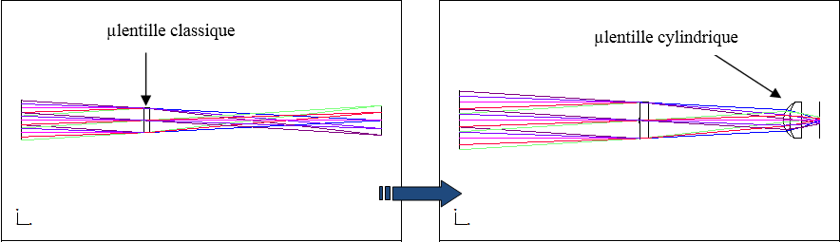
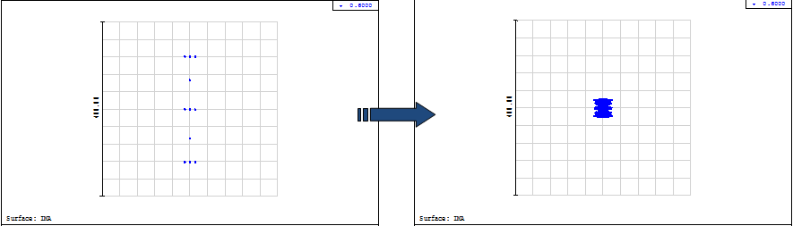
Solution #1: Two levels of µlenses
The µlenses solution – preliminary Zemax model
µlens diameter 200µm. Focal length 1.8mm.
Classical µlens (pupil plane)
Extended object
Extended image
400µm

Slide 7
Solution #1: Two levels of µlenses
The µlenses solution – preliminary Zemax model
µlens diameter 200µm. Focal length 1.8mm.
Additional set of cylindrical µlens array before the detector
Classical µlens (pupil plane)
Cylindrical µlens (off pupil)
Extended object
Extended image
400µm
40µm

Slide 8
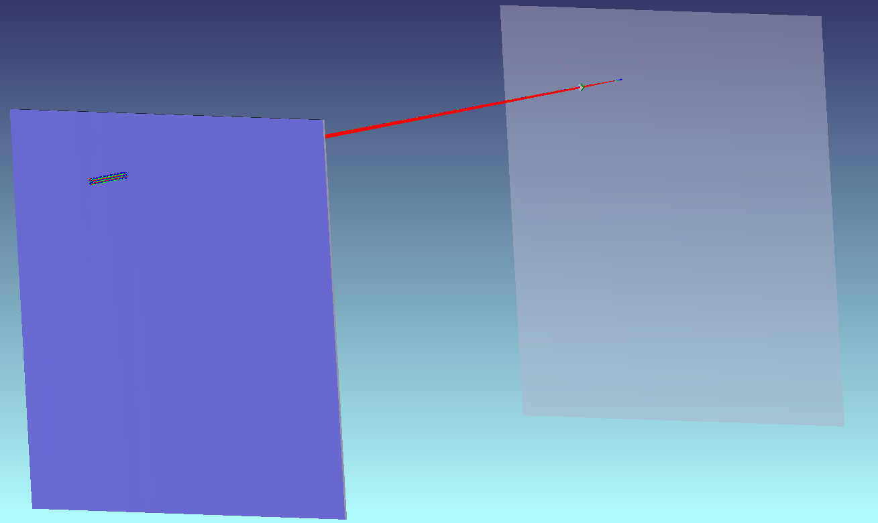
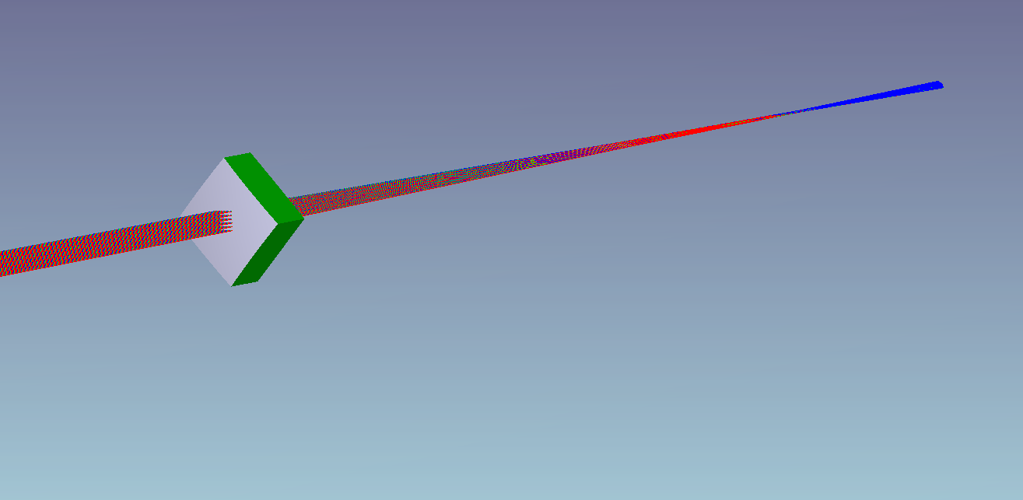
Solution #1: Two levels of µlenses
The µlenses solution – preliminary Zemax model
µlens diameter 200µm. Focal length 1.8mm.
Additional set of cylindrical µlens array before the detector
Currently building the Zemax model
→ Calculate cylindrical shape of each µlens
→ Perform exhaustive performance simulation – response to aberrations
74x74 sub pupils model

Slide 9
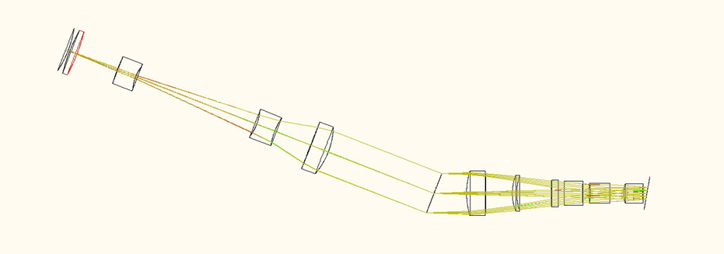

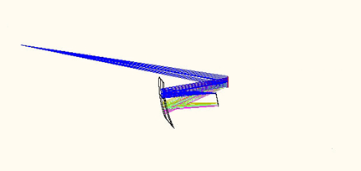
Towards efficient instrumentation
From Cuby+ 2006 includ. Hugot
Collimator: 4 lenses
Grating
Camera: 6 lenses
Conventional spectrograph
Length: 2.0 m
No collimator
Length: 0.6m
Only 2 mirrors
Volume gain x5
Throughput gain 20%
No chromaticity
Simplified AIT phase
Grating
Camera: 1 freeform(!)

Slide 10
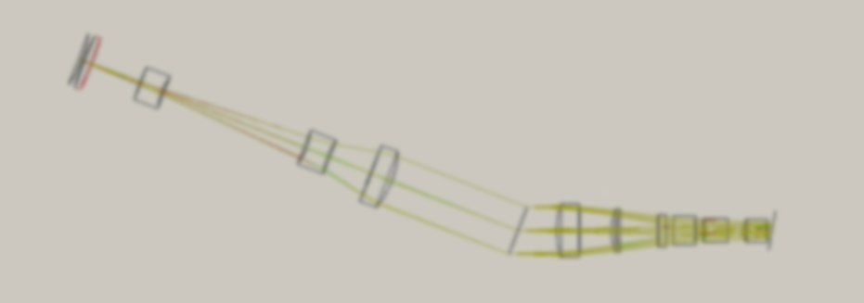
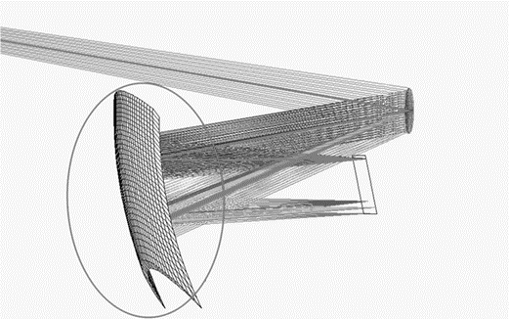

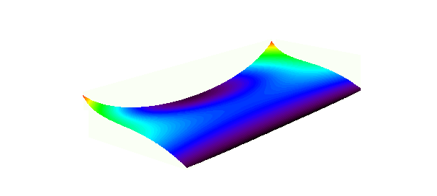
The price to pay
F/16 beam
150mm
Detector
2k x 2k
F/4 beam
1. Extreme freeform shape
10 times higher than state of the art
2. Flat field, large detector
Increased optics complexity
Overcome fabrication limits
→ Make them active
→ Curve the focal plane
6mm
deviation
Required optical quality <100nm

Slide 11
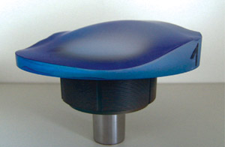
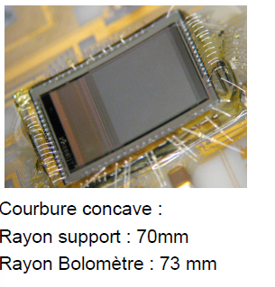

Breakthrough point
Disruptive technologies
I: 3D printing
II. Flexible electronics
New paradigms in instrumentation
+
Freeform Active optics
Curved detectors
Extreme freeform surface
IR Curved bolometer (λ=11µm)

Slide 12
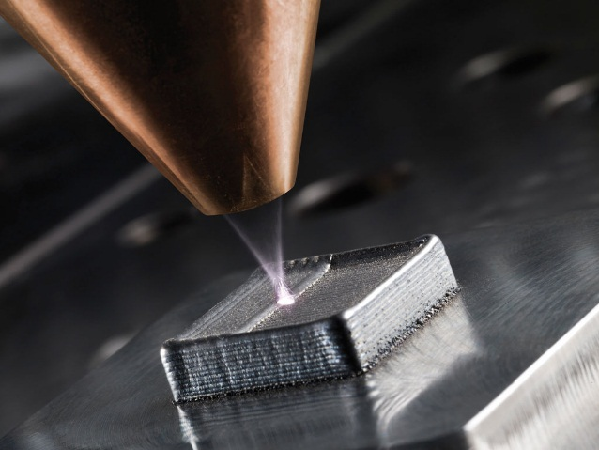
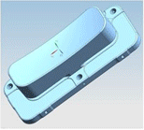
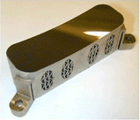
MISSion:
Enable
3D printing of Active Freeforms
  Optimize exotic deformable structures
  adapted to 3D printing
  Characterize prototypes performance
Metal deposition
Laser cladding
Classical design
ESA TROPOMI mirror
3D printed mirror
(TNO)
Mass gain x 2
Same Performance
Mass 284g
Mass 128g!

Slide 13

LAM in the MISS project
Contributions to MISS WP3&4
WP3: To study the capability to manufacture advanced optical components including metamaterial designs from LEM techniques (e.g. lenses with integrated gratings, laser forming of lenslet arrays, ARCs, mesh lenses).
WP4:To design a prototype optical mirror/lens system with integrated actuators and sensors using AM and LEM techniques;
LAM ongoing project: ERC ICARUS
An EU funded 5 years effort
One line of sight: Innovative cost-effective, compact instrumentation
Two wings: 3D printing of freeform active mirrors, Curved detectors
ICARUS in flight mode: Fall 2016
Complementarities MISS/ICARUS

Slide 14
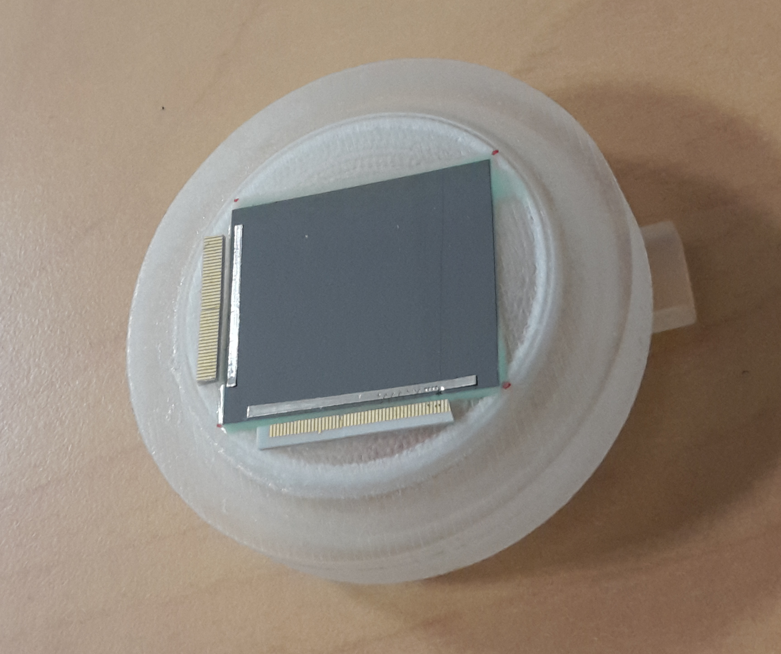
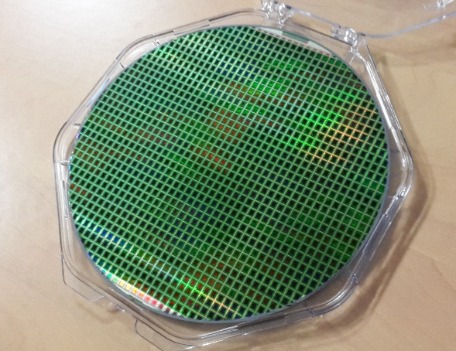
ICARUS
Prepare
for collective curving of IR detectors
  Handle warping of curved arrays prototypes
  (mechanical analysis, electronic performance)
  Develop mass production process
Curved single chip prototype
On deformable substrate
Wafer level
Extend to large scales
Production rate
x100 to x1,000

Slide 15
ICARUS / MISS complementarities
MISS
Cryo-cooling systems
Moving mechanisms
Advanced optical components, active mirrors and structures
ICARUS
Innovative optical designs
3D printed active mirrors: design, FEA, prototypes
Curved detectors: towards IR devices
Prototypes
System oriented
Device oriented
NIR

Slide 16
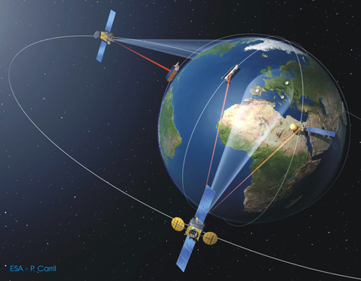
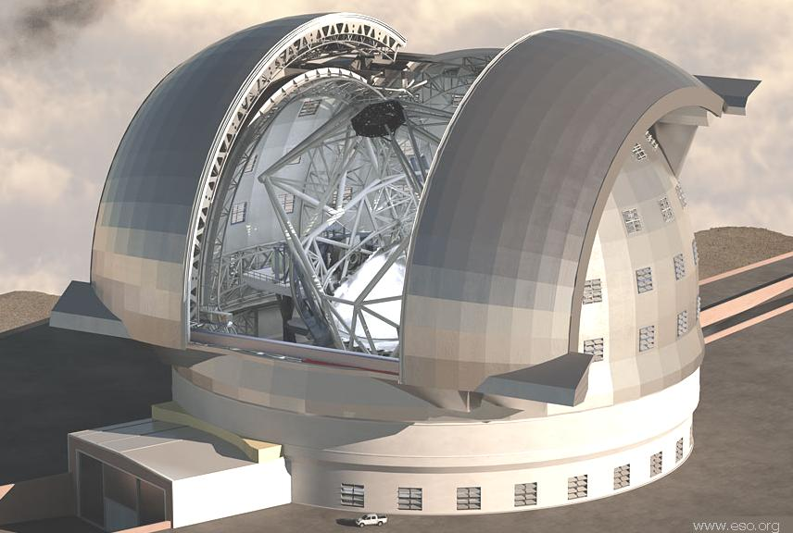
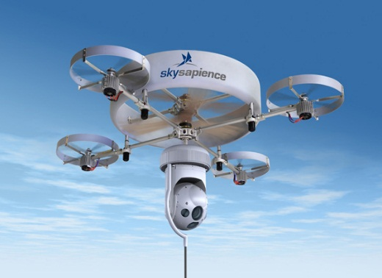
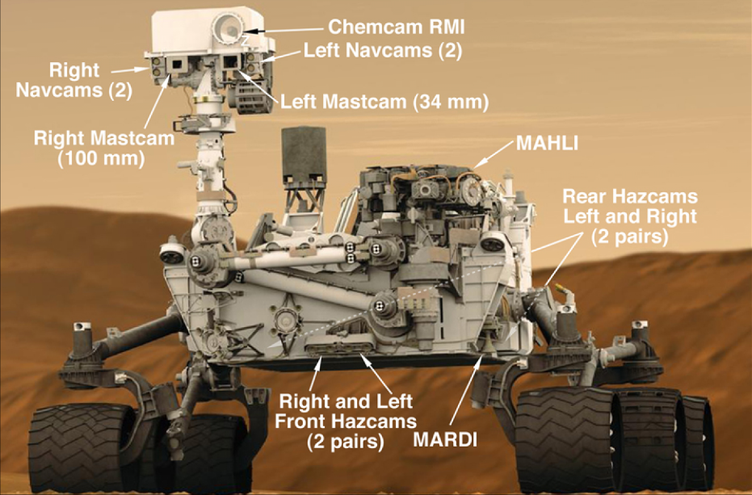
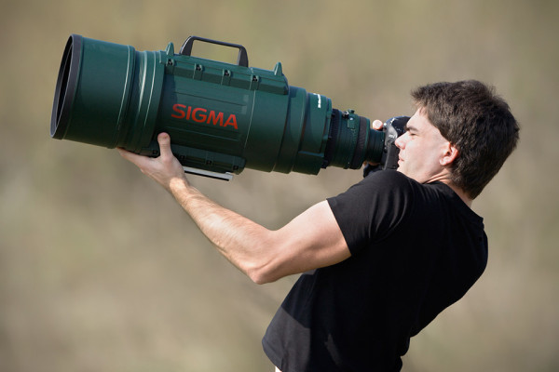
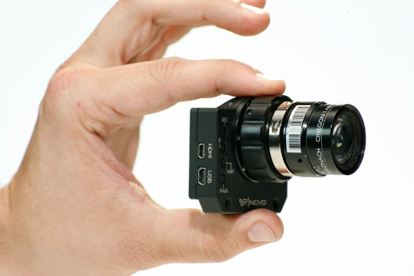
MISS: a multi-disciplinary impact
Earth observation
Giant telescopes
E-ELT Instrumentation
VLT 3rd generation
Drones
Rovers
High tech cameras

Slide 17
MISS / LAM rough budget
Cost Category |  |  |  |  | Total in Euro
Direct |  | Personnel | PI (10% over 4 years) |  | 31 342
Costs |  |  | Senior Staff |  | -
 |  |  | Postdoc (2 years) |  | 97 232
 |  |  | Students |  | -
 |  |  | Other |  | -
 | i. Total Direct costs for Personnel (in Euro) |  |  |  | 128 574
 |  | Travel |  |  | 15 000
 |  | Equipment |  |  | -
 |  | Other goods |  | Consumables | 15 000
 |  | and services |  | Publications (including Open Access fees), etc. | -
 |  | Other (please specify) |  |  | -
 | ii. Total Other Direct Costs (in Euro) |  |  |  | 30 000
A – Total Direct Costs (i + ii) (in Euro) |  |  |  |  | 158 574
B – Indirect Costs (overheads) 25% of Direct Costs (in Euro) |  |  |  |  | 39 643
C1 – Subcontracting Costs (no overheads) (in Euro) |  |  |  |  | -
C2 – Other Direct Costs with no overheads (in Euro) |  |  |  |  | -
Total Estimated Eligible Costs (A + B + C) (in Euro) |  |  |  |  | 198 217
Total Requested EU Contribution (in Euro) |  |  |  |  | 198 217

