Slide 1
Freeform based optical designs
Gabby Kroes, Tibor Agócs, Felix Bettonvil
NOVA Optical Infrared Instrumentation Group at ASTRON, P.O. Box 2, 7990 AA, The Netherlands.

Slide 2
NOVA
Optical Infrared Group

Slide 3
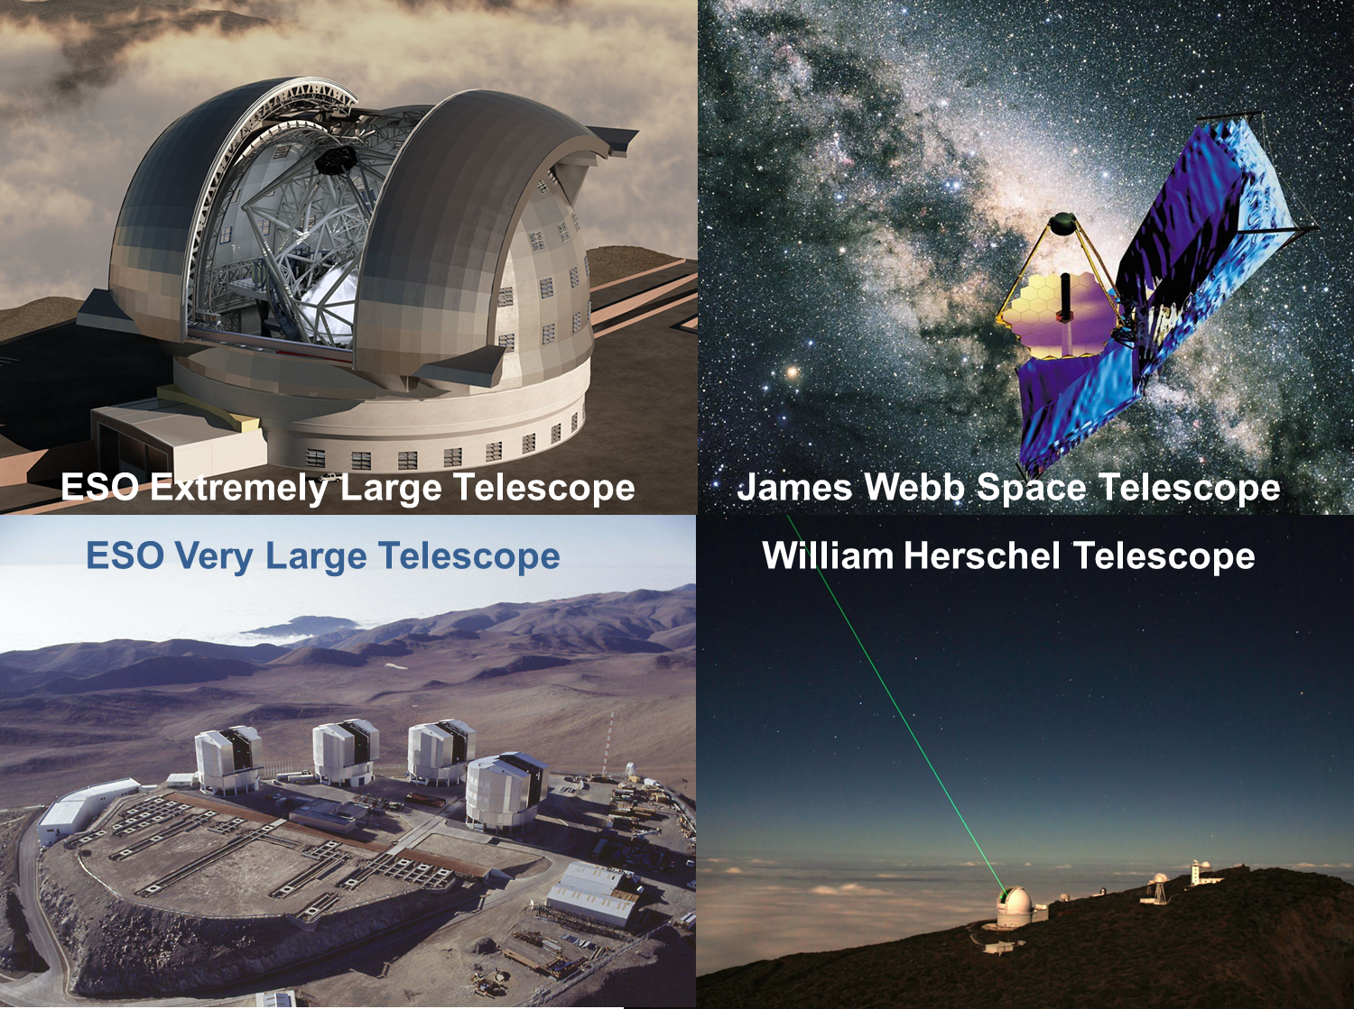
NOVA - Optical InfraRed Group

Slide 4
Work methodology
NOVA Optical Infrared instrumentation group (Netherlands)
Concurrent engineering
Plan design-manufacturing-alignment-verification cycle
Find the optimum (best trade-off)
Mechanical
Verification
Design
Optical
Thermal
Concurrent
Engineering
Manufacture
Alignment
Electrical
Software

Slide 5
Introduction
Freeform design, manufacturing, testing

Slide 6
Introduction
Freeform surface based systems offer
  More degrees of freedom
  Superior image quality
  Compact designs
    smaller space envelope, lower weight
  Less number of surfaces
  Generally better solutions when the symmetry of the system is broken
  Tailor made optimizations (dedicated merit function targeting system geometry, distortion, etc)
New way of thinking is needed in
  Optical design
  Manufacturing
  Testing

Slide 7
Introduction
Freeform optical design
  Existing methods mostly for non-imaging applications (car head lamps, illumination, solar collector)
  NOVA developed freeform optical design methods for imaging applications (collimators, cameras, relays, etc.)
Freeform manufacturing
  Diamond turning, nickel plating
  Stress polishing
  Hydroforming
Freeform testing
  Tactile measurements
  Shack Hartmann
  Deflectometry

Slide 8
Freeform based optical design examples (NOVA)
METIS SMO, two-, three-mirror systems, reflective Alvarez

Slide 9
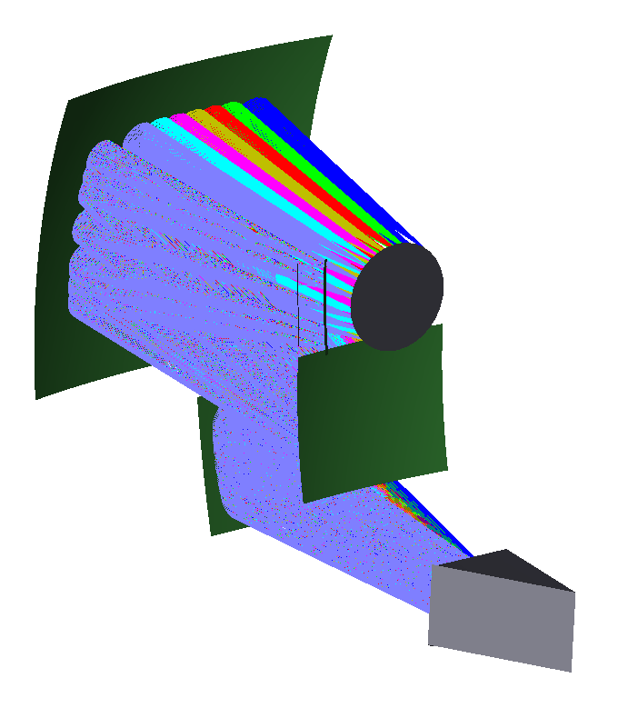
Freeform based optical designs
METIS LM band spectrograph
Double pass three mirror anastigmat
Re-optimized design with freeform M3, all other surfaces are spherical
PV 10.2µm, RMS 1.2µm deviation from BFS
M1 spherical
50 mm
M2 spherical
M3 freeform
55 mm
IG

Slide 10
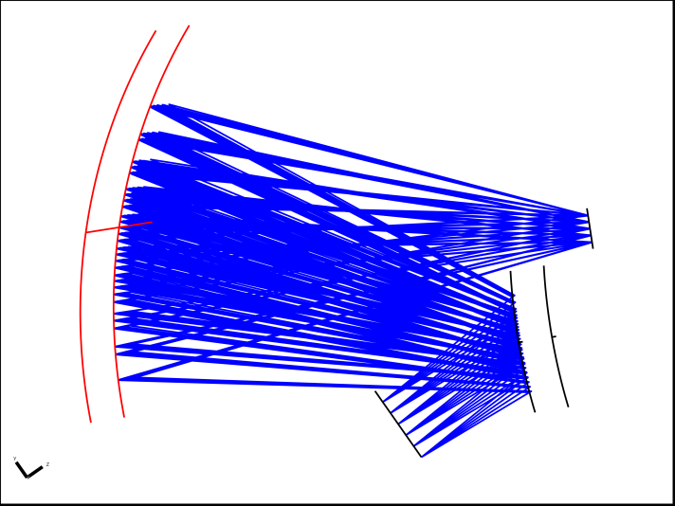
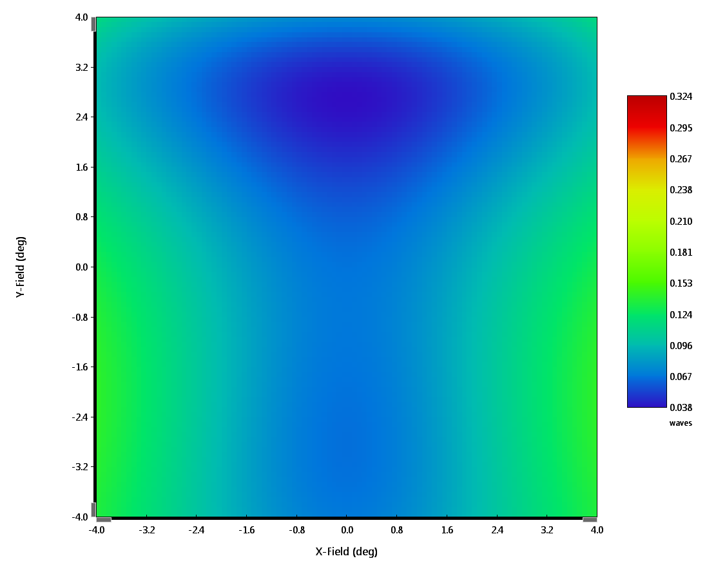
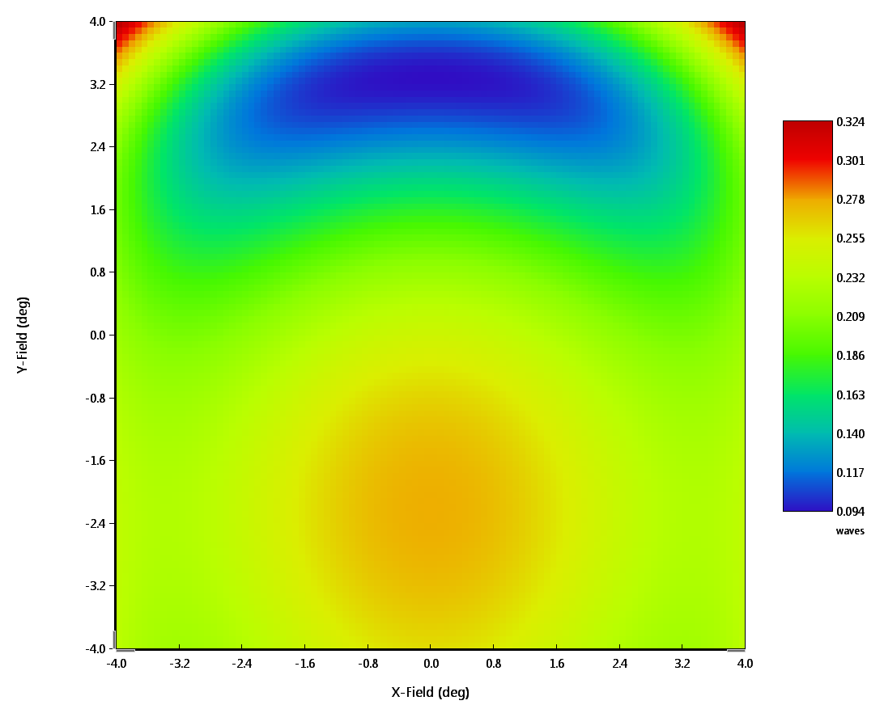
Freeform based optical designs
M2 (freeform)
Entrance pupil
F1.5 Two mirror system

Slide 11
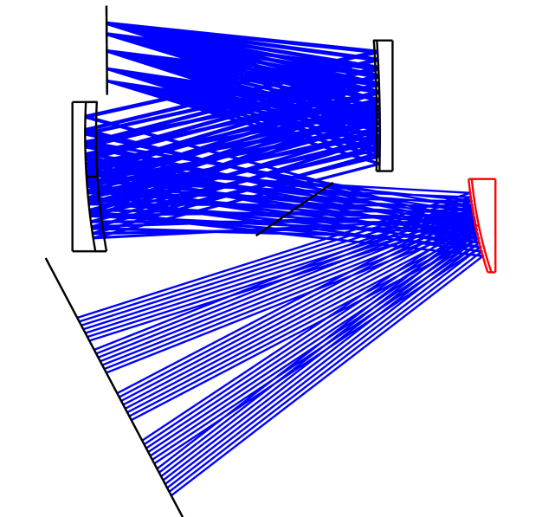
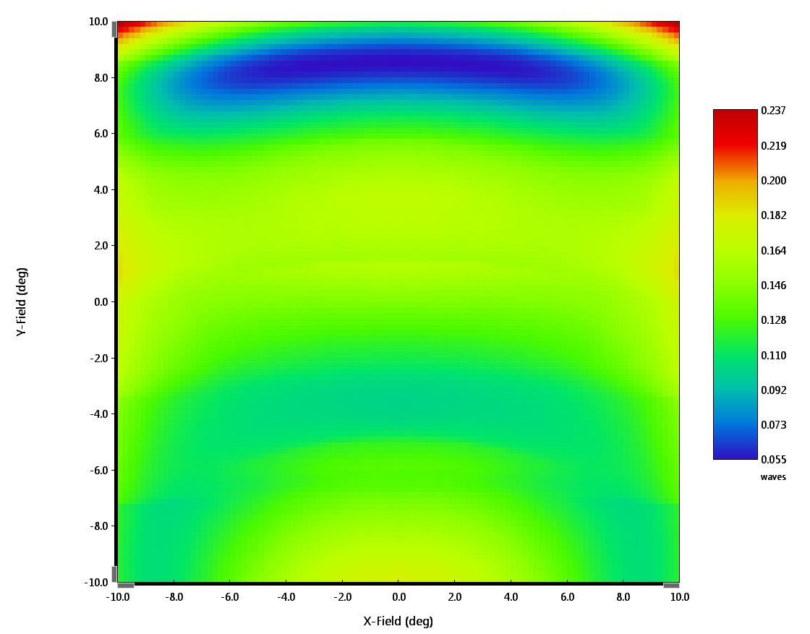
Freeform based optical designs
F2 Three mirror system
M3 spherical
M2 spherical
M1 freeform

Slide 12
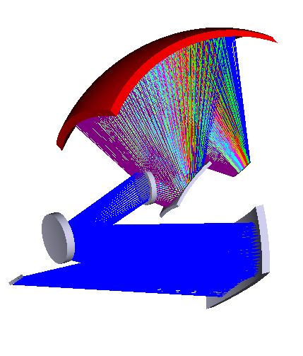
Freeform based optical designs
Complete spectrograph
(220mm pupil, 176mm slit, F1.8 camera)
M4 freeform
M1 freeform

Slide 13
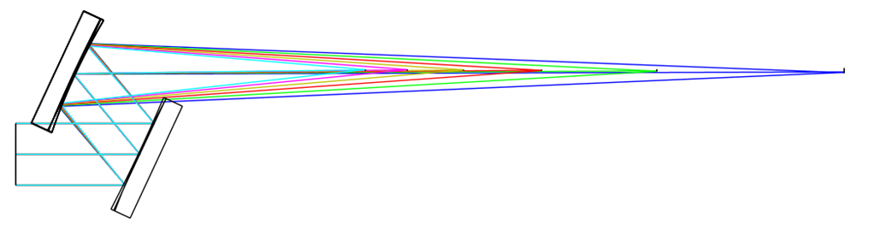
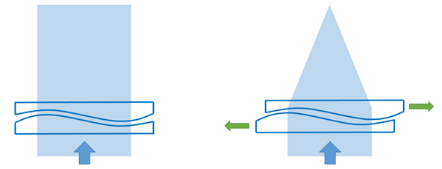
Freeform based optical designs
Reflective Alvarez
Classical Alvarez
Side view

Slide 14
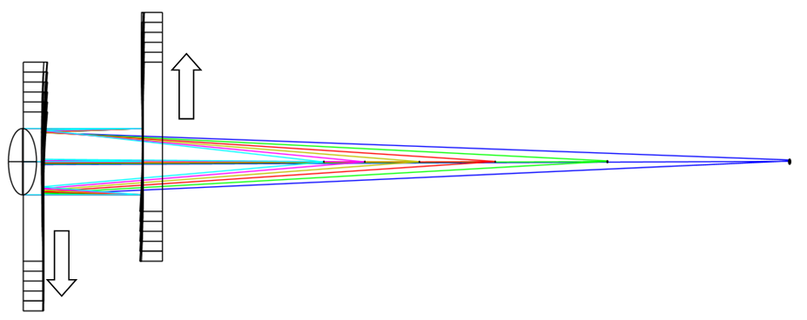
Freeform based optical designs
Reflective Alvarez
Classical Alvarez
Top view

Slide 15
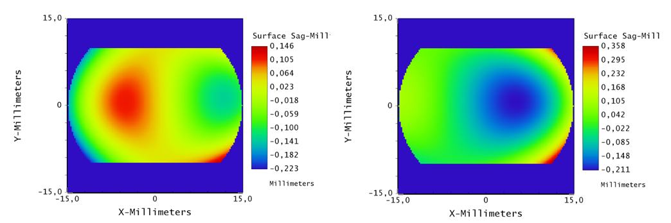
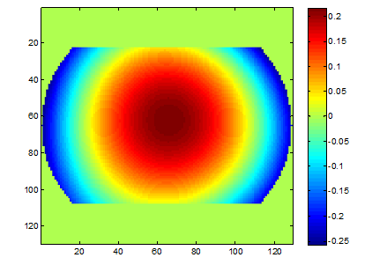
Freeform based optical designs
Reflective Alvarez
M1
M2
M1-M2

Slide 16
Freeform work methodolgy
Concurrent engineering

Slide 17
AM and optical systems design
To achieve the best results with respect to the freeform based optical system
  System optimization is needed
  Concurrent engineering
From the perspective of the optical design knowledge is inevitable on
  Manufacturing processes, limitations, capabilities
  Testing strategy, testing equipment, etc.

Slide 18
interests
Use available knowledge
  @ NOVA
  FAME
Integrated instrument design
  Advance on our concurrent design philosophy
Better instrumentation
  High(er) quality
  Smaller
  Lighter
  Manufacturing, Assembly, Integration, Test, Handling and Transport

