Slide 1
management summary
Additive manufacturing is multidisciplinary and
vigorously innovating.
TNO links materials innovations with systems innovations in a collaborative approach between the Brightlands Materials Center and The High Tech System Center.
The Systems for AM center focuses on application driven equipment innovations.
The BMC focusses on application driven materials innovations.
An open innovation model is used to network and share resources & IP for a higher ROI.
Dedicated exclusive projects are also possible.
Contact us to see how you can get involved and get more detailed information about the ongoing innovations.

Slide 2
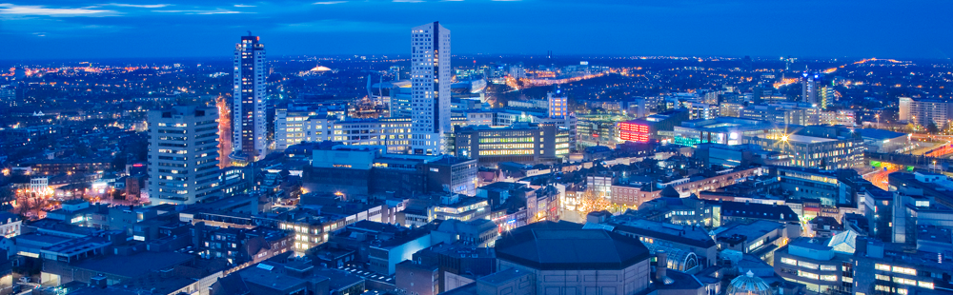
TNO
Additive Manufacturing Proposition
Matthew Maniscalco, 21 January 2016
Edinburgh OPTICON Meeting

Slide 3
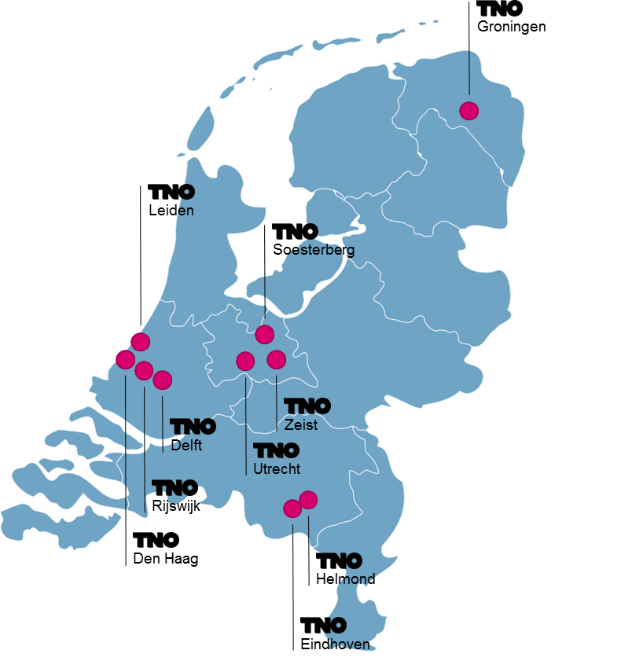
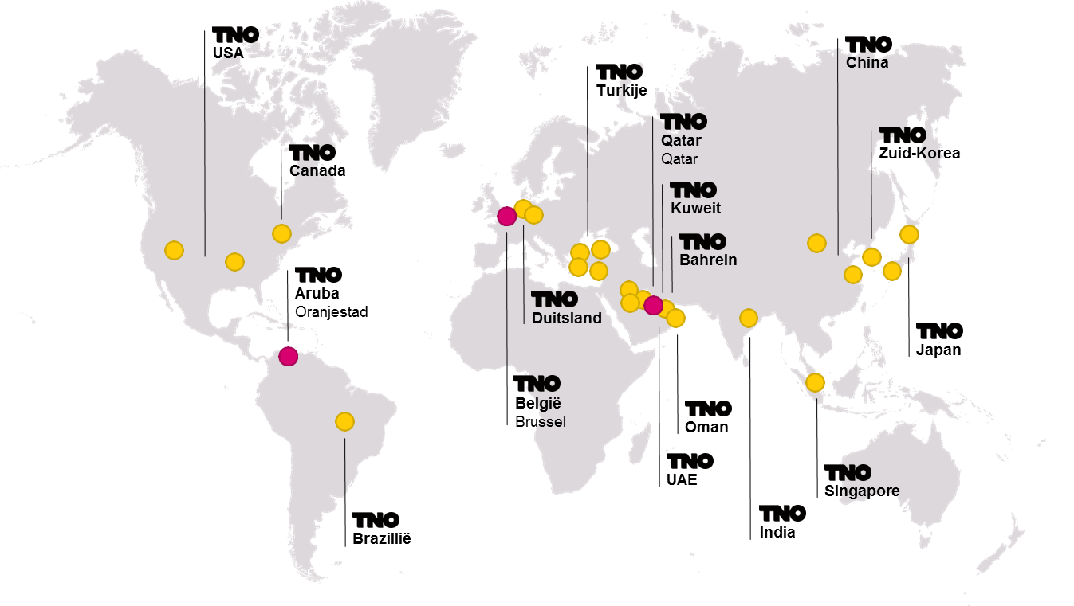
TNO at a glance
Dutch research organization for applied scientific research
Established by law and started in 1932
Independent of public and private interests
Assisting companies to innovate by doing R&D
Supporting government in policy making

Slide 4
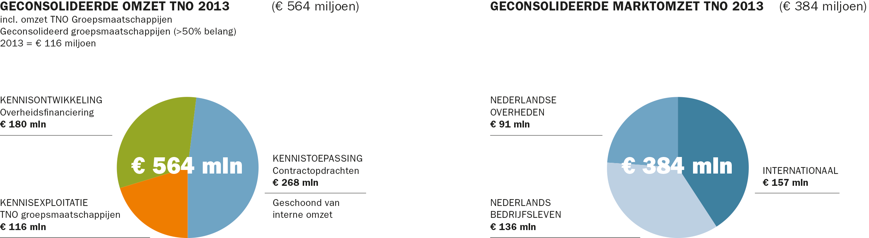
  TNO Organization in numbers
Number of employees (2013):
Consolidated turnover:
3300
€ 564 mln

Slide 5
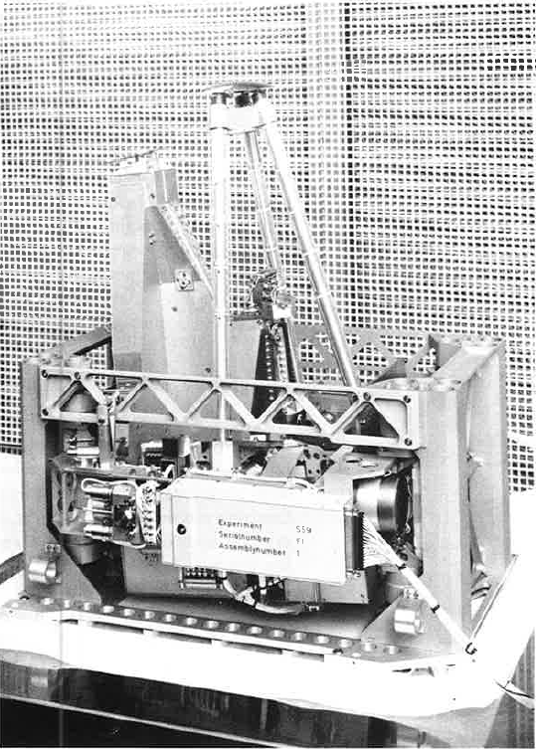
First TNO Space endeavour 1964
50 years of Optical instruments for space
Development of UV star spectrophotometer (S59) for Europe’s first 3-axis stabilized satellite TD-1A.
50th anniversary of our collaboration with ESA
Innovative optical solutions using e.g. off-axis parabolic gratings
Notes:
Our space activities started in 1964 when TNO-TPD was asked by the Laboratory for Space Research (Laboratorium voor Ruimte-onderzoek) in Utrecht, one of the predecessors of SRON, the Netherlands Institute for Space Research, to develop a star spectrophotometer. TNO built the telescope and spectrometer for near UV (206-287 nm) to register spectra of three 10 nm wide intervals with resolution of 0.18 nm.
This spectrophotometer, called S59, was going to fly on TD-1A, one of the first satellites of ESRO, later ESA, which was founded in the very same year 1964. Therefore, 2014 also marks our 50 year collaboration with ESA, something we are extremely proud of.
The satellite, by the way, was TD-1A, Europe’s first 3-axis stabilized satellite, which was launched in 1972. Our activities for S-59 also led to the development of a starmapper instrument for ESTEC. Here we collaborated with NLR, the National Aerospace Laboratory.
Regarding ESA, something I learned recently is that ESTEC originally was to be located in Delft, but because of unforeseen difficulties Noordwijk was chosen instead.
Background info: ESRO (European Space Research Organisation), founded in 1964, merged with ELDO (European Launcher Development Organization) to become ESA in 1975.

Slide 6
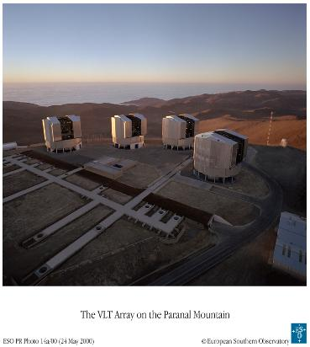
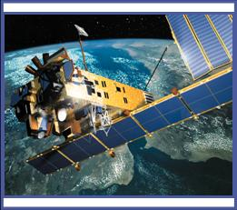
Space Science & Astronomy
Space instruments
Space Science
Earth observation: spectrometers
Instrument calibration
Attitude sensors
OGSE
Leading customers:
ESA, NASA, ABDS, Thales
Astronomy
Delay lines
Star separators
Active & Adaptive optics
Free form mirrors
Leading customer:
ESO

Slide 7
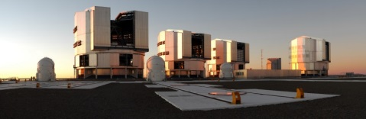
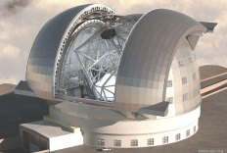
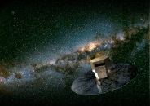
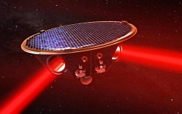
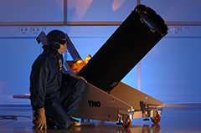
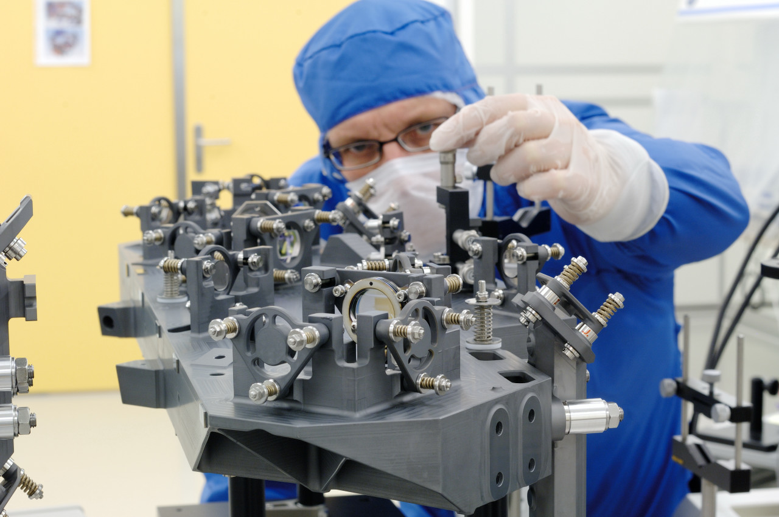
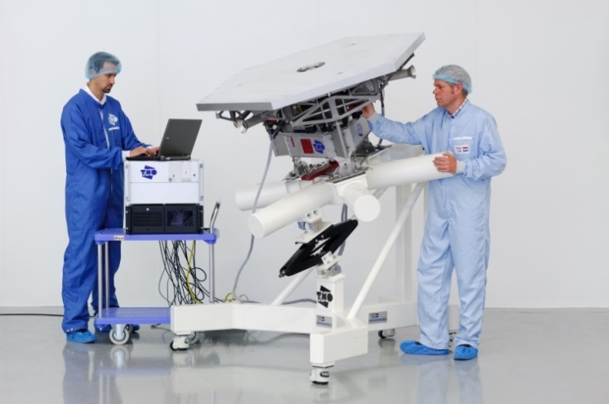
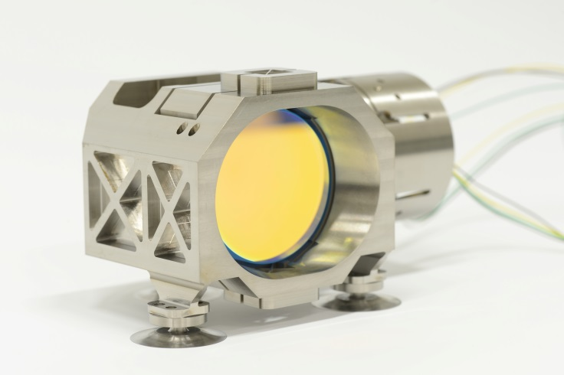

Scientific Instrumentation – applications and research
  Earth based
  VLTI, E-ELT
  Spaceborne
  GAIA, LISA, Darwin, Echo, Safari, Euclid

Slide 8
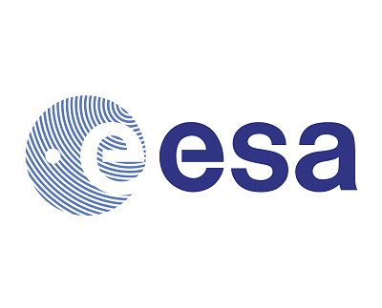

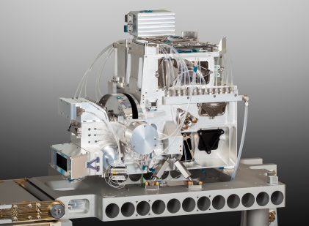
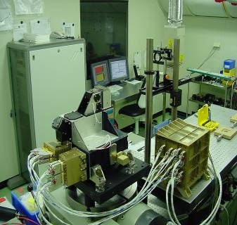
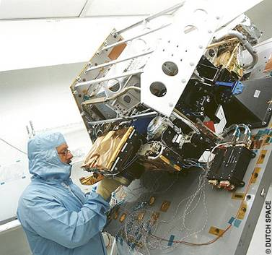
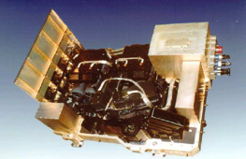
Earth Observation Instruments
TROPOMI
2015 Sentinel 5 precursor
OMI
2004 EOS-AURA
2015
TROPOMI vs OMI
Sciamachy
2002 Envisat
6x higher spatial resolution
  7x7 km2 vs. 13x24 km2
25x data volume of OMI)
  20 GByte /orbit
CO and CH4 observations
  SWIR band
Improved cloud measurement
  O2A band
GOME / GOME-2
1995 ERS-2
2006-2020+ METOP1, 2, 3
1995

Slide 9
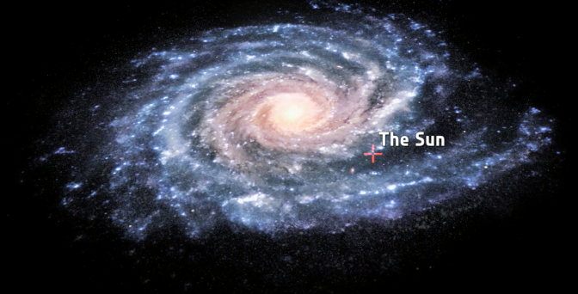
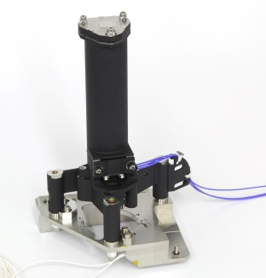
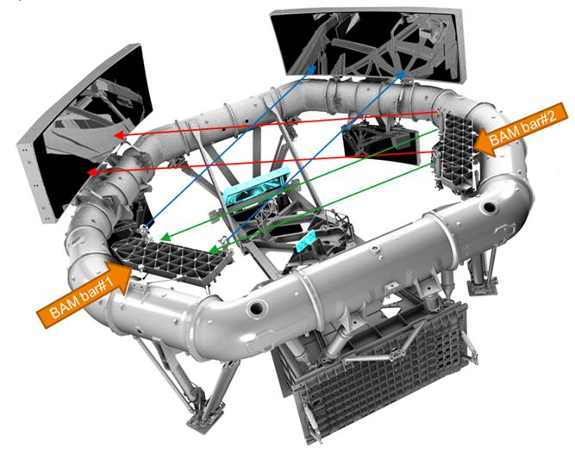
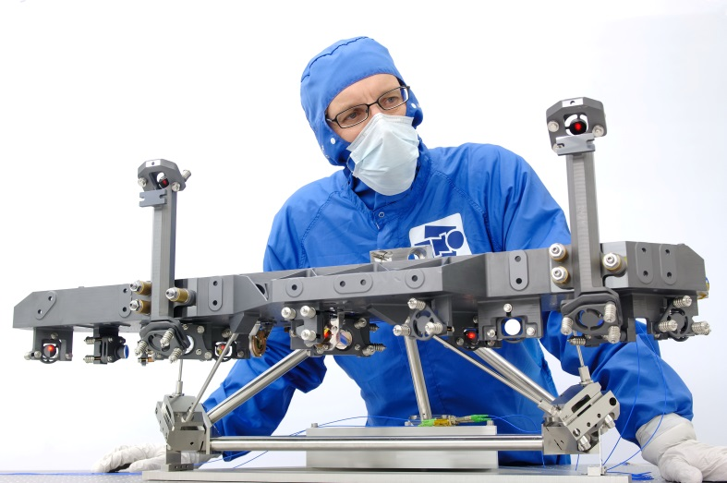
Accuracy astrometric measurements:
  24 micro-arcseconds (diameter of human hair measured from a distance of 1000 km)
GAIA
  Silicon Carbide (SiC) for ultra stable construction
TNO delivered metrology systems:
  Basic Angle Monitoring (BAM)
  Wave Front Sensor (WFS)

Slide 10
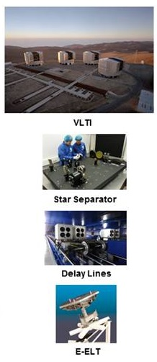
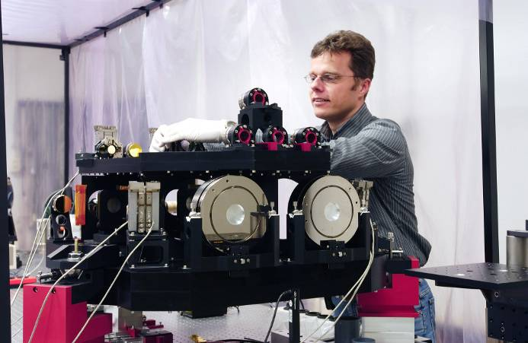
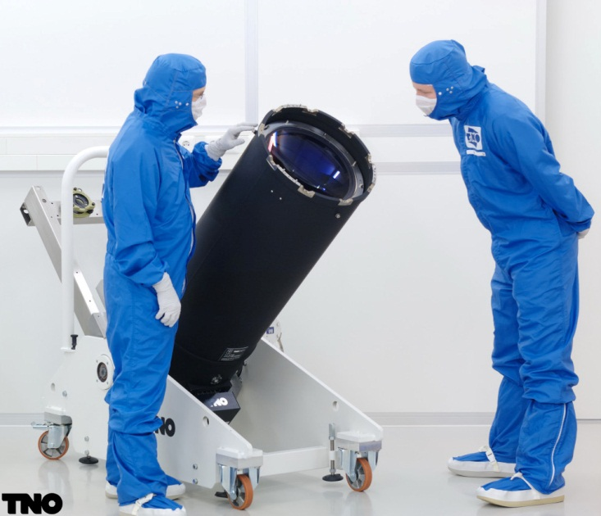
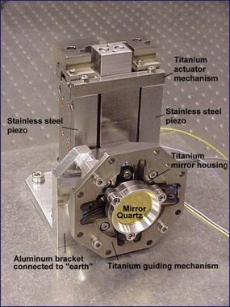
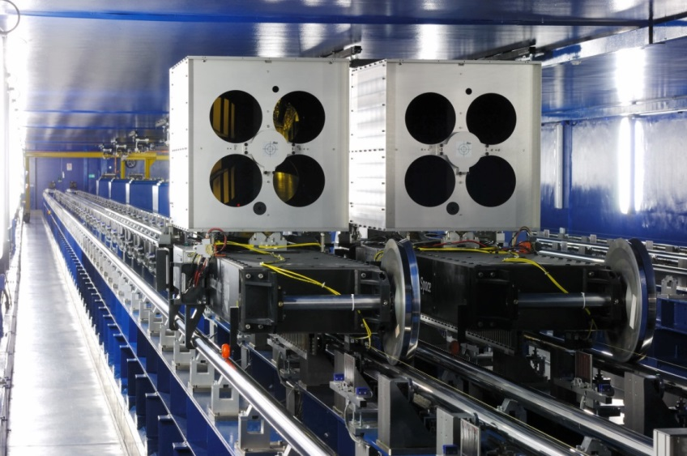
History of TNO projects for ESO
VLT OTA
VLT STS-AT star separator
tip-tilt mechanism
VLTI delay lines

Slide 11
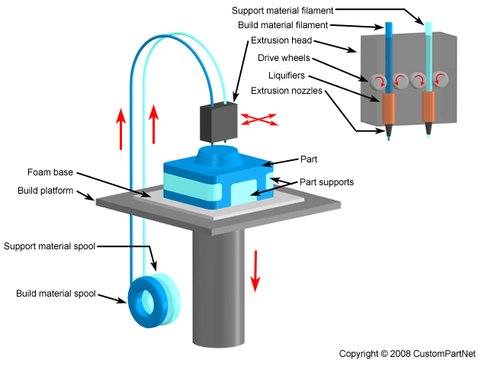
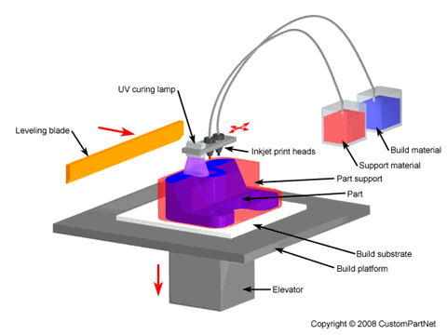
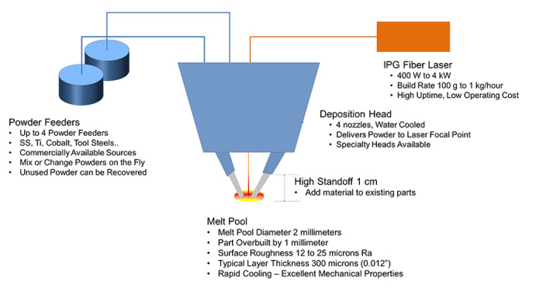
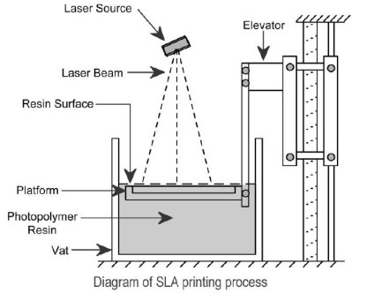
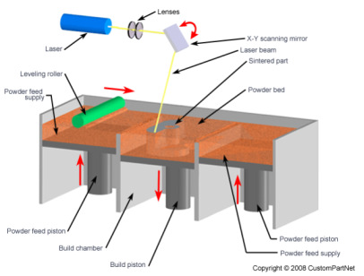
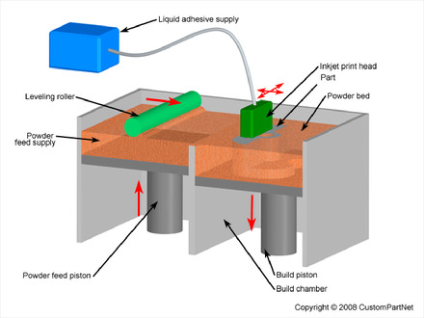
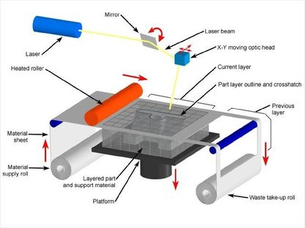
AM technologies
Jetting
Laser cladding
FDM
Powder Bed Droplet
LOM
SLA/DLP
SLS/SLM
Notes:
Material deposition
Fdm – fused deposition modeling, hot glue gun on spool
Jetting – like ink jet printer, more viscous with drops, different heads/matls
Laser cladding – metal printing, complex nozzle with laser and powder, cross and melt at surface, low res fast rate. Can be used on 5axis machine, repairs, post machine. turbines
Lom – not used. Sheet material cut outs and gluing.
Sla/dlp – stereo lithography, vat photo polymzn, digital light processing. Small si chip mirror pixels determine projection. Special uv hardened photo polymers, layer buildup. Very hard like epoxy available.
Sls/slm – selective laser scintering/melting, laser melt bonds powder, polymer or metal - titanium
Powderbed droplet – jetting onto flat powder for reaction

Slide 12
multidisciplinary and vigorously innovating
AM technology is a 20 year hype that is now becoming a manufacturing reality.
There are many organizations and companies, filled with fragmentation and networking initiatives worldwide.
AM technology is transitioning from prototyping to manufacturing to hybrid manufacturing.
TNO links materials innovations with systems innovations in a collaborative approach.

Slide 13
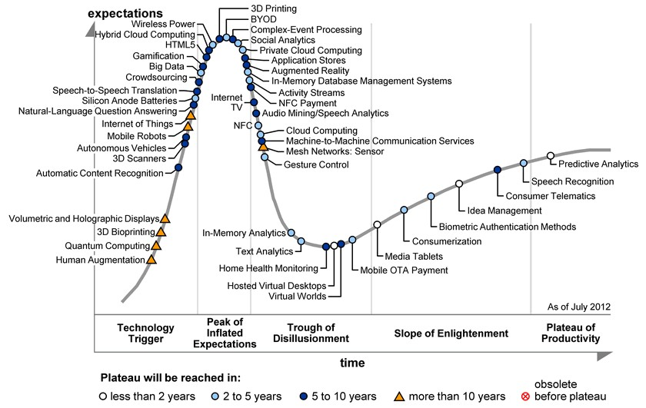
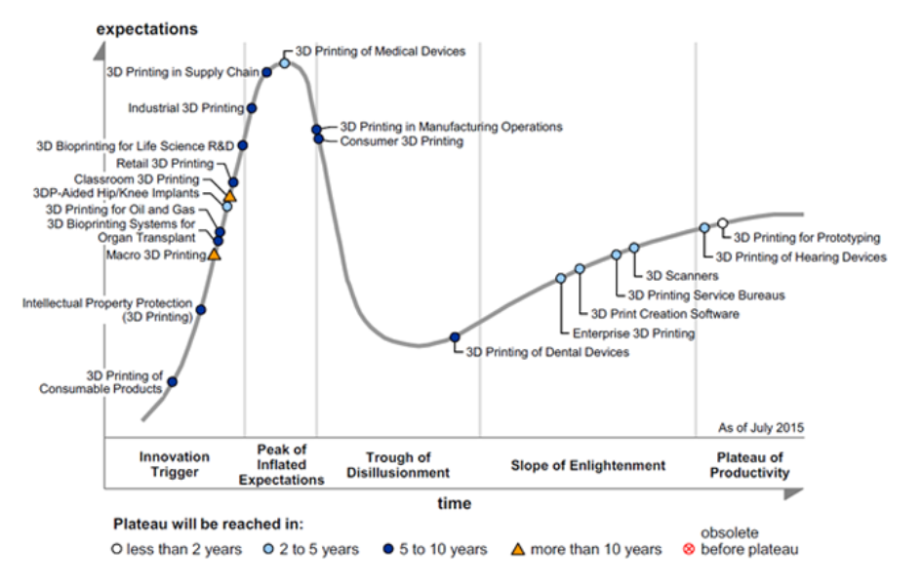
hype is becoming reality
AM technology is a 20 year hype that is now becoming a manufacturing reality
2012
2015

Slide 14





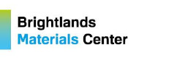




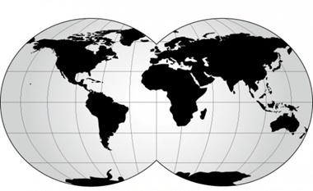










activity worldwide
The Netherlands
R&D materials
R&D equipment
OEM companies
Germany
R&D materials
R&D equipment
OEM companies
USA
R&D materials
R&D equipment
OEM companies
Belgium & France
R&D materials
R&D equipment
China
OEM companies

Slide 15
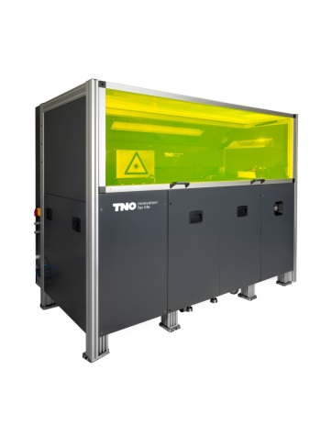
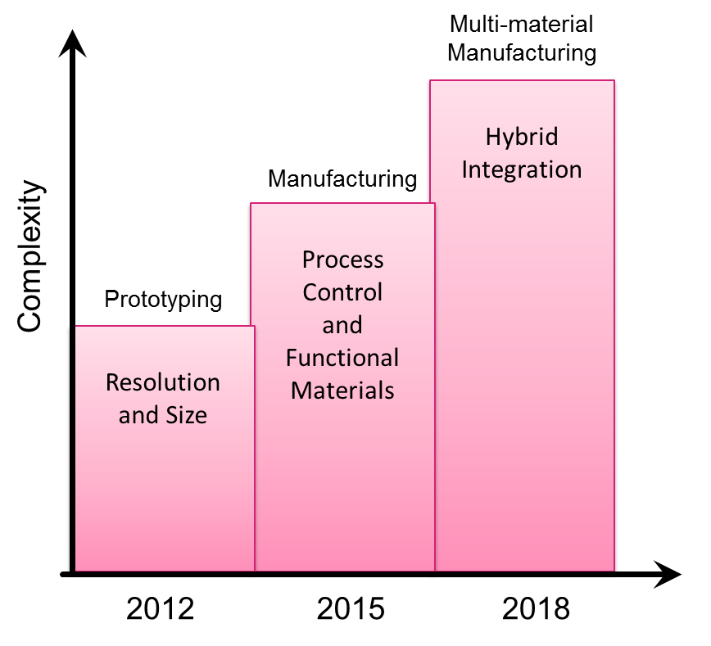
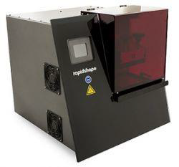
AM technology is transitioning
  prototyping ➔ manufacturing ➔ hybrid manufacturing
Notes:
Electronics and multi metals, maskless lithography

Slide 16
additive manufacturing at TNO
TNO has been active in Additive Manufacturing for almost 20 years.
Our expertise covers the whole process from fundamental (material) research, design and engineering to manufacturing and testing of products and systems.
We have a successful IP track record in additive manufacturing, along with many exploitation examples.
We build strategic alliances with complementary international R&D partners including equipment manufacturers, material companies, and end users in shared innovation and bi-lateral developments.
We aim to develop world-class, next generation, additive manufacturing technology to enable or accelerate innovations by companies along the value chain.
We focus on process integration; combining materials innovations within the Brightlands Materials Center and equipment innovations within Systems for AM.
Notes:
Tno improves resolution, throughput and matl mix

Slide 17
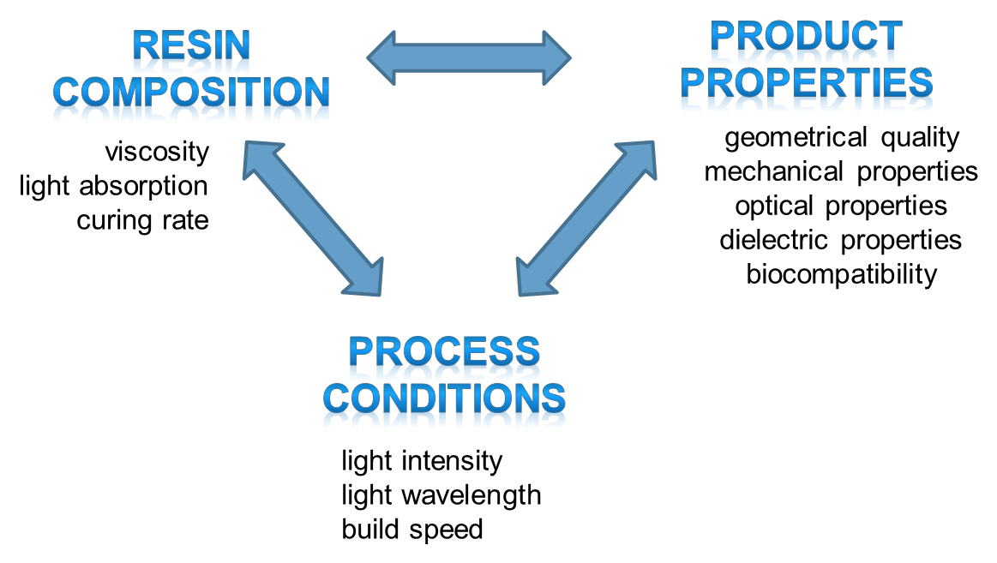
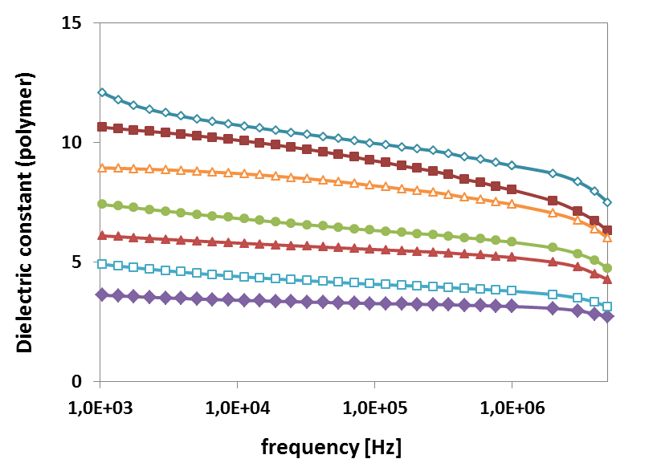
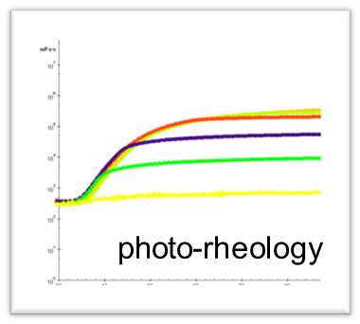
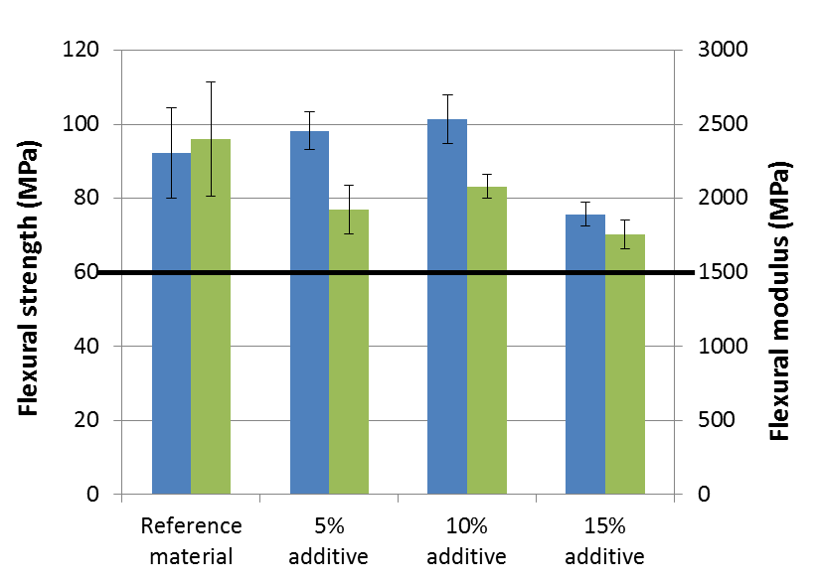
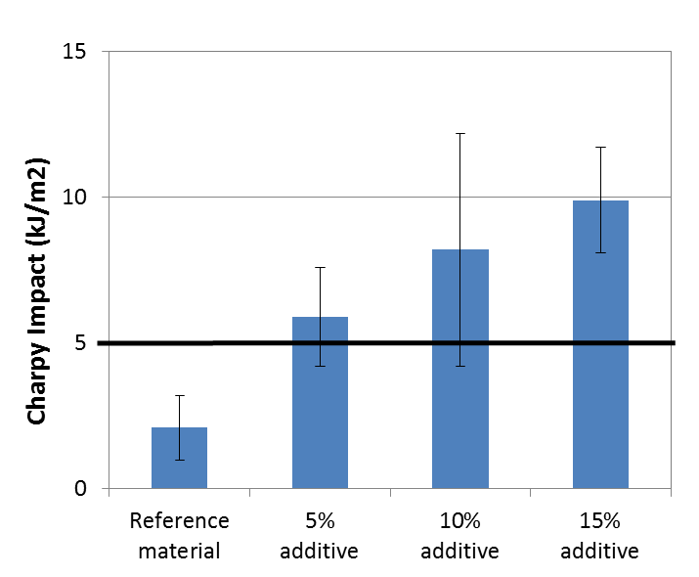
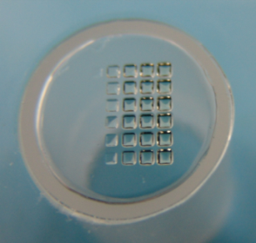
Technology: MATERIAL DEVelopment
Developing photocurable materials with improved functionality
Supported by advanced characterization & screening methods
Example: tuning dielectric properties
Example: materials with improved impact strength

Slide 18
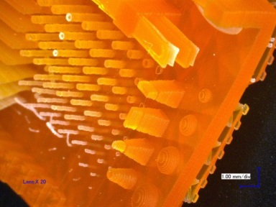


Technology: HIGH resolution printing
Optimizing material and process conditions for high resolution DLP printing
New AM machine concept for large-size, high-resolution (20 μm) and high-speed (scan speed 100 mm/s, 10 s per layer) additive manufacturing
New exposure module based on multiple array of laser sources
Example: microfluidics
500 µm mixing channels
200 µm bridging channels

Slide 19




Technology: MULTIMATerial deposition
Exploring possibilities for high-resolution multimaterial processing
Minimizing post-processing needs
Example applications:
  Embedded electronics
  Metamaterials
  Multicolor prostheses
Notes:
Metal tracks in polymer, antenna. Gratings? Not yet. Now 10-20 micron. Need nanometers 5-10 years….
New tech is faster iphones

Slide 20


Technology: Hybrid integration
Concepts for high-throughput, continuous 3D printing
Combining additive & subtractive technologies, pick & place component integration
In-line inspection and post-processing
Notes:
Proto machine by tno for difft materials – carosel - patented

Slide 21






Two ecosystems in close collaboration
Focus: high speed multi-material and mass-customization AM
Activities: development of next generation AM systems, to enable multi-technology and mass-customization
Expertise: ICT and data path architecture, system engineering and prototyping of new equipment concepts, testing equipment, process modelling and integration.
Focus: functional AM materials
Activities: development of materials with improved quality and durability and incorporating new functionalities
Expertise: new chemical concepts, multi-scale materials modelling, characterization methods, process integration
Application-drive R&D supported by basic academic knowledge
with industrial partners
with industrial partners

Slide 22

Technological innovations are application driven
Healthcare
  Dental crowns and bridges – multi-material, multi-colour
  Implants – multi-material implants
  Biocompatible materials
Embedded / free-form electronics
  Integrated sensors in lightweight structures
  Conductive and isolating materials
  Increased functionality
Automotive
  Strong lightweight structures
  Temperature resistant materials
  High durability materials

Slide 23
Open innovation contracts and intellectual property
Specified by
Usage rights
Bilateral Research Project
Dedicated
Research
Shared Research
Single participant /
consortium
e.g.: exclusive in a domain / period
[Full cost]
Program Foreground:
Non-exclusive;
co-ownership if
co-invented
[Participation Fee]
Program Background:
Non-exclusive, as needed to exploit Foreground
[Entrance Fee]
Brightlands Materials Center and ‘Systems for AM’ program participants
Program Background

Slide 24
Open innovation contracts
Costs are structured based on participation level and type of each partner
Program | Benefits | IP Arrangement | Notes
‘Systems for Additive Manufacturing’ | Ecosystem developed around applications 3 PhD projects tailored to program Additional program funding for better budget ROI. | Shared Research IP Agreement | Background remains with original owner. Co-developed IP is shared non-exclusively with all partners involved. See Table on next slide for specific description.
Brightlands Materials Center AM Program | Ecosystem developed around applications 8 PhD projects tailored to program Additional program funding for better budget ROI. | Shared Research IP Agreement | Background remains with original owner. Co-developed IP is shared non-exclusively with all partners involved. See Table on next slide for specific description.

Slide 25
Open innovation Intellectual property
Background
Results
Non-Generic **
Generic **
TNO Research
Company
Company
Other
Participant
Company
Contributed
Non-
Contributed
Improve Company provided background
Improve Other Participant provided background
Intellectual contribution by Industrial Resident
Intellectual contribution not by Industrial Resident
Company
License *
Entrance Fee
Ownership
Ownership
No License
Co-Ownership
License *
Participation Fee
TNO
Ownership
No License
License *
outside business domain
License *
outside business domain
Co-Ownership
Ownership
Other Participant
Purchase / License
Purchase / License
* All licenses are non-exclusive and may be restricted by domain in relation to entrance fee or participation fee as noted.
** Includes improvements to equipment, materials, processes or software

Slide 26
Dedicated exclusive contracts
Costs are structured based on participation level and type of each partner
Program | Benefits | IP Arrangement | Notes
‘Systems for Additive Manufacturing’ | Dedicated research goals and deliverables tailored to company Exclusive IP rights Faster results with potential to join programs at end of project | Exclusive IP based on TNO standard Terms and Conditions | 2-Year Confidentiality Background remains at origin. Foreground is owned by developing party. See PDF Terms and Conditions for more info.
Brightlands Materials Center AM Program | Dedicated research goals and deliverables tailored to company Exclusive IP rights Faster results with potential to join programs at end of project | Exclusive IP based on TNO standard Terms and Conditions | 2-Year Confidentiality Background remains at origin. Foreground is owned by developing party. See PDF Terms and Conditions for more info.

Slide 27
Summary of conditions
Program members will have a non-exclusive right to use within the agreed application business domains all results created by TNO in the shared research programs.
Joining of partial or all programs by select working groups is possible.
Program member will become co-owner of results created together with TNO.
Program member has the option to bring in ‘industrial residents’ in our team on part-time or full-time basis.
Background intellectual property (and other Industrial Participants) is by default not affected.
Additionally, dedicated and/or exclusive activities can be defined between program member and TNO that are specifically relevant to intended unique selling proposition, for instance activities regarding material development.

Slide 28

contact to learn more
Matthew Maniscalco
Business Developer
Space Science & Astronomy
Subject Area Lead:
Dr. Gregory Hayes
Business Developer and
Technical Program Manager
Additive Manufacturing
E: greg.hayes@tno.nl
Notes:
Tno has netwrking field lab org – give brochure
Metal printing with nlr – slms, learn make predict design.

