Slide 1

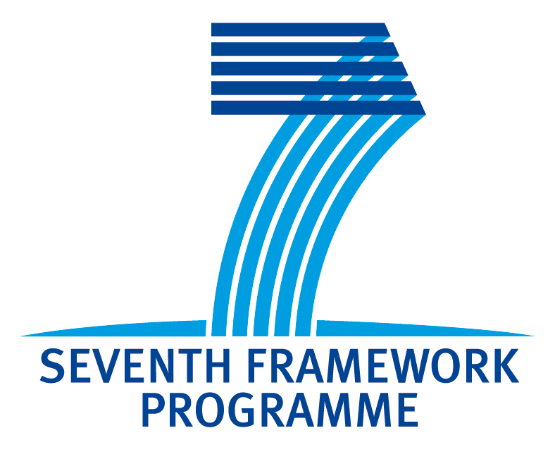




Ultrafast laser based 3D printing of photonic structures
Robert R. Thomson
Scottish Universities Physics Alliance (SUPA), Institute of Photonics and Quantum Sciences (IPaQS), Heriot-Watt University, Edinburgh, UK.

Slide 2
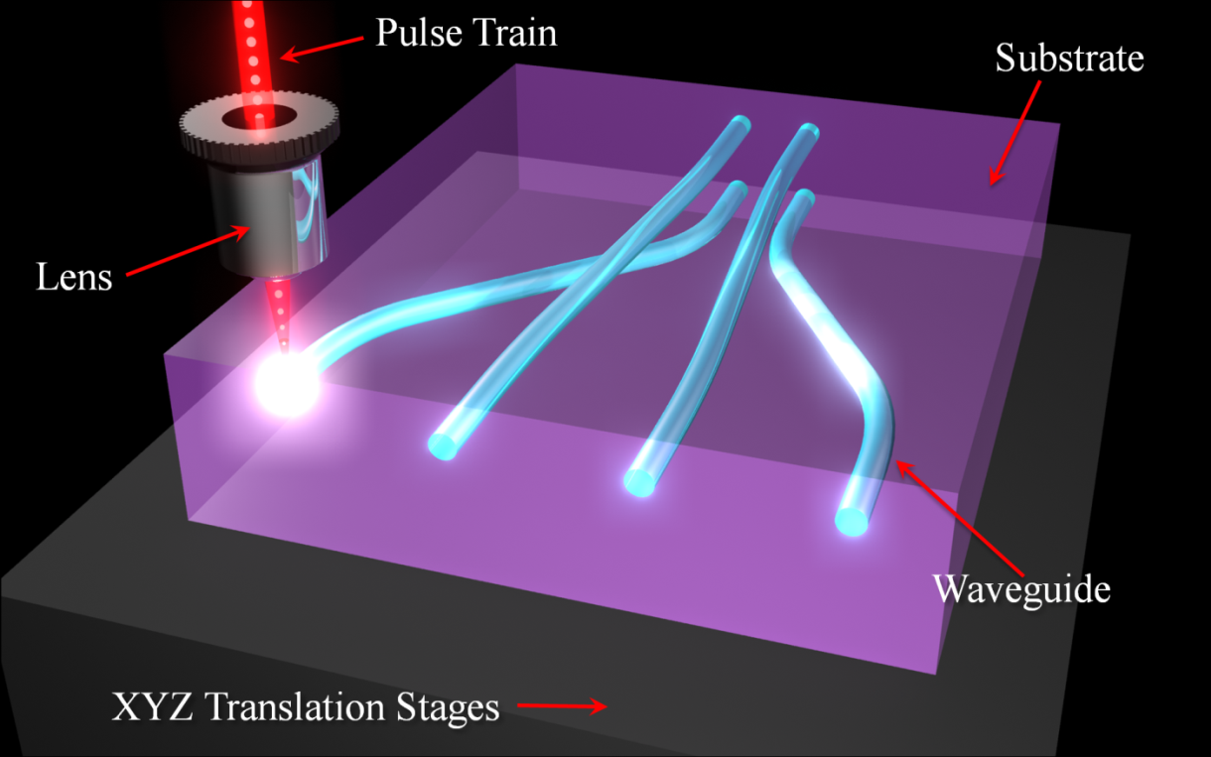
Ultrafast laser inscription (ULI)

Slide 3
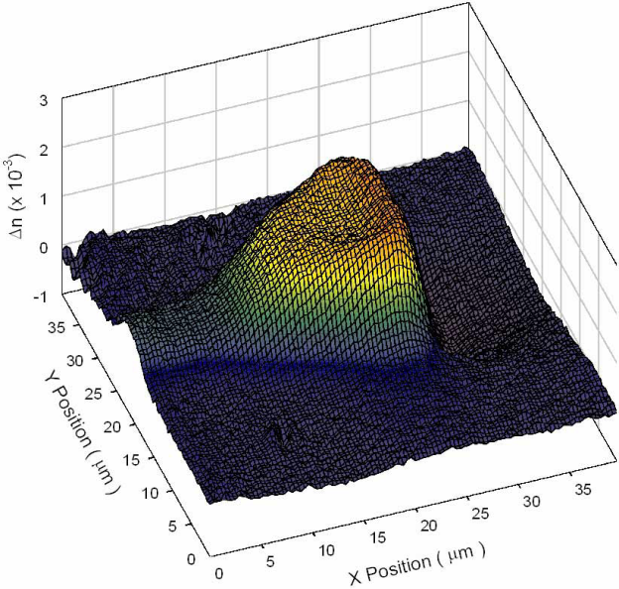
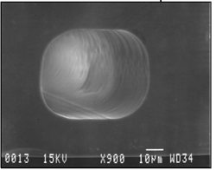
Ultrafast laser induced modifications
Little et. al., Opt. Express. 16, 20029 (2008)
Bellouard et. al., Opt. Express. 12, 2120 (2004)
Refractive index modification
Chemical etch-rate modification

Slide 4
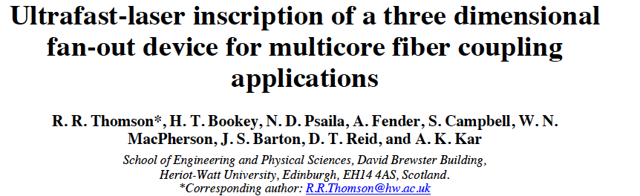
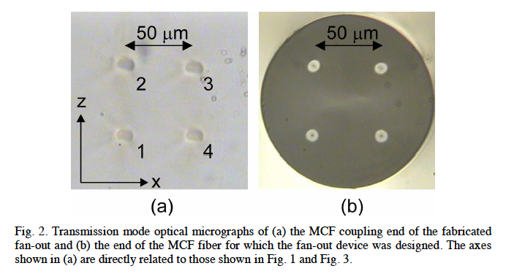
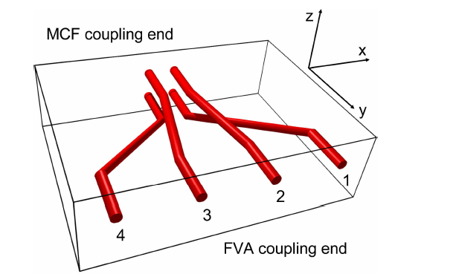
3D integrated waveguide fan-outs

Slide 5
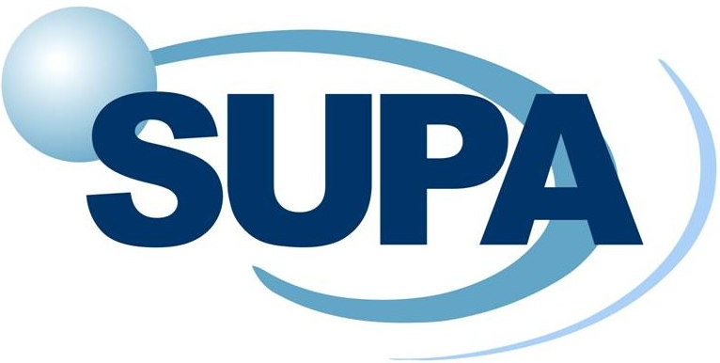
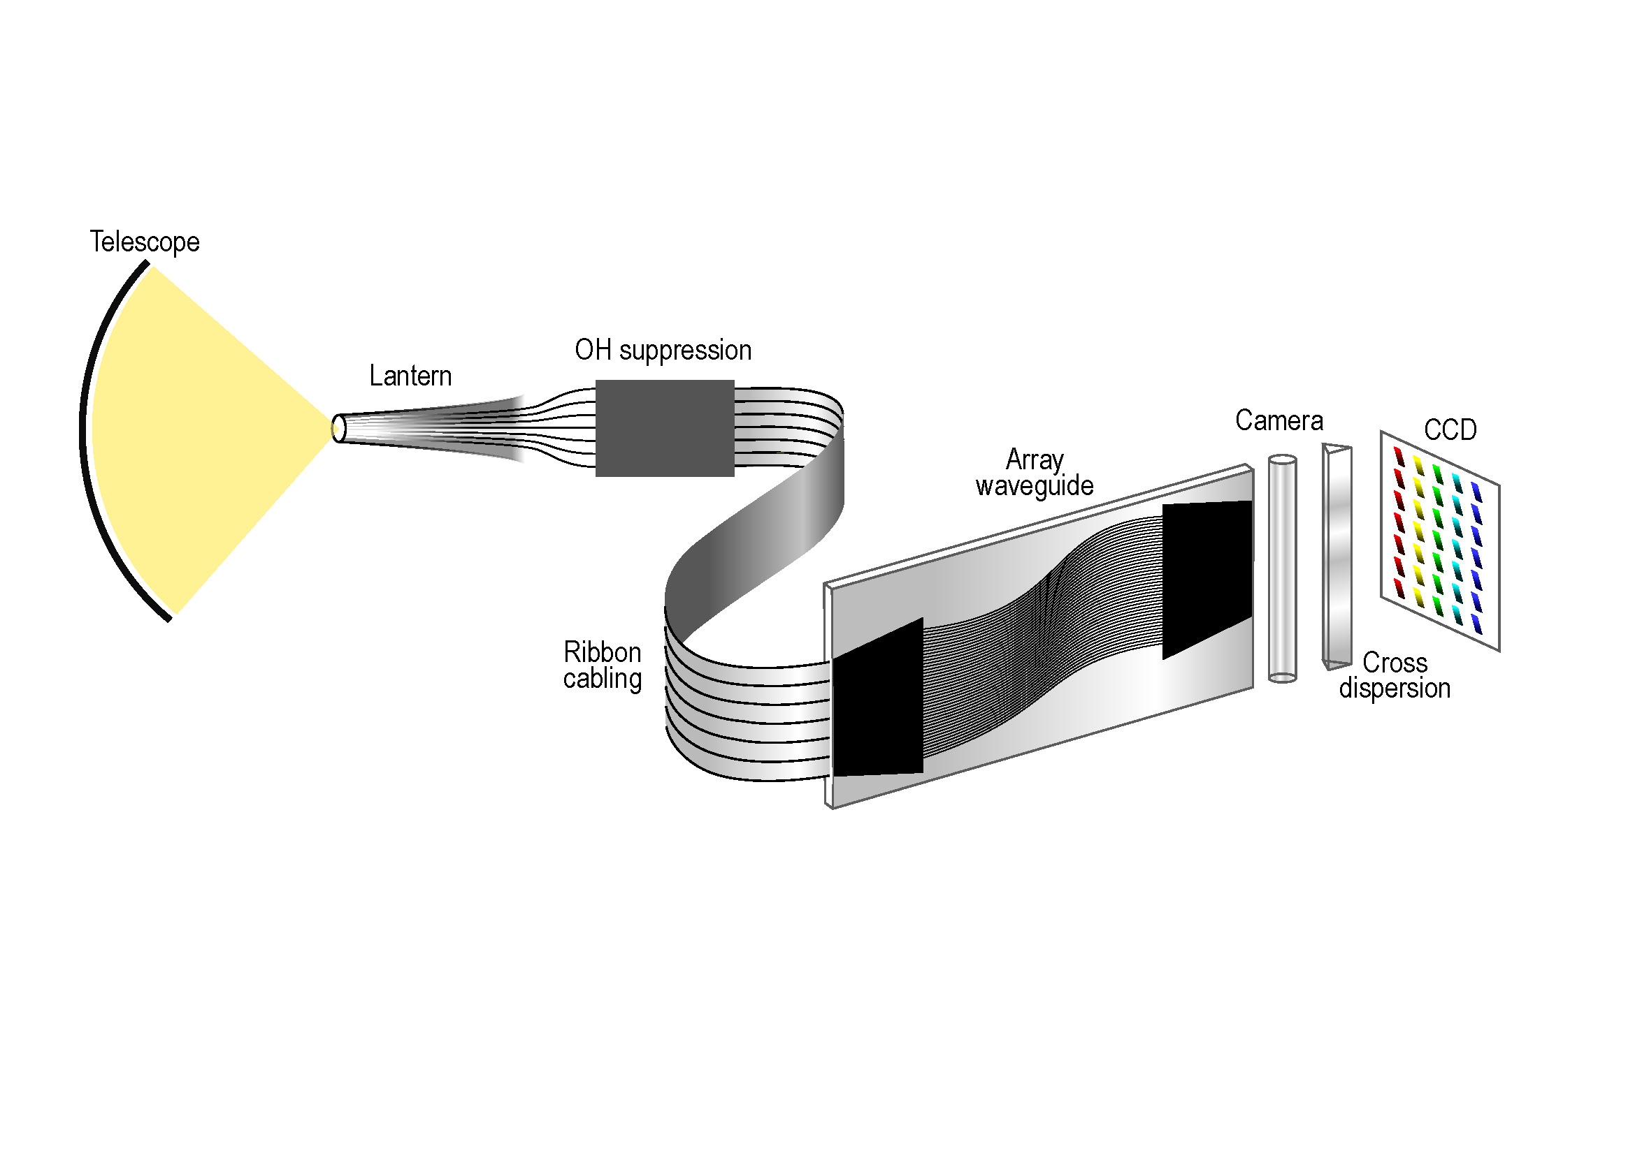
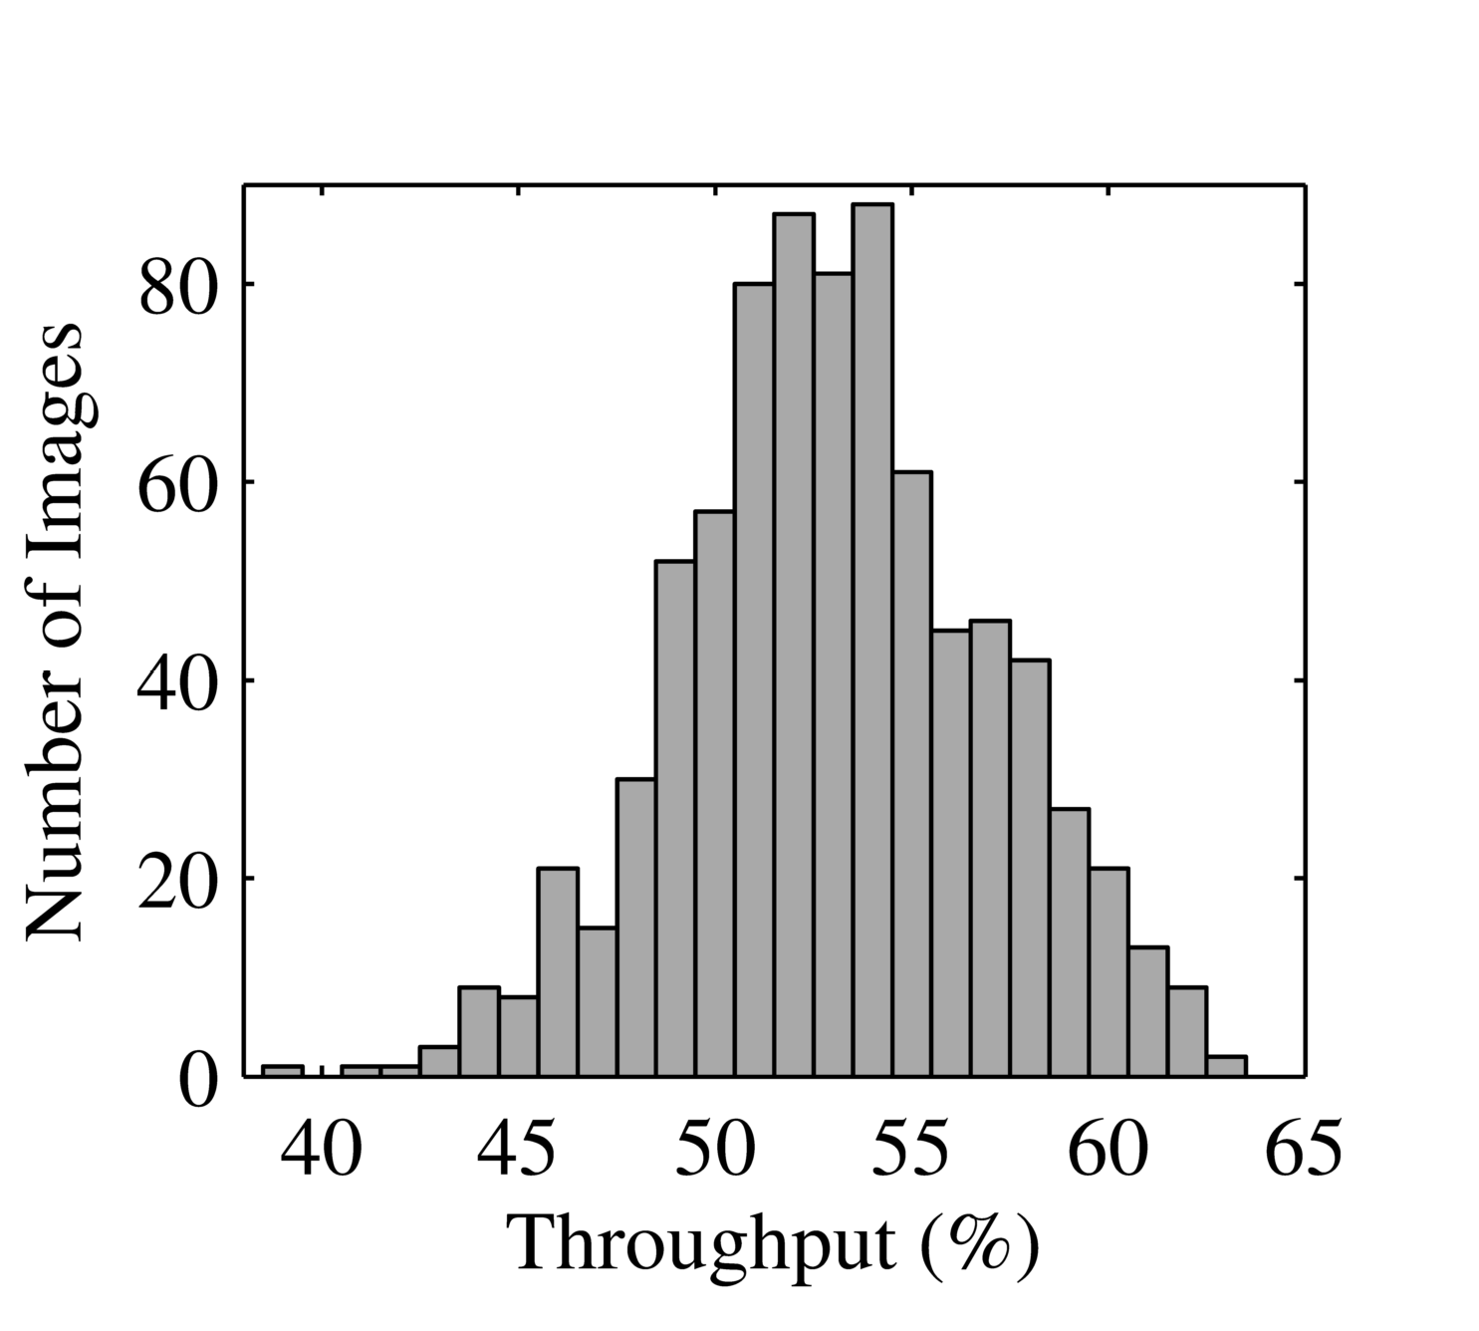
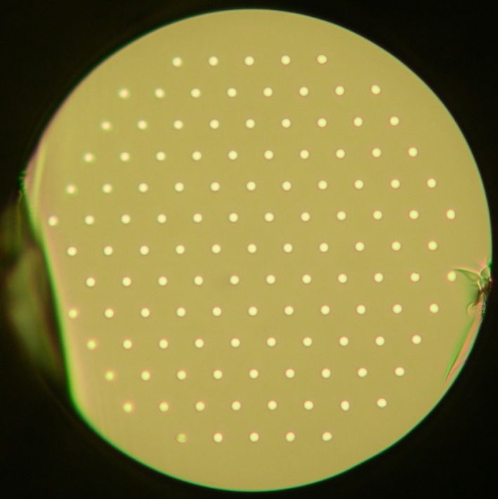
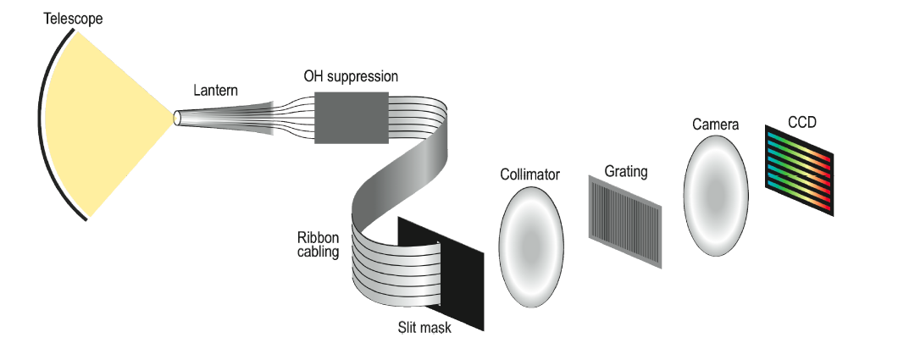
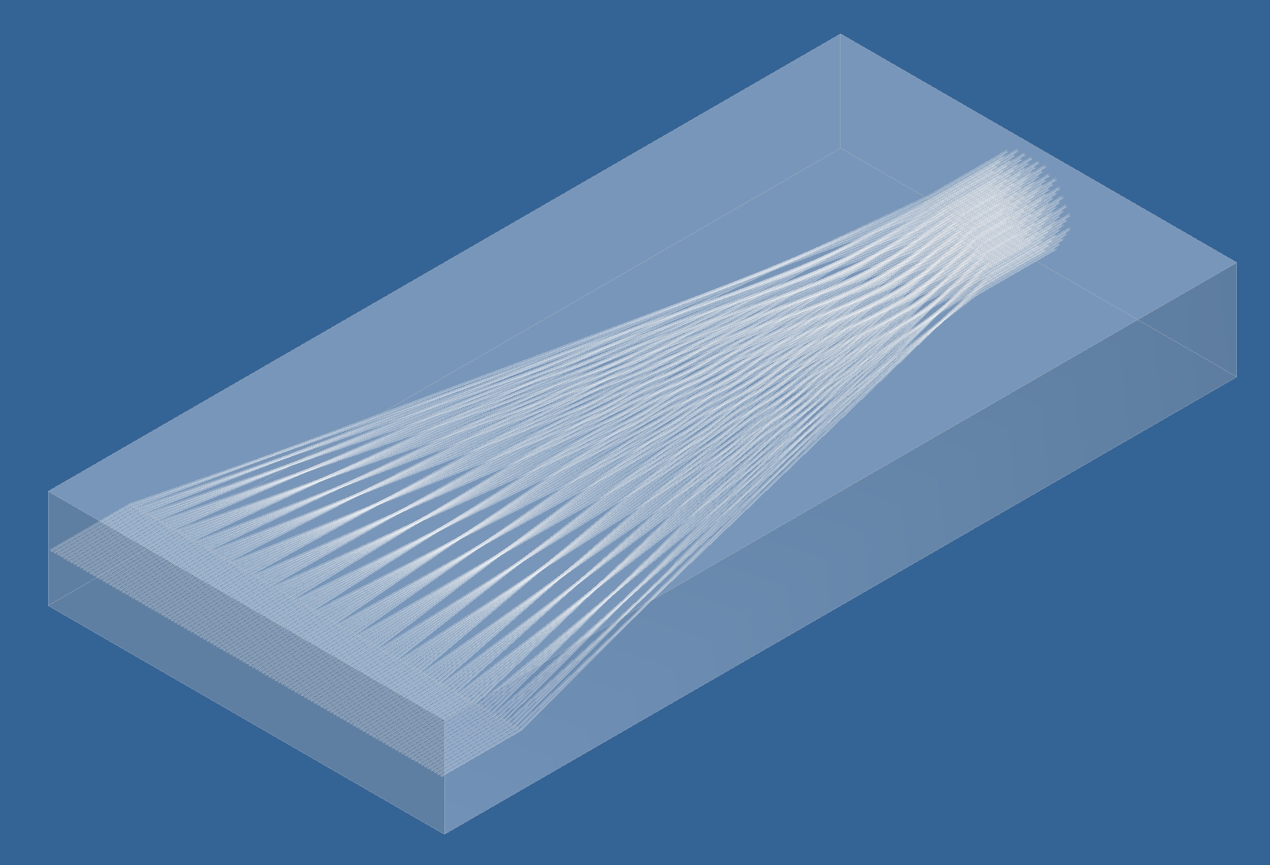
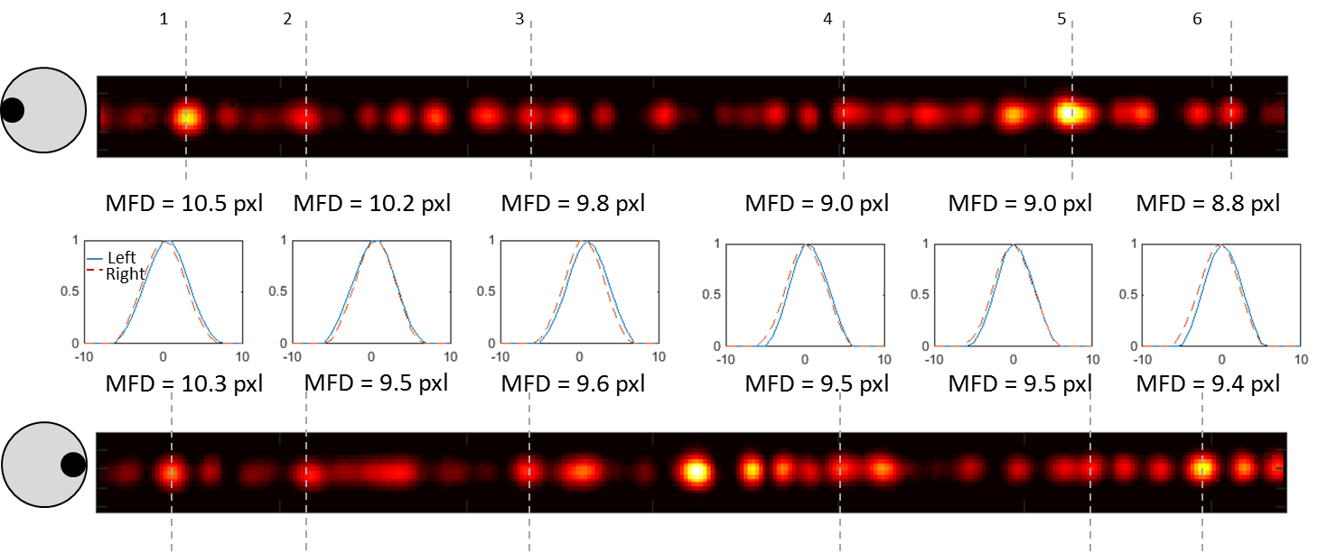
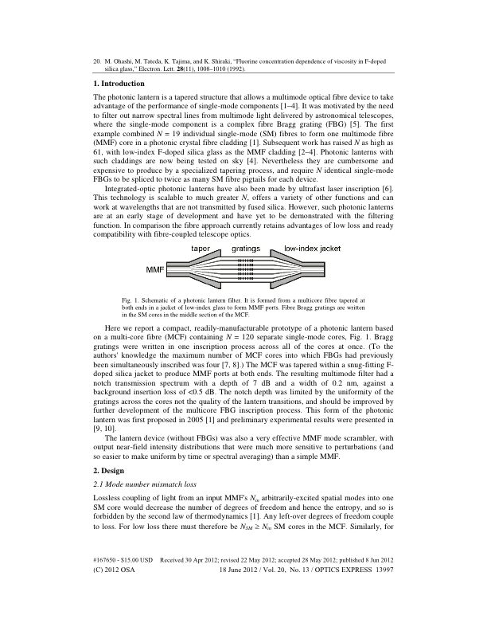
Photonic-enabled
precision spectrographs
Lab throughput ~ 70% for incoherent multimode light @ 1550 nm.
“Appears” not to induce modal noise.

Slide 6
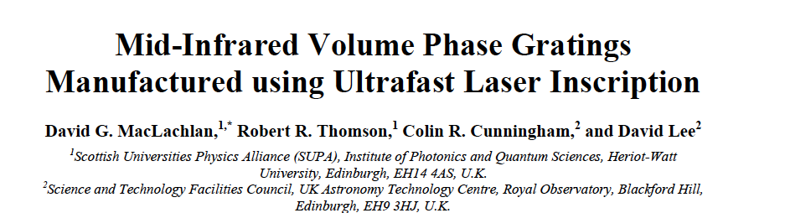
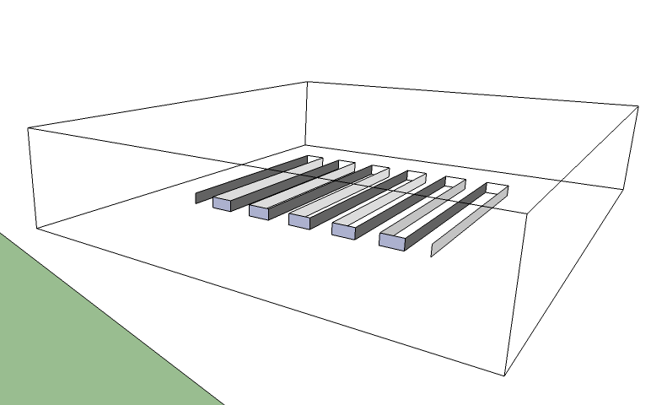
z
x
y

Slide 7
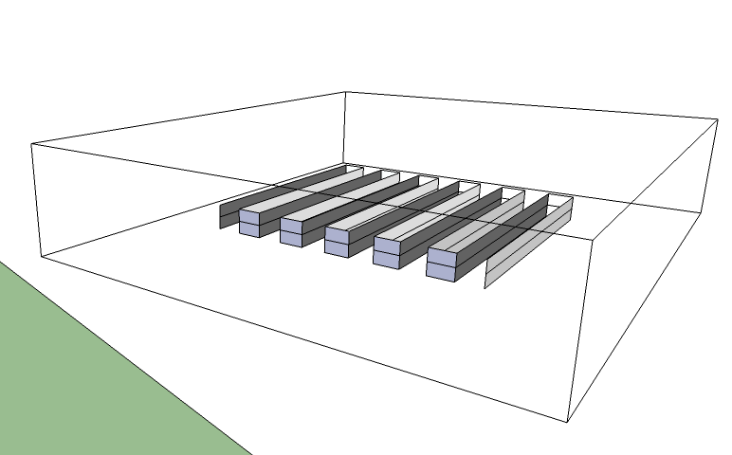
z
x
y

Slide 8
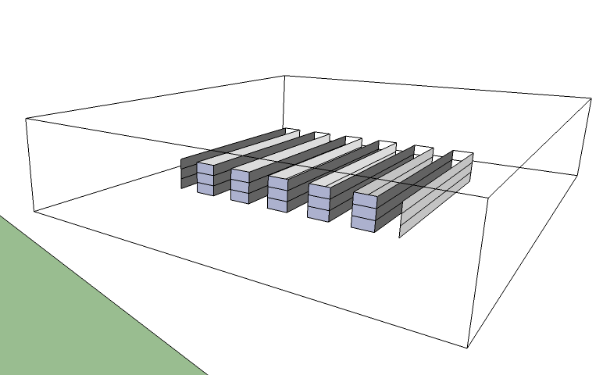
z
x
y

Slide 9
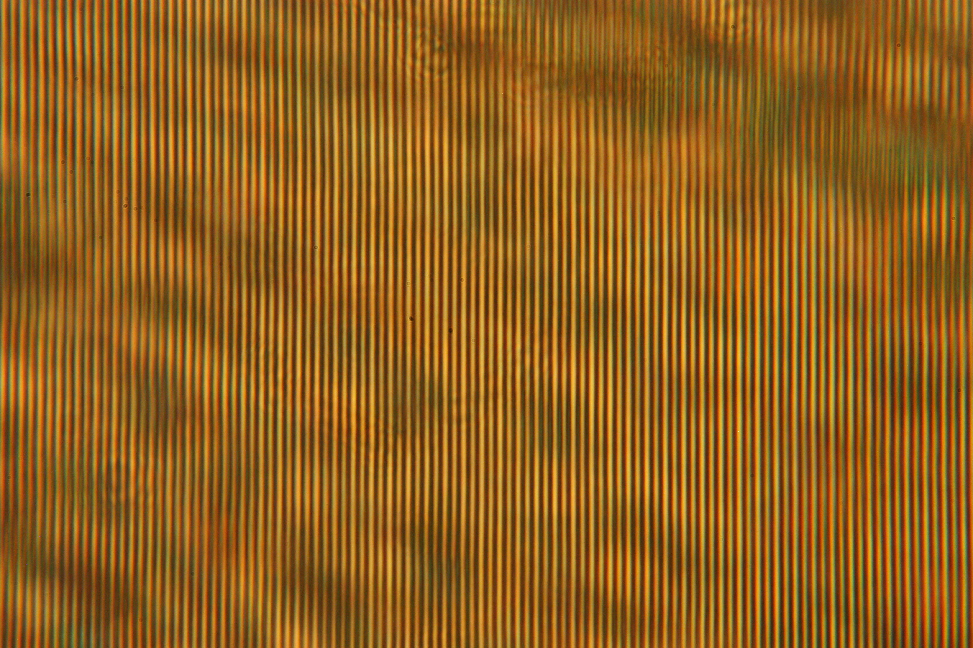
60 µm
Transmission mode microscope image through a ULI fabricated volume grating in gallium lanthanum sulphide chalcogenide glass.

Slide 10
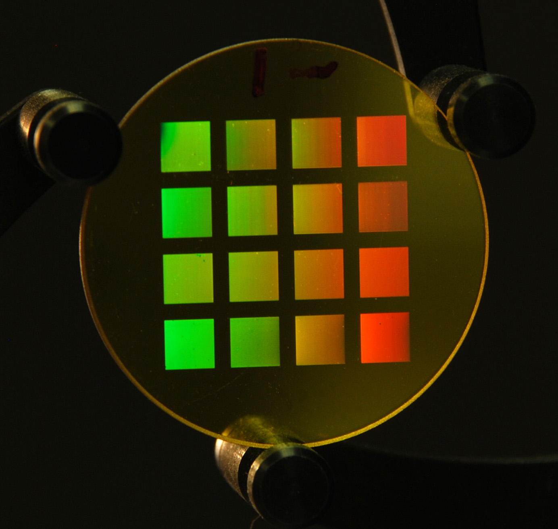
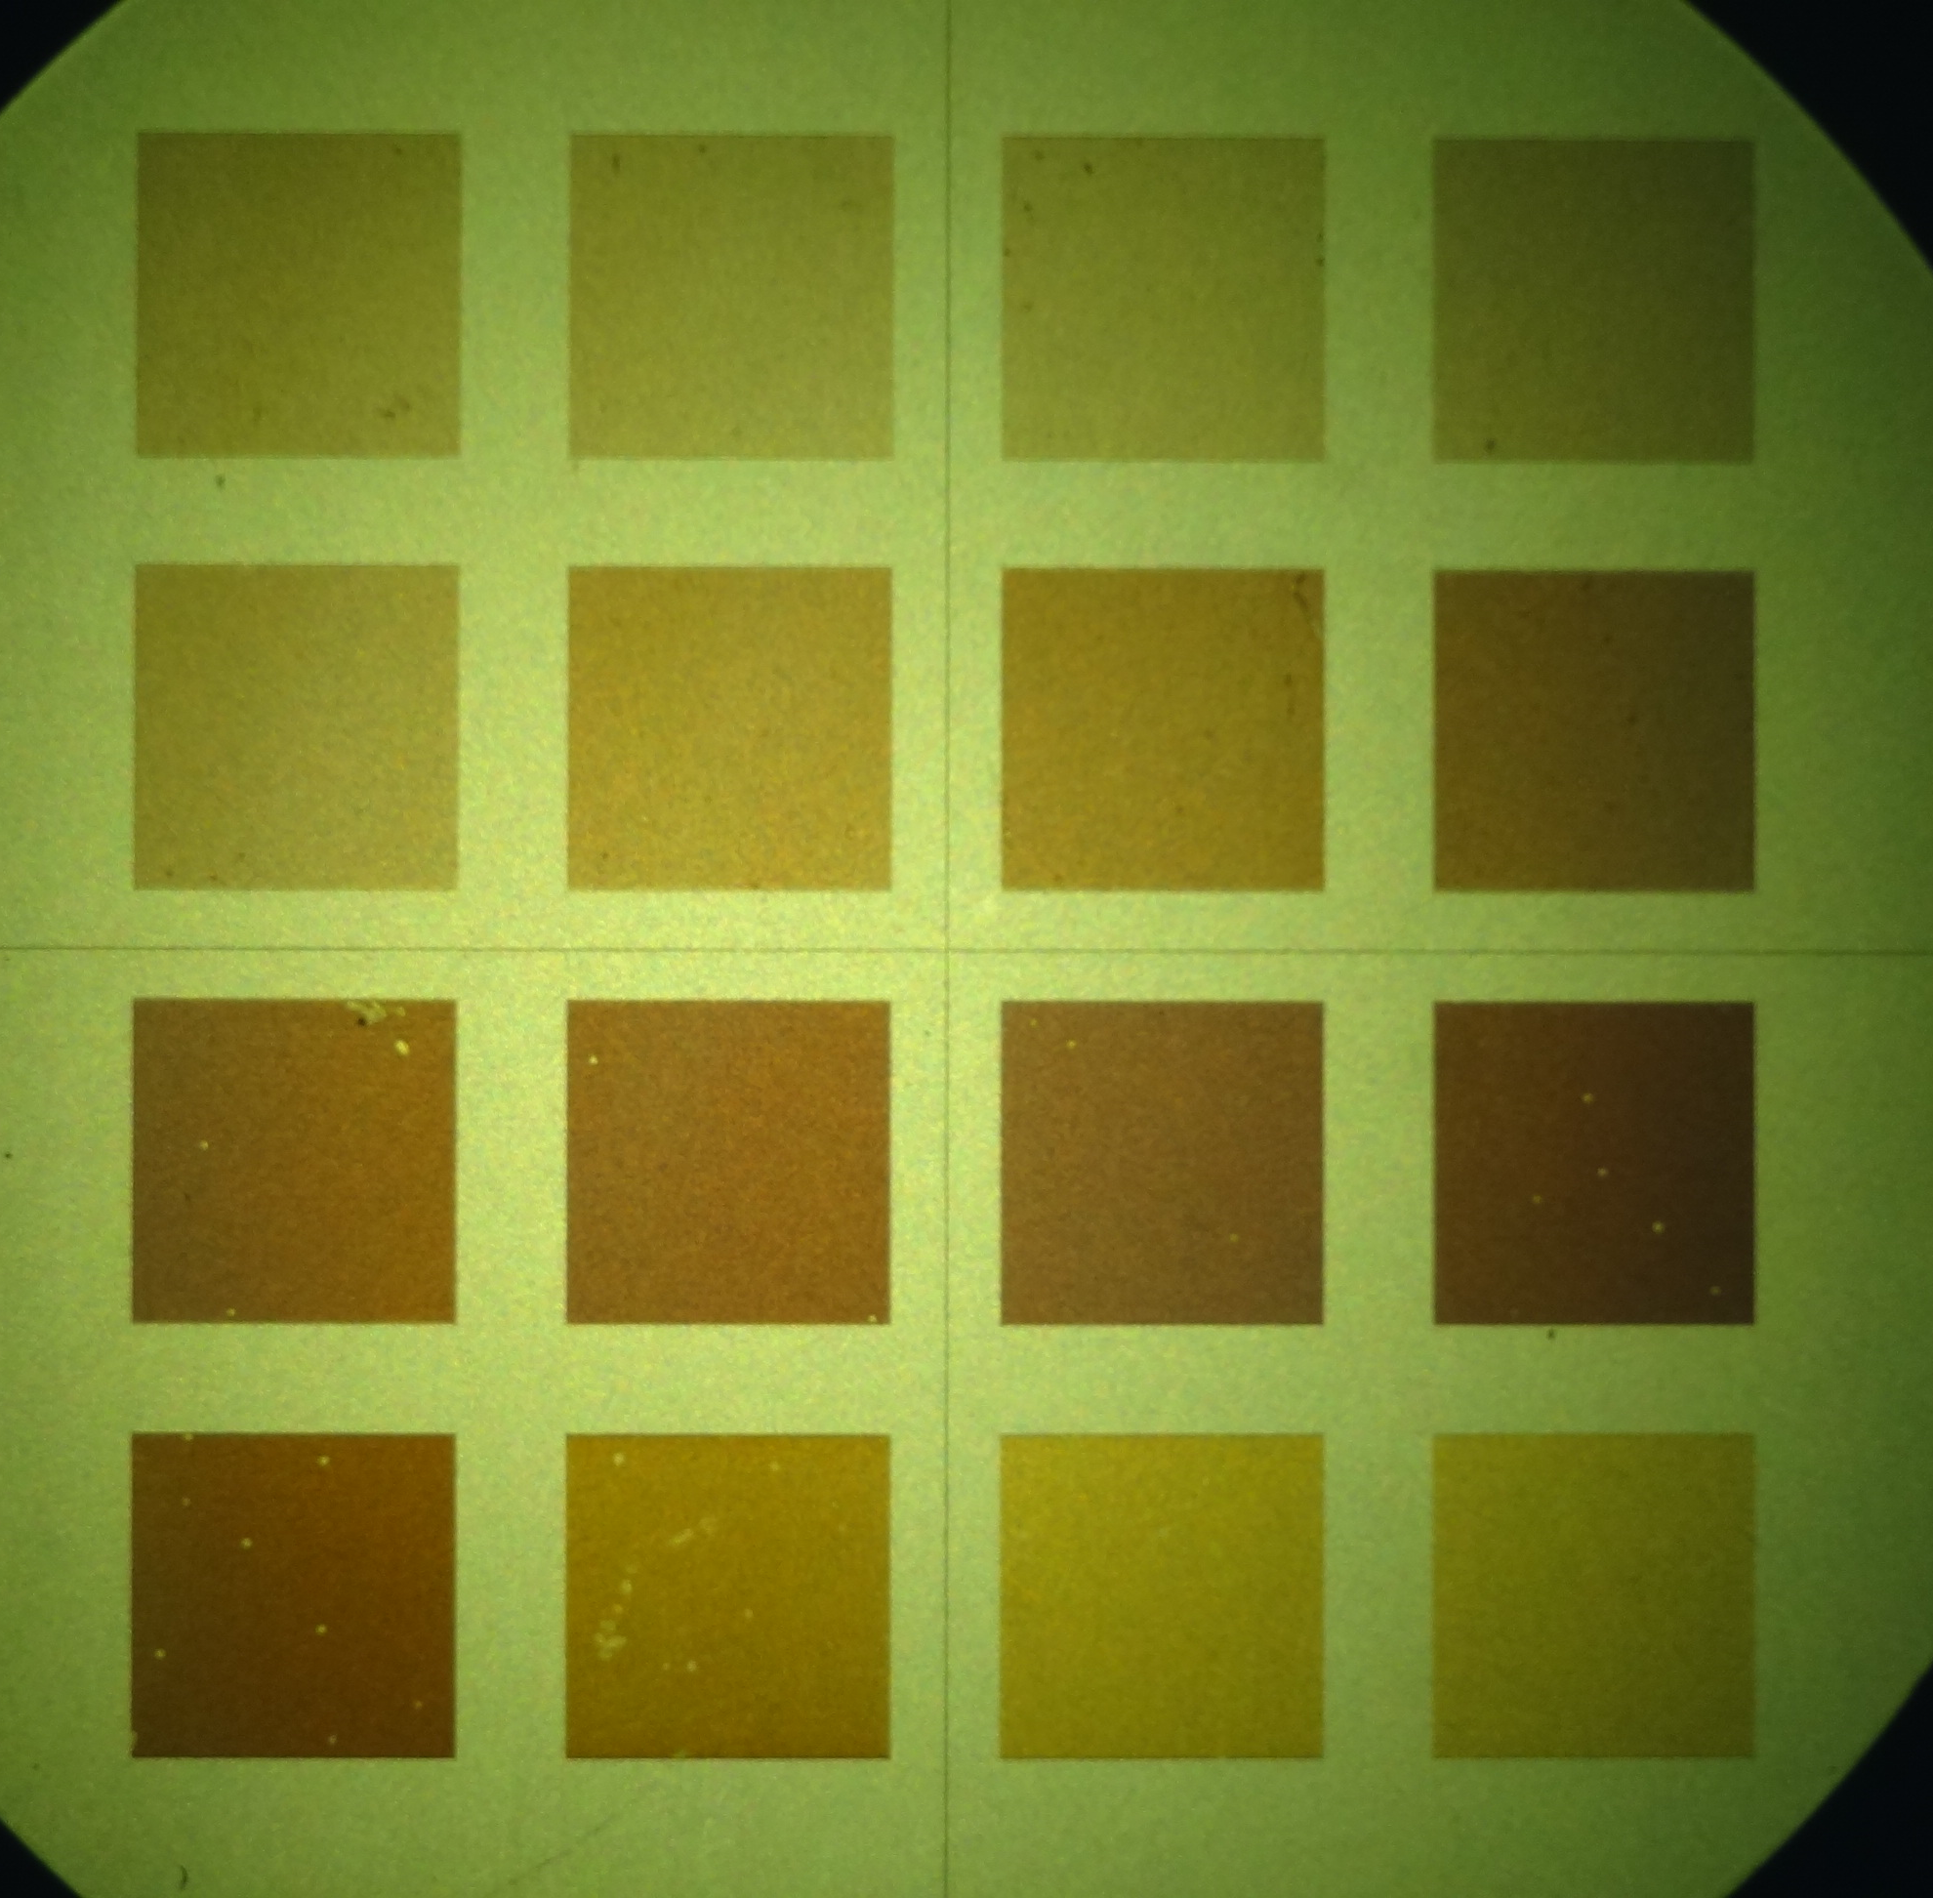
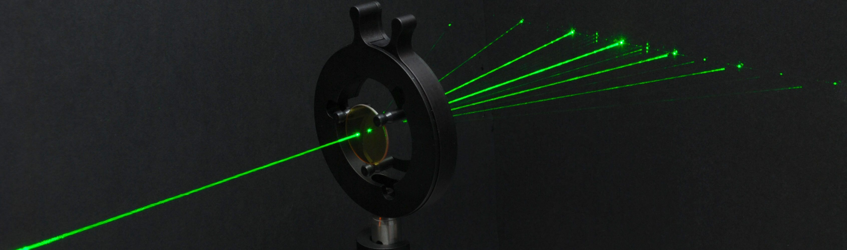

Slide 11
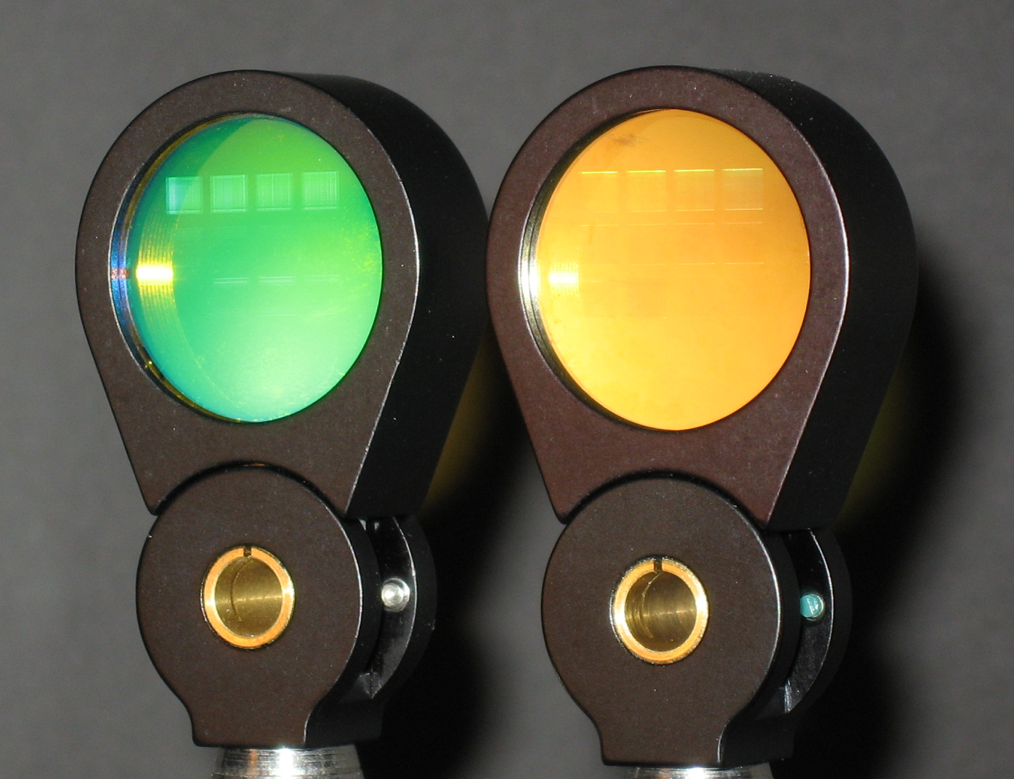
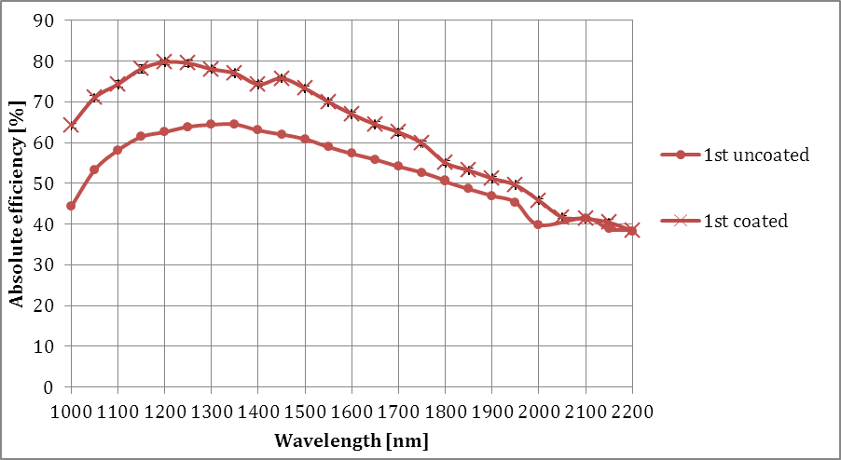
Anti-reflection coating GLS
Coated Uncoated
(b)

Slide 12
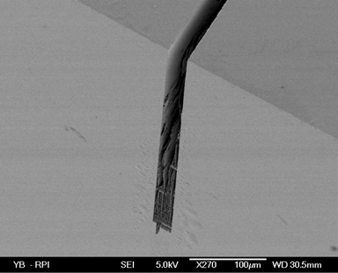
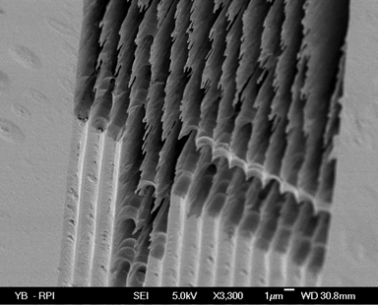
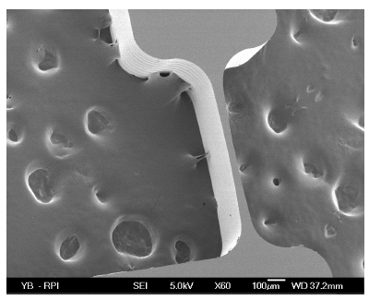
Ultrafast laser induced selective etching
High aspect ratio surface μ-channels
Sub-surface μ-channels
Bellouard et. al., Opt. Express. 12, 2120 (2004)
μ-mechanics
Bellouard et. al., Opt. Express. 12, 2120 (2004)
Bellouard et. al., Opt. Express. 13, 6635 (2005)

Slide 13
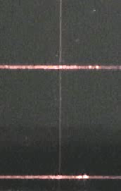
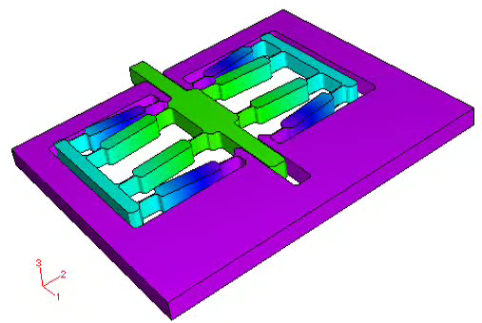
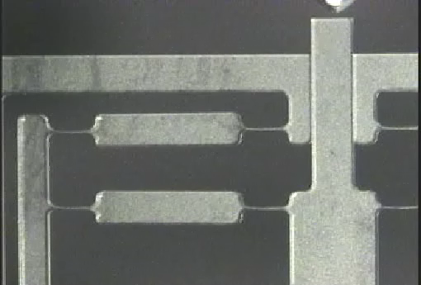
Yves Bellouard,
Opt. Express 13, 6635-6644 (2005)

Slide 14
Yves Bellouard,
Opt. Express 13, 6635-6644 (2005)

Slide 15
Yves Bellouard,
Opt. Express 13, 6635-6644 (2005)

Slide 16
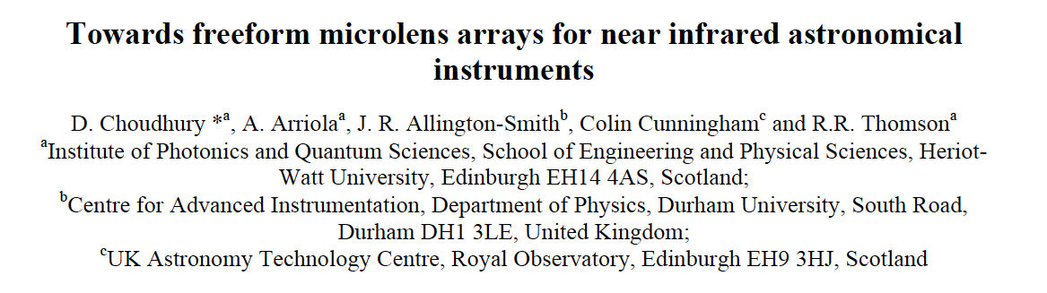
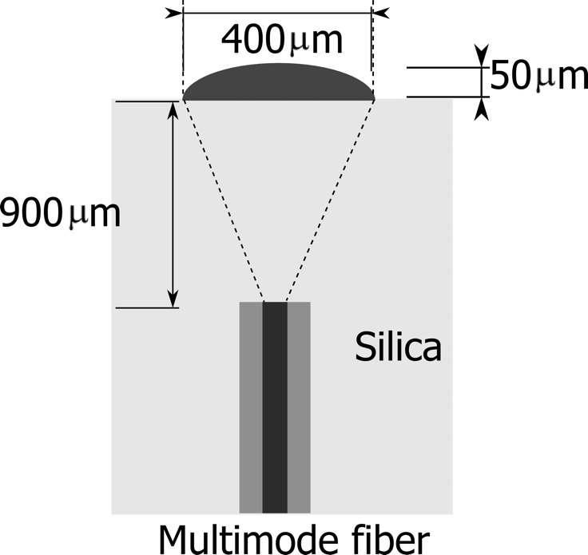
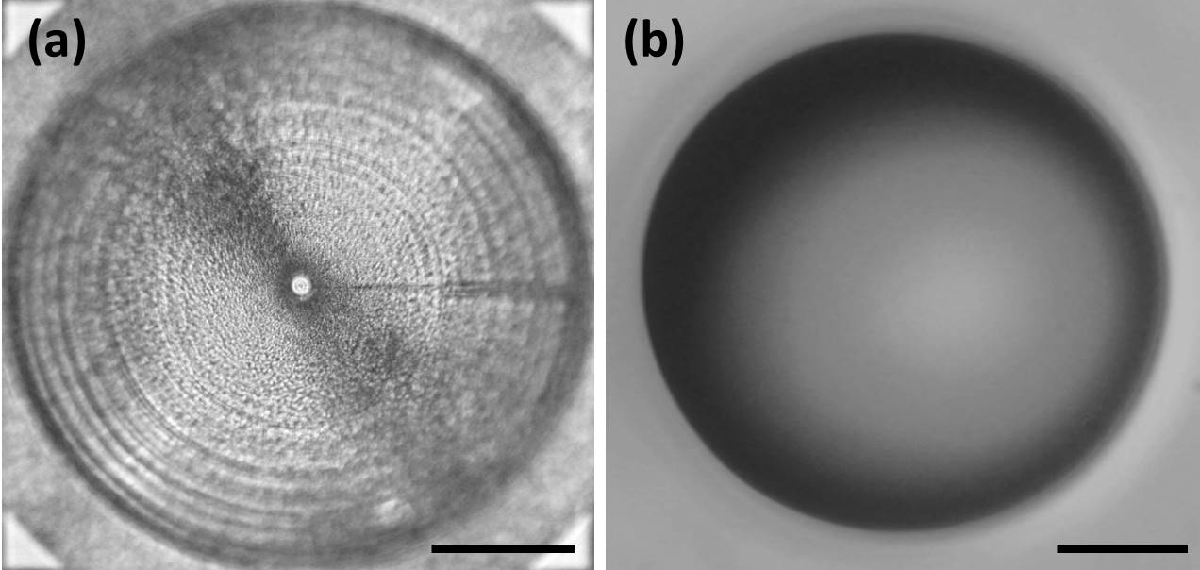

Slide 17
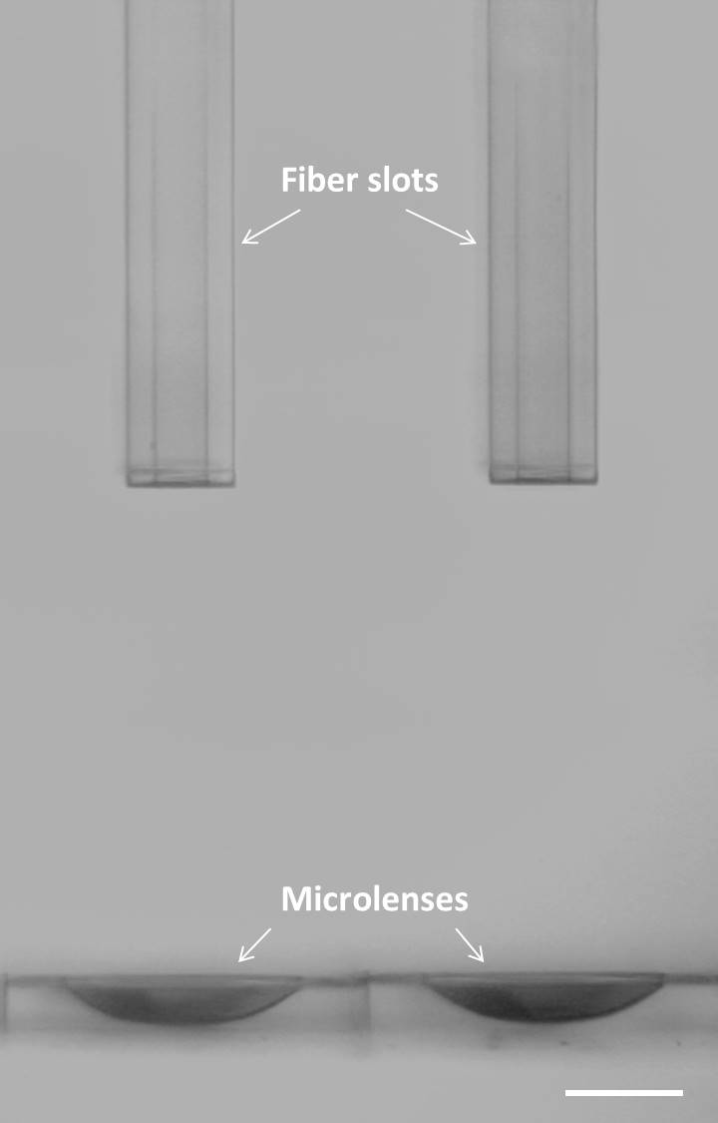

Slide 18
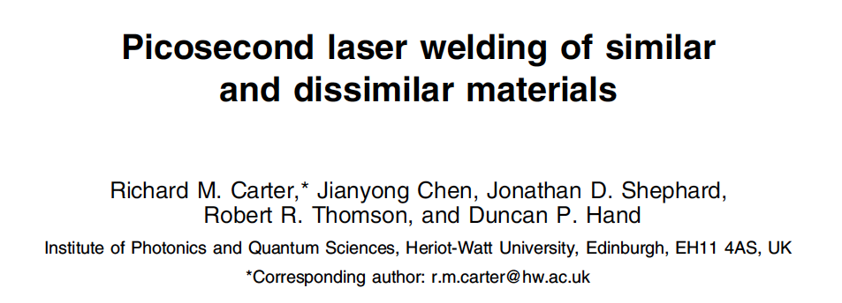
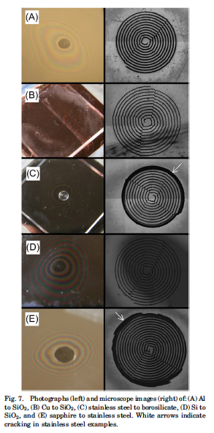
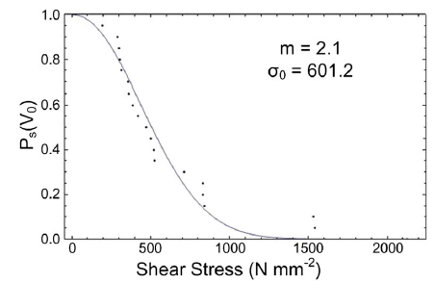
Weibull plot for borosilicate - borosilicate
90% and 99% survival stresses are ~200 N.mm⁻² and ~70 N.mm⁻²
Adhesives exhibit failure strengths of ∼10 to 20 N.mm^{−2.}

Slide 19
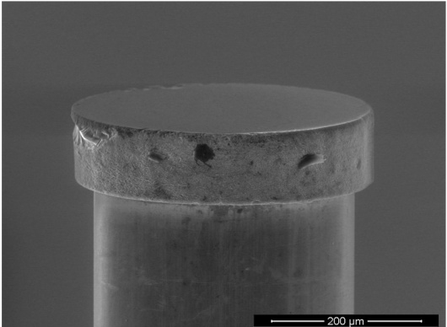
David Hélie et al, Opt. Mater. Express 3, 1742-1754 (2013)

Slide 20
Possible applications?
Freeform silica micro-optics (and possibly even macro-optics)
Freeform silica microlens IFU’s with PA slots for optical fibres
Freeform volume gratings (visible-to-mid-IR) - integrated into optics
Low-cost, high volume precision encoders for position sensing
Ultrafast laser welding of fibres to dielectrics and metals
(avoid issues with gluing e.g. cryogenics)
The case:
High risk / high reward research: enabling & potentially revolutionary
Excellent commercialisation and spin-out opportunities
Solution looking for problems: Now is the time to exploit the capabilities of ultrafast laser printing

