Slide 1
Vik Dhillon
Professor of Astrophysics at the University of Sheffield
& Visiting Researcher at the Instituto de Astrofisica de Canarias
I am a builder, and user, of astronomical instrumentation, primarily “Visitor Instruments”, which mount on large telescopes around the world (VLT, NTT, ESO 3.6m, WHT, GTC)
Most of the instruments I have built are high-speed, multi-beam optical imagers (ULTRACAM, ULTRASPEC, HiPERCAM)
I work in collaboration with the UKATC, and Iain Todd/James Hunt in the AM group at Sheffield

Slide 2
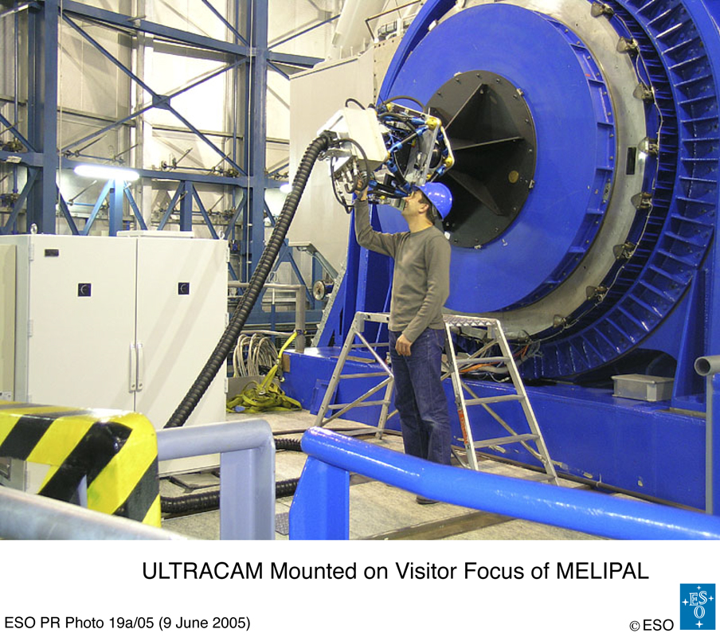
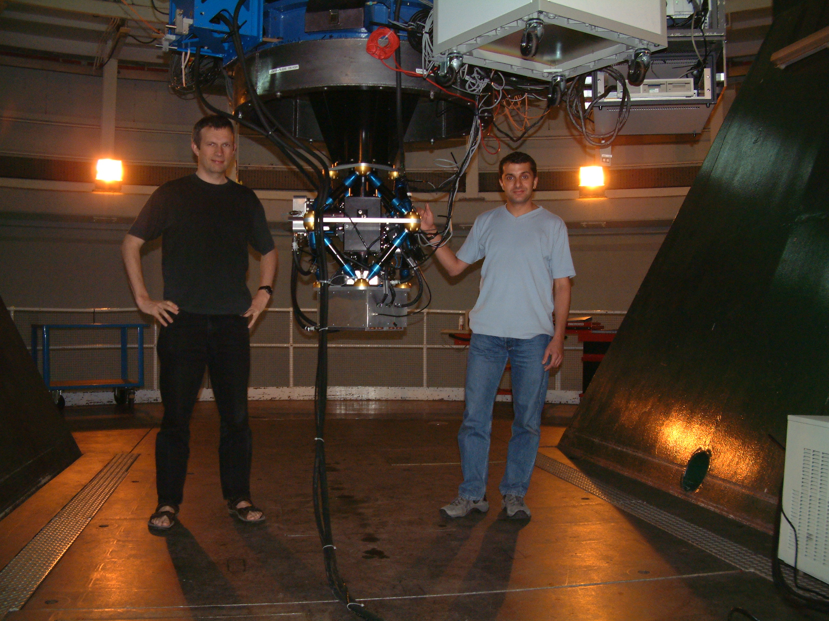
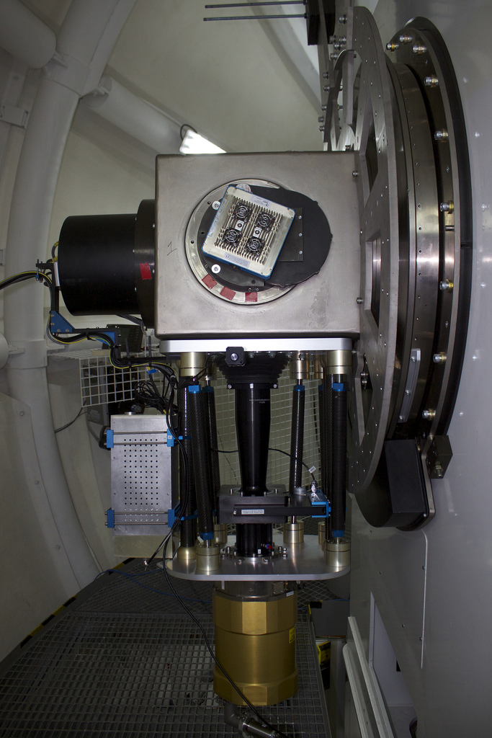
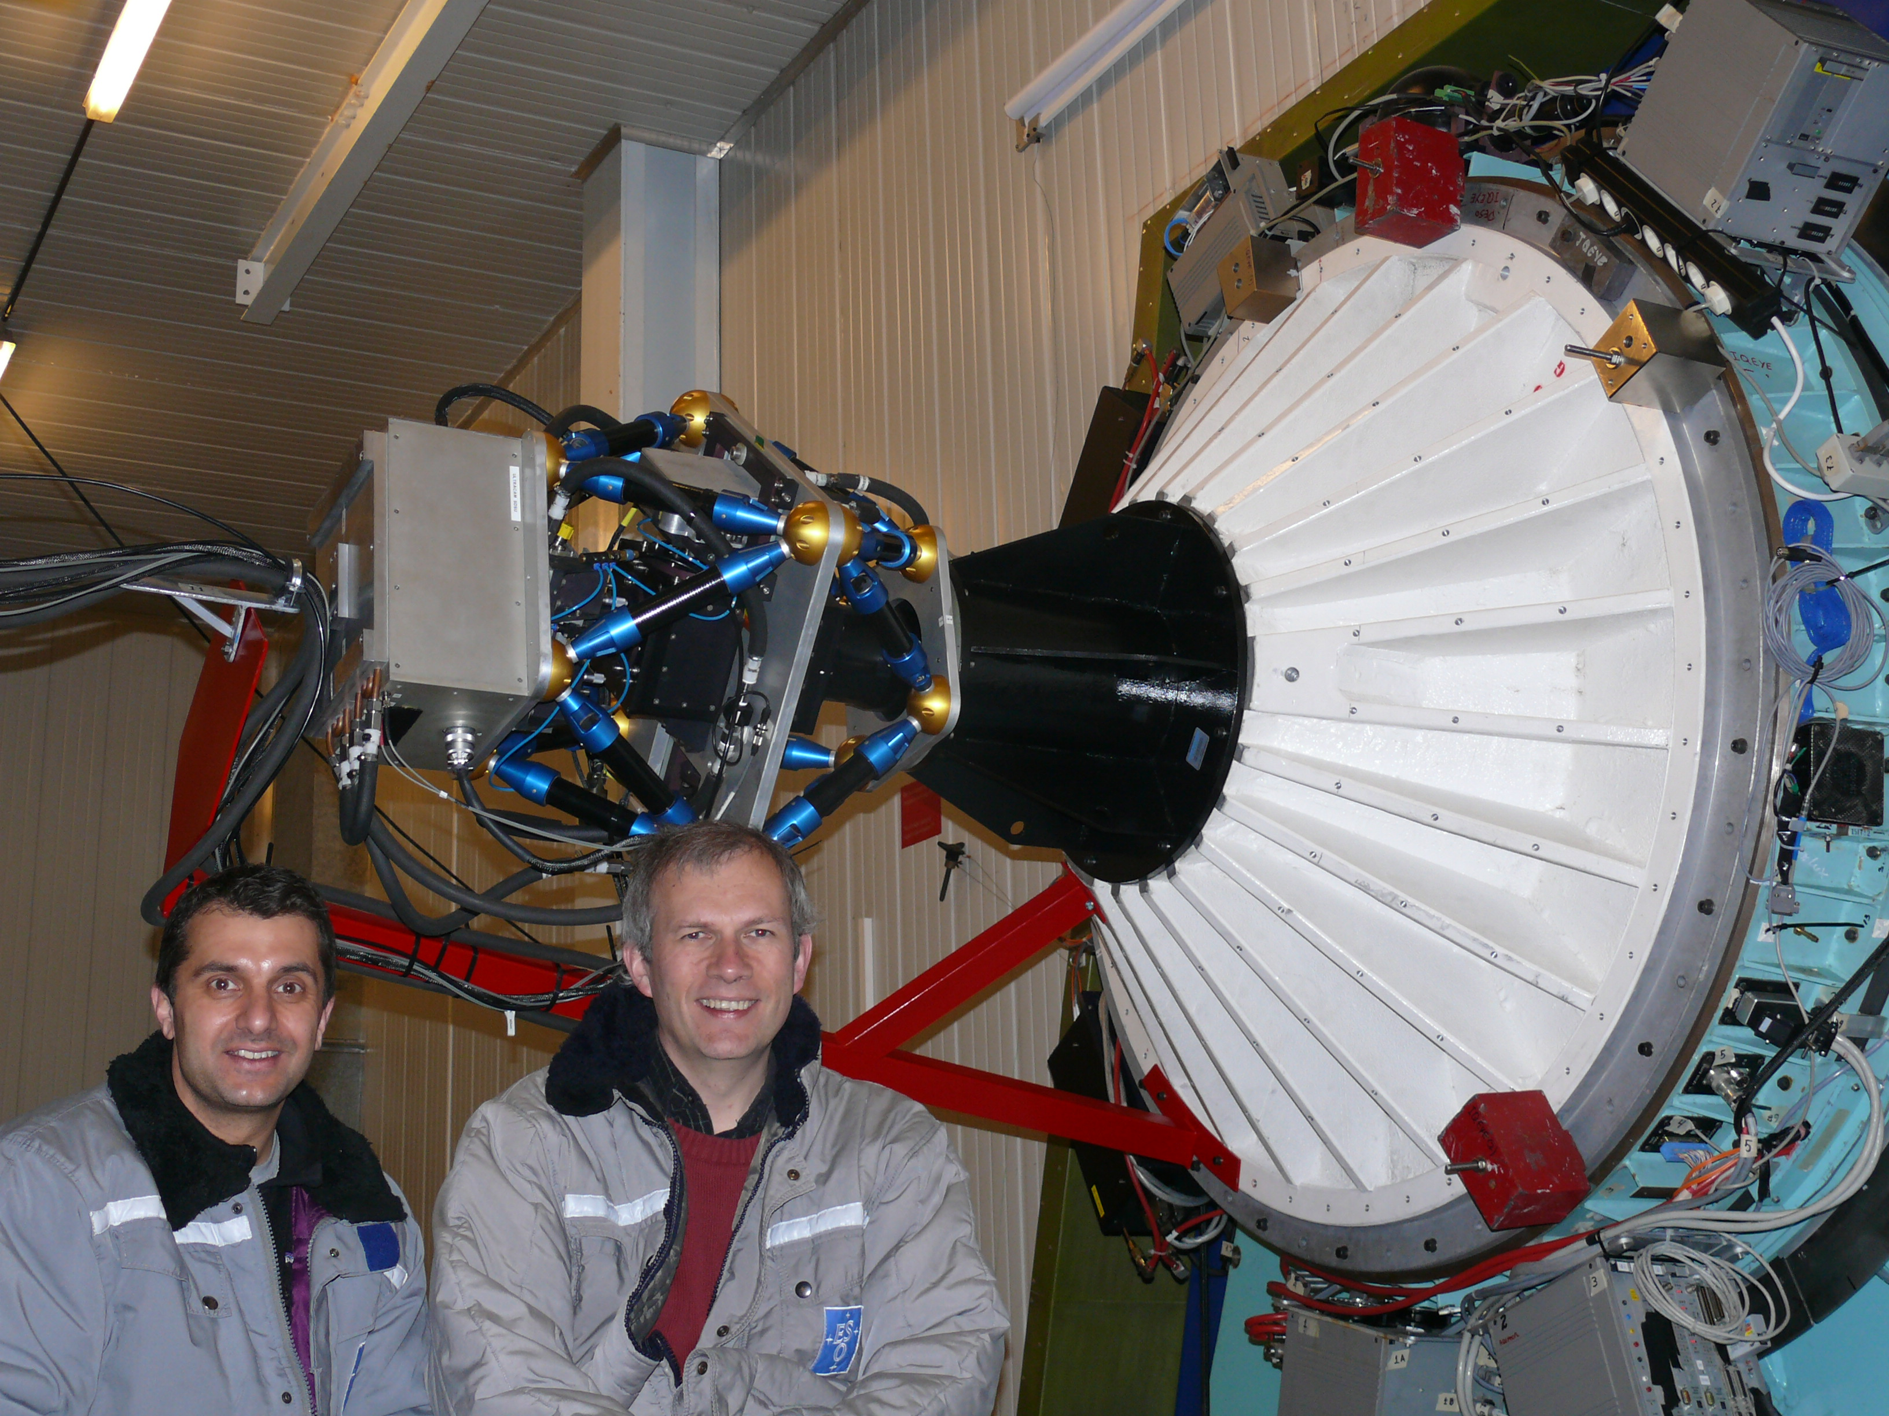
WHT
VLT
NTT
TNT

Slide 3
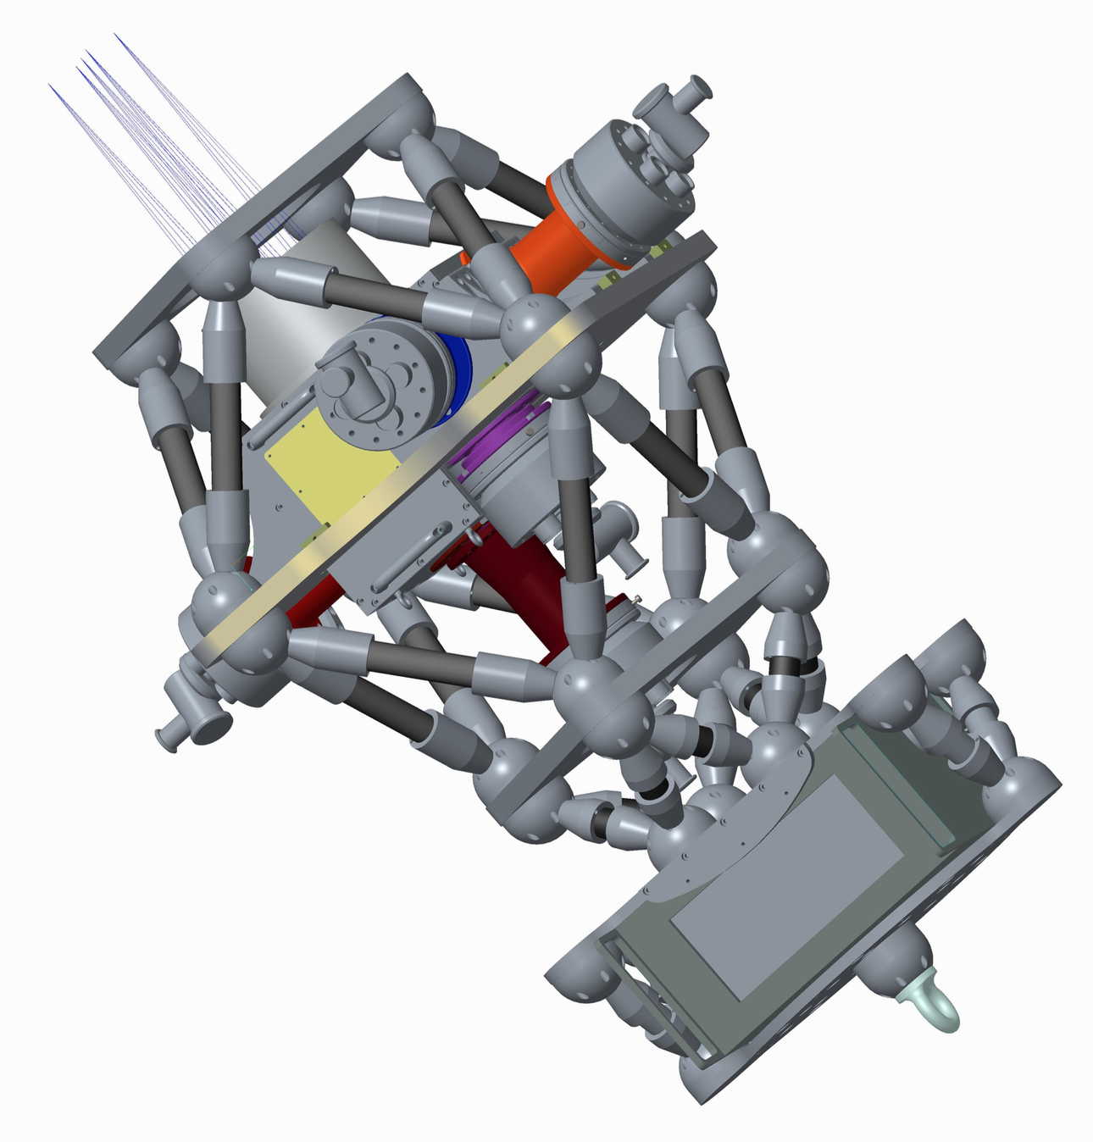
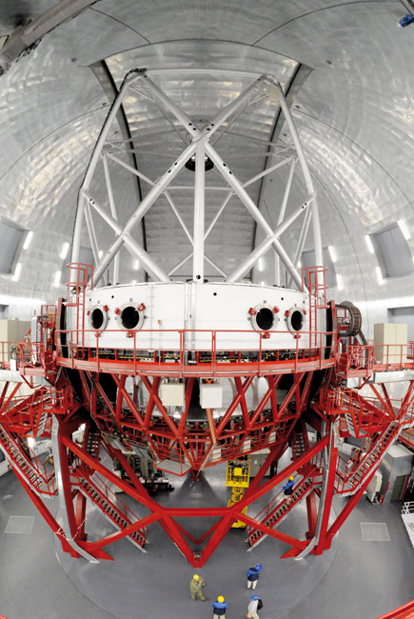
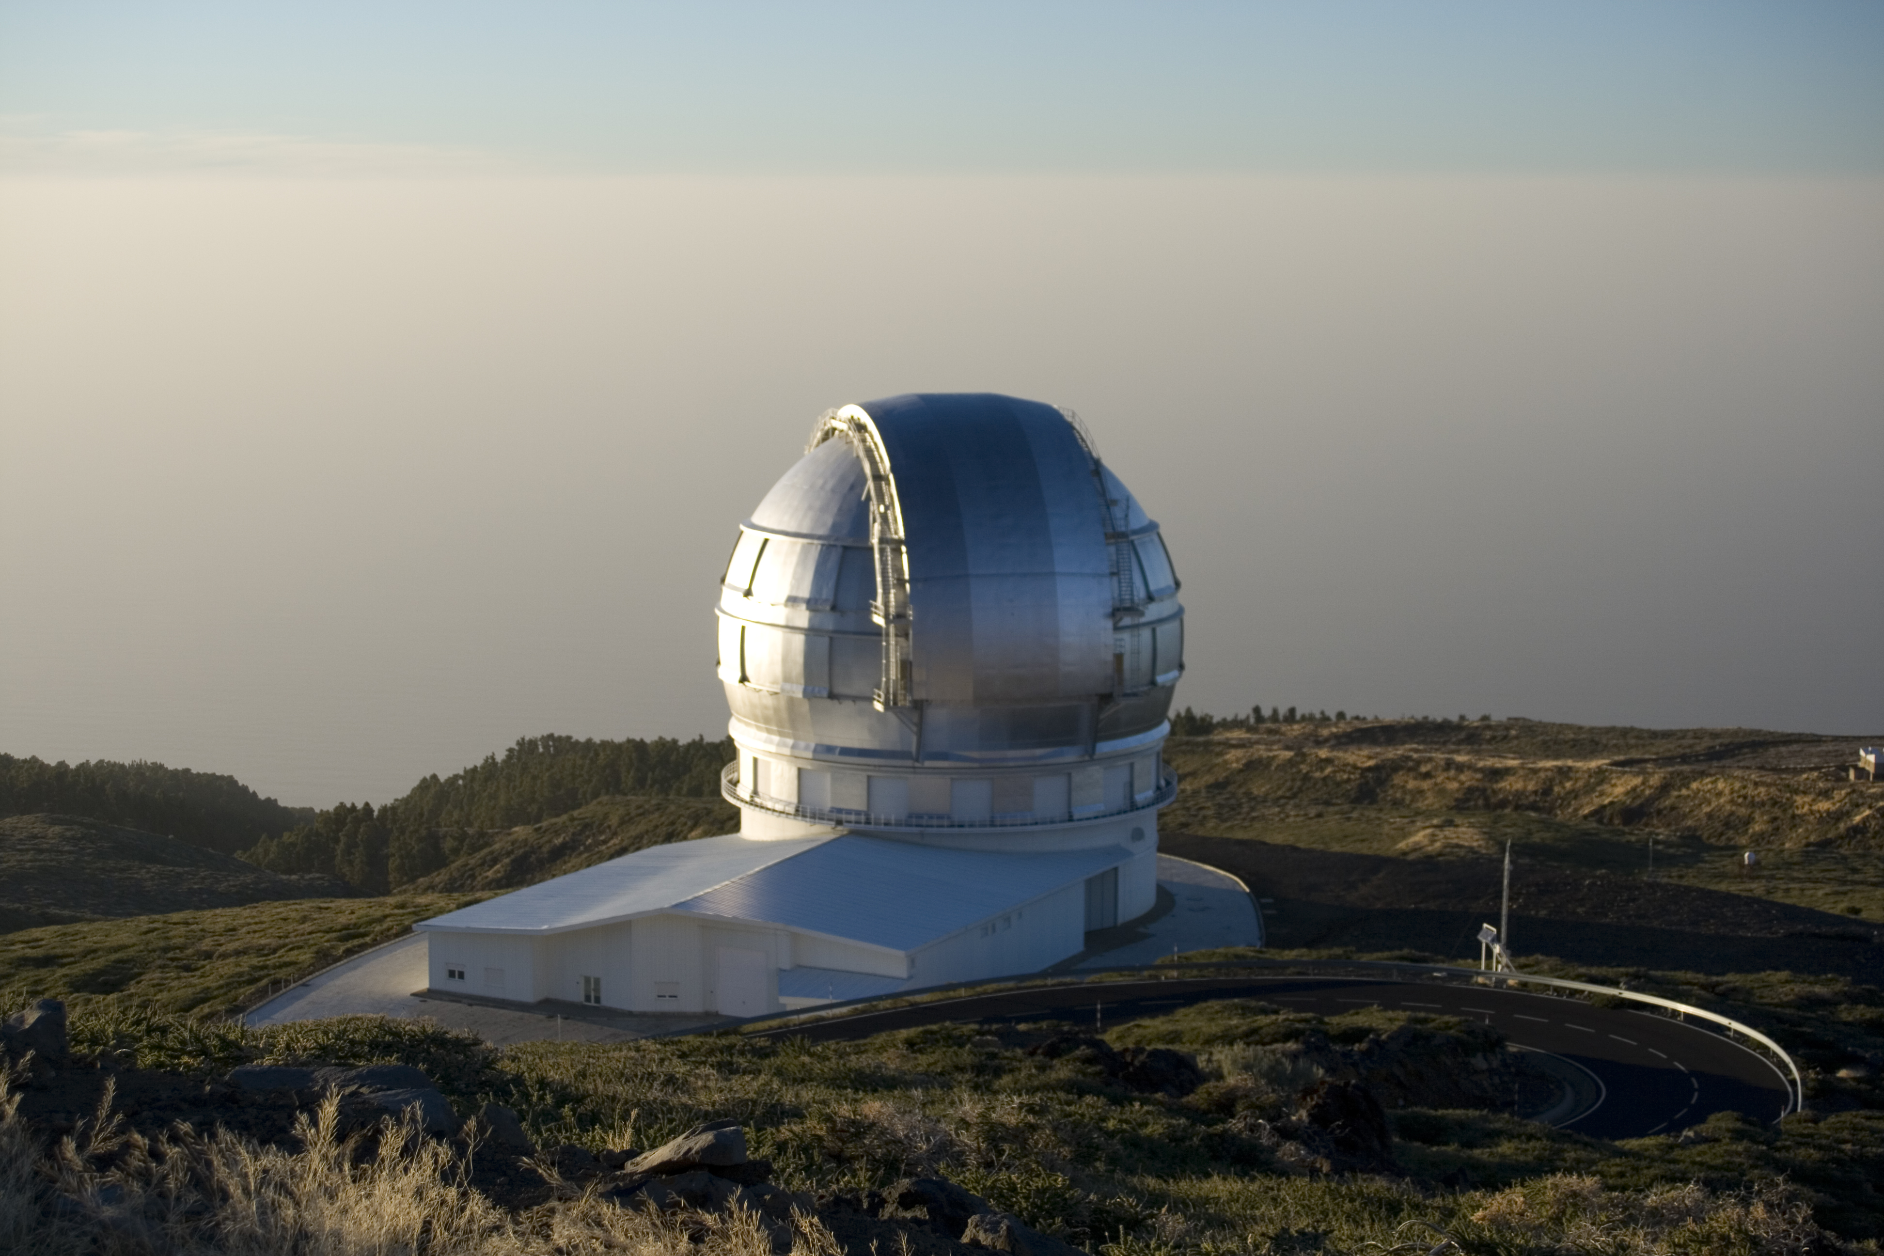
My current project is HiPERCAM, funded by a 3.5Meuro ERC Advanced Grant
Five-channel (u’g’r’I’z’), high-speed (>1 kHz) optical imager which we hope to mount on the 10.4m GTC in 2017
Parts of the mechanical structure of the instrument will be made using AM at Sheffield

Slide 4
Why am I interested in AM?
Multi-band imagers need to exhibit low levels (≈10μm) of flexure and temperature-induced size variations
Visitor instruments also need to be lightweight to make shipping and handling as easy as possible
AM offers the promise of meeting all requirements (stiffness, low mass, temperature invariance)
AM also offers potential for easier/faster/cheaper (?) manufacture of repeat units, e.g. hemispheres, cones, struts, or combining multiple parts into a single unit
Being located in Sheffield offers an ideal opportunity to exploit the local expertise in AM
The proposed OPTICON bid would allow us to explore the use of AM in our current and future instrumentation projects, e.g. by allowing us to design and make prototype parts

